Slide 1
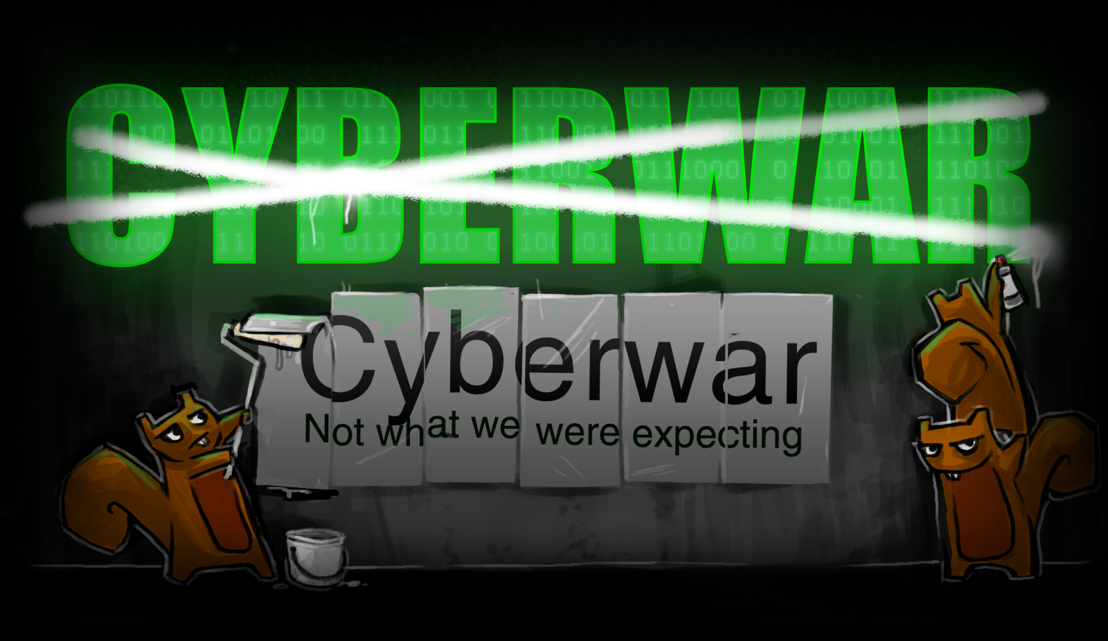
Josh Corman & Jericho
BruCON 2012
Notes:
Cyberwar: Not what we were expecting.
Would we know Cyberwar if we saw it?

Slide 2

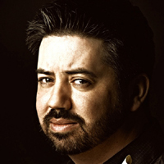
  Joshua Corman
  Jericho
  Director of Security Intelligence for Akamai Technologies
Was Research Director, Enterprise Security [The 451 Group]
Was Principal Security Strategist [IBM ISS]
  Random Facts
Faculty: The Institute for Applied Network Security (IANS)
CyberWarTargetDummy
Co-Founder of “Rugged Software” www.ruggedsoftware.org
  Things he’s been researching
DevOps
Security Intelligence
Chaotic Actors
Espionage
Security Metrics
  Chief Curmudgeon for attrition.org
  President/COO of Open Security
  Foundation (OSF)
  Director of Non-profit Activity at Risk
  Based Security
Random Facts
Waiting for Industry Cyber-Pompei
Cyberwar Cannon Fodder
Original owner of lemming.com
  Things I’ve been researching
The Myth of Compliance & Certification
Disruptive Rants and Twitter Replies
InfoSec Industry Errata
Squirrels
Vulnerability Databases & Metrics
Notes:
Who are we? Just two guys that observe and think about random topics. Just like we aren’t Anonymous, we’re not experts either, and that may be a good thing!

Slide 3
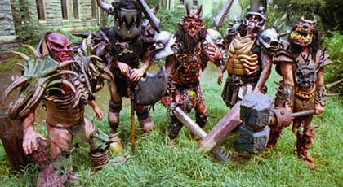
Cyber-GWAR?

Slide 4
Cyberwar
Thought
Terminating
Cliché
Notes:
The term “cyberwar” *is* a thought terminating cliché, because of all the hyperbole and misconceptions surrounding it. The only way to move forward and advance this thinking, is to start over to some degree.

Slide 5
1) Failed Analogies
2) What Most Agree On
3) Less Considered/Closer To Home

Slide 6
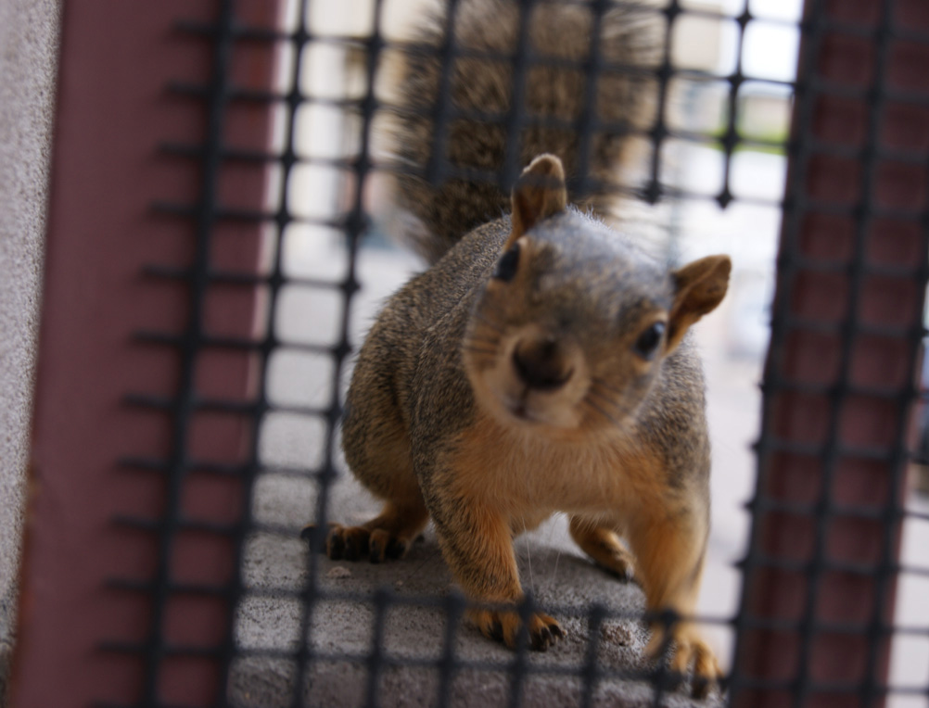
Clarifications?
Ask early, ask often.
Notes:
Most presentations should be an open dialogue, not a lecture.
Clarifications now, discussions afterwards.

Slide 7
1) Failed Analogies

Slide 8
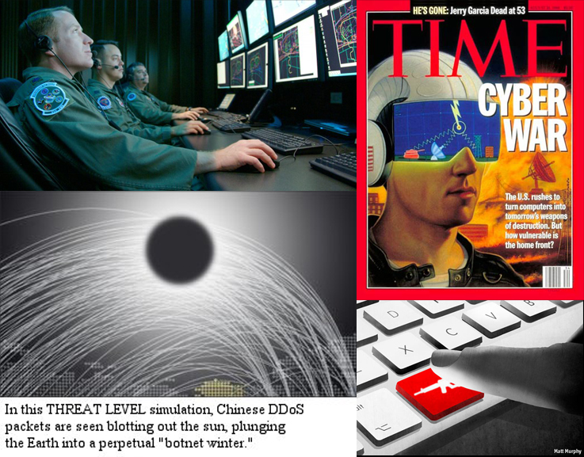
The Media
Notes:
Google Image search “cyberwar” and note the humorous images that populate the screen. In other cases, slick graphics try to make “cyberwar” look high-tech but in reality, it automatically creates a disconnect because it embodies a distanced feel, and breaks away from classic images we associate with war.
Sources:
http://www.time.com/time/covers/0,16641,19950821,00.html Aug 21, 1995 Cover
http://www.wired.com/threatlevel/2010/04/booz-allen/
http://securityaffairs.co/wordpress/6776/security/the-cyber-war-era-began-long-ago.html
http://www.wired.com/threatlevel/2007/08/cyber-war-and-e/

Slide 9
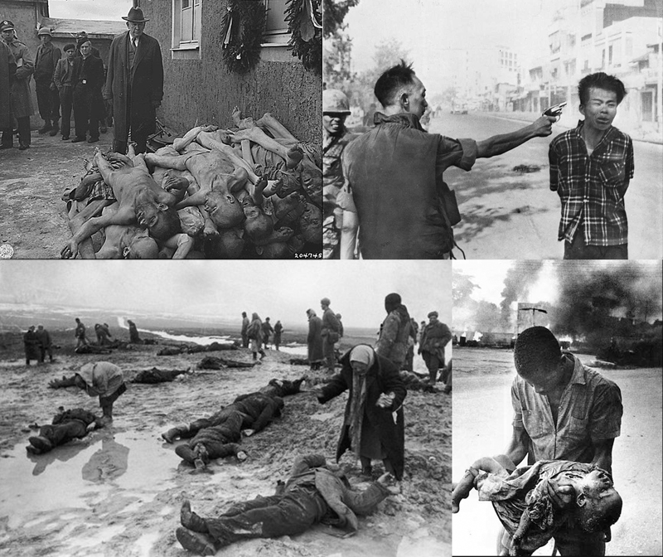
The Media Disconnect
Notes:
The term “cyberwar” invokes the word “war” in a misleading manner. When we think of war, we don’t think of packets flying across a network; we think of the atrocities, killing, and mass destruction.
Sources:
http://www.chilloutpoint.com/featured/unseen-world-war-ii-photos.html
http://thepoliticalfish.com/2012/01/is-the-golden-rule-for-war/
http://www.whale.to/b/buchenwald_p.html
http://freeimagesarchive.com/img4025.search.htm

Slide 10
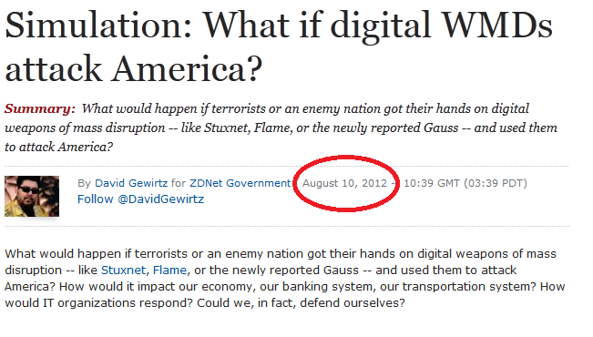
The Pundits
Notes:
http://en.wikipedia.org/wiki/Weapon_of_mass_destruction
A weapon of mass destruction (WMD) is a weapon that can kill and bring significant harm to a large number of humans (and other life forms) and/or cause great damage to man-made structures (e.g. buildings), natural structures (e.g. mountains), or the biosphere in general.

Slide 11
Buzzword Hype
Electronic/Cyber Pearl Harbor (1996, US)
  CIA Director John Deutch warned yesterday that hackers could launch "electronic Pearl Harbor" cyber attacks on vital U.S. information systems.
Cyber 9/11 (2003, AU)
  “A cyber ‘September 11’ has been predicted by Mike McConnell, a former director of the US National Security Agency.”
Cyber-apocalypse (2003, UK)
  “Both need to be addressed before Nimda and Slammer are followed by the third and fourth horsemen of our cyber apocalypse.”
Notes:
References. Note: Examples based on cyberwar/attack, *not* Y2K which introduced some of these terms, or cyber terrorism (since terrorism typically takes place outside of war).
Electronic Pearl Harbor
http://articles.nydailynews.com/1996-06-26/news/18004926_1_deutch-pearl-harbor-hackers
Cia Chief Plans Cyber Defense
Richard Sisk, Daily News Washington Bureau
Wednesday, June 26, 1996
"CIA Director John Deutch warned yesterday that hackers could launch "electronic Pearl Harbor" cyber attacks on vital U.S. information systems."
[Google news search “cyber pearl harbor”, term was shifted to that at some point. Heavily used throughout the years since 1996. - jericho]
Cyber 9/11:
http://www.smh.com.au/articles/2003/04/21/1050777200225.html
April 22, 2003: 'Cyber 9/11' risk warning
By Sue Cant
http://www.cio.com/article/715374/Does_a_Cyber_9_11_Loom_?taxonomyId=3089
Does a Cyber-9/11 Loom?
http://www.v3.co.uk/v3-uk/news/2173206/hp-chief-meg-whitman-warns-threat-scale-cyber-terrorist-attack
“Whitman said that she believes a "cyber-attack of 9/11 scale" is likely to take place in the near future, while she was speaking at an HP customer event in London.”
http://abcnews.go.com/blogs/politics/2012/08/despite-threat-of-cyber-911-lawmakers-punt-cyber-security-bill/
Aug 2, 2012 3:35pm
Despite Threat of ‘Cyber 9/11', Lawmakers Punt Cyber Security Bill
Cyber-apocolypse:
http://news.bbc.co.uk/2/hi/technology/2710031.stm
31 January, 2003
Both need to be addressed before Nimda and Slammer are followed by the third and fourth horsemen of our cyber apocalypse.
http://www.theregister.co.uk/2004/09/15/brazil_cybercrime_shocker/
15th September 2004 14:26 GMT
This looks more like talking up a problem in the hopes of getting more government funding, than an SOS from a country on the brink of cyber-apocalypse.

Slide 12
Buzzword Hype
Electronic Hiroshima (2003, US) / Cybershima (2012, US)
  "...the real impact of a concerted electronic attack on our infrastructure can just as easily resemble an electronic Hiroshima, all for the cost of an $899 laptop PC.“ (2003)
  “Stuxnet is the Hiroshima of cyber-war.” (2011, David Gewirtz and then Michael Joseph Gross in Vanity Fair)
Cybergeddon (2004, US/UK ?)
  “Debunking cybergeddonists during MyDoom viral pandemic”
Cyber atomic bomb (2012, US)
  “Toney Jennings, CEO of CoreTrace, adds that companies might have the equivalent of a “cyber atomic bomb” in the server that “is not doing anything bad today.” That bomb could be set off by an intruder at a later date, well after the initial breach took place.”
Notes:
References. Note: Examples based on cyberwar/attack, *not* Y2K which introduced some of these terms, or cyber terrorism (since terrorism typically takes place outside of war).
Hiroshima:
http://pqasb.pqarchiver.com/orlandosentinel/access/319393931.html?dids=319393931:319393931&FMT=ABS&FMTS=ABS:FT&type=current&date=Mar+29%2C+2003&author=Sohail+Mamdani&pub=Orlando+Sentinel&desc=DIGITAL+PEARL+HARBOR%3F&pqatl=google
DIGITAL PEARL HARBOR?
Mar 29, 2003: Orlando Sentinel - Orlando, Fla.
Sohail Mamdani
"...the real impact of a concerted electronic attack on our infrastructure can just as easily resemble an electronic Hiroshima, all for the cost of an $899 laptop PC."
http://nl.newsbank.com/nl-search/we/Archives?p_product=NewsLibrary&p_multi=BBAB&d_place=BBAB&p_theme=newslibrary2&p_action=search&p_maxdocs=200&p_topdoc=1&p_text_direct-0=135C35F95DAC5428&p_field_direct-0=document_id&p_perpage=10&p_sort=YMD_date:D&s_trackval=GooglePM
BBC Archive - Mar 4, 2011
"It is the US electronic Hiroshima in the Middle East. And it is the first time it is being done on such a large scale and so effectively."
http://www.zdnet.com/blog/government/special-report-stuxnet-may-be-the-hiroshima-of-our-time/9888
Jan 2011: Special Report: Stuxnet may be the Hiroshima of our time
http://www.vanityfair.com/culture/features/2011/04/stuxnet-201104
Apr 2011: A Declaration of Cyber-War
Stuxnet is the Hiroshima of cyber-war.
http://www.csmonitor.com/USA/2012/0106/Stuxnet-cyberweapon-looks-to-be-one-on-a-production-line-researchers-say
Stuxnet cyberweapon looks to be one on a production line, researchers say
By Mark Clayton, Staff writer / January 6, 2012
"Stuxnet, the first military-grade cyberweapon known to the world, has been called a digital missile and a cyber-Hiroshima bomb."
Cybershima:
http://blogs.gartner.com/dan-blum/2012/02/20/proposing-an-international-cyber-weapons-control-protocol/
Cybergeddon:
http://www.theregister.co.uk/2004/02/20/q_whats_the_av_industrys/
Q: What's the AV industry's definition of happy?
A: Debunking cybergeddonists during MyDoom viral pandemic
20th February 2004 15:20 GMT
Cyber atomic bomb (legitimate):
http://www.scmagazine.com/cyber-warfare-the-next-cold-war/article/232568/2/
April 02, 2012
Toney Jennings, CEO of CoreTrace, adds that companies might have the equivalent of a “cyber atomic bomb” in the server that “is not doing anything bad today.” That bomb could be set off by an intruder at a later date, well after the initial breach took place.
This term was used to make fun of people long before:
http://forums.newdoom.com/archive/index.php/t-12727.html
March 26th, 2001
http://www.wilderssecurity.com/archive/index.php/t-160316.html
January 4th, 2007
Bonus: Not war, but disaster related terms.
Cyber-chernobyl:
http://www.scmagazine.com.au/Feature/261987,do-we-need-a-cyber-chernobyl.aspx
Do we need a cyber-Chernobyl?
By Lisa Myers on Jun 28, 2011 4:23 PM
Cyber Katrina:
http://www.pcmag.com/article2/0,2817,1920908,00.asp
U.S. Government to Put 'Cyber Katrina' to the Test
By Paul F. Roberts
February 7, 2006
U.S. Government agencies are conducting electronic war games this week to test the government's ability to respond to the digital equivalent of Hurricane Katrina.
http://www.crowell.com/documents/Cyber-Tsunami-Digital-Pearl-Harbors-Cyber-Riptides-Swirling-Cybersecurity-Standards_OOPS2010.pdf
2010-05-26: Cyber Tsunami 2.0: Digital Pearl Harbors, Cyber Riptides, & Swirling Cybersecurity Standards

Slide 13
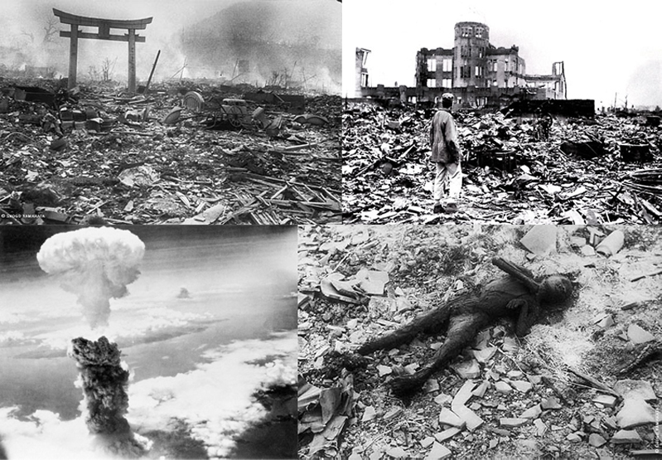
This is Hiroshima in Context
Notes:
Sources:
http://www.english.illinois.edu/maps/poets/g_l/levine/bombing.htm
http://www.britannica.com/EBchecked/media/87911/Aftermath-of-the-atomic-bomb-strike-on-Hiroshima-Japan-August
http://izismile.com/2011/04/16/frightening_hiroshima_and_nagasaki_atomic_bomb_pictures_49_pics.html

Slide 14

Pundits/Experts – Lot of History
Jan 1992: In today's world of billistic (sic) missiles, biological and chemical warfare, terrorism, and cyberwar, this strategy, based on an illusion of power where effectively there can be none, is unspeakably dangerous.
Jun 1994: This new concept is often termed "cyberwar" where robots and unmanned platforms such as cruise missiles do more of the killing, making pilots and other human control roles on platforms of war obsolete.
Notes:
Jan 1992: http://dwightmurphey-collectedwritings.info/BR18-Mosher.htm
June 1994: http://www.dtic.mil/cgi-bin/GetTRDoc?AD=ADA361082
DESIGNING, TESTING, AND USING COMMAND, CONTROL, COMMUNICATIONS, COMPUTERS, AND INTELLIGENCE (C4I) SYSTEMS: WHAT CAUSES THE DISCONNECTS AND WHAT CAN BE DONE ABOUT THEM?
by JAMES E. ARMSTRONG JR.
Lieutenant Colonel, United States Army

Slide 15
Pundits/Experts – Lot of History
Dec 1994: “Cyberwar, God And Television: Interview with Paul Virilio” - If you look at the Gulf War or new military technologies, they are moving towards cyberwars.
Sep 1995: “Information War - Cyberwar – Netwar” - Despite the lack of authoritative definition, “netwar” and “cyberwar” are emerging as key concepts in discussing Information War.
Notes:
Dec 1994: Dec 1http://www.ctheory.net/articles.aspx?id=62
Cyberwar, God And Television: Interview with Paul Virilio
Sep 1995: http://www.airpower.au.af.mil/airchronicles/battle/chp6.html

Slide 16

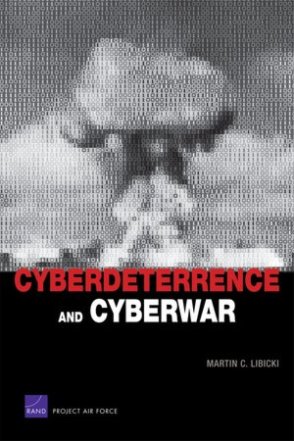
Experts - Lot of History (RAND)
Cyberwar is Coming! [1993]
  By John Arquilla, David Ronfeldt
Cyberdeterrence and Cyberwar [2009]
  By Martin C. Libicki
“In the nearly 20 years since David Ronfeldt and I introduced our concept of cyberwar, this new mode of conflict has become a reality. Cyberwar is here, and it is here to stay, despite what Thomas Rid and other skeptics think.” – John Arquilla
Notes:
In short, it appears we can blame RAND for the term “cyberwar” and the resulting hype? The 2009 paper certainly offers some level-headed perspective, but still gets many things wrong. The book version of the paper uses a nuclear mushroom cloud on the cover, perpetuating the hype.
http://www.rand.org/pubs/reprints/RP223.html
Cyberwar is Coming!
By John Arquilla, David Ronfeldt
“We offer a distinction between what we call “netwar”—societal-level ideational conflicts waged in part through internetted modes of communication—and “cyberwar” at the military level. These terms are admittedly novel, and better ones may yet be devised.”
“While both netwar and cyberwar revolve around information and communications matters, at a deeper level they are forms of war about “knowledge”—about who knows what, when, where, and why, and about how secure a society or a military is regarding its knowledge of itself and its adversaries.”
http://www.rand.org/pubs/monographs/MG877.html
Cyberdeterrence and Cyberwar
By Martin C. Libicki
Quote from:
Cyberwar Is Already Upon Us
http://www.foreignpolicy.com/articles/2012/02/27/cyberwar_is_already_upon_us

Slide 17
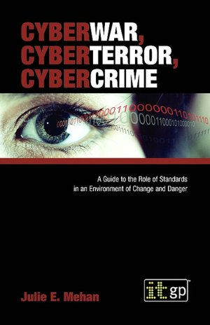
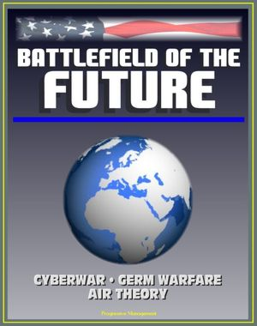
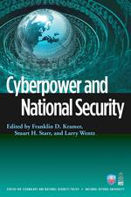
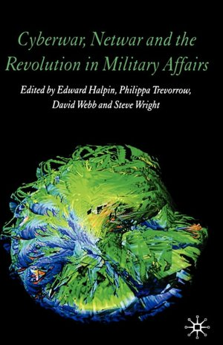
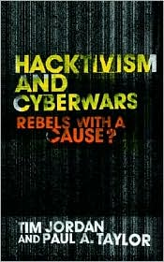
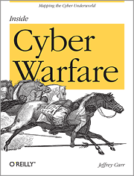
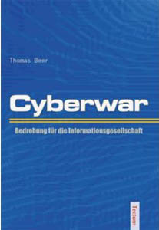
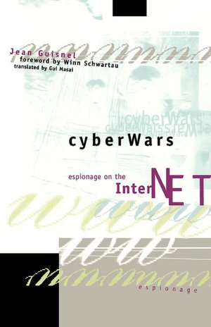
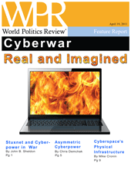
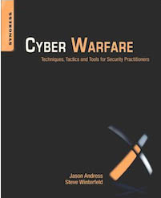
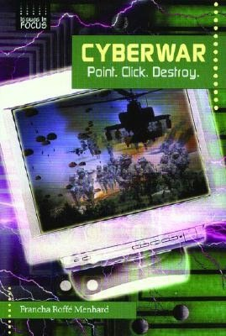
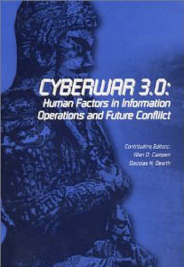
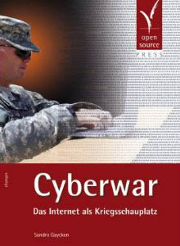
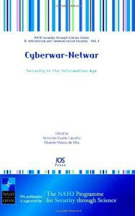
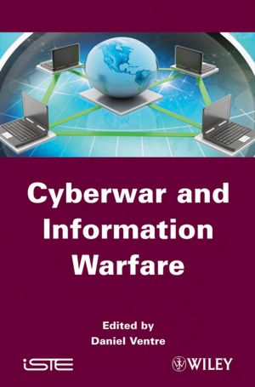
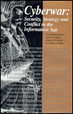
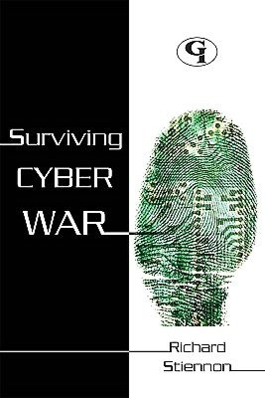
Lot of Experts?
Notes:
An incomplete list of “Cyberwar” books:
Cyberwars: Espionage on the Internet
by Jean Guisnel, Winn Schwartau (Foreword by), Gui Masai (Translator)
Surviving Cyber War
by Richard Stiennon
Cyberdeterrence and Cyberwar
by Martin C. Libicki
Cyberwar and Information Warfare
by Daniel Ventre
Hacktivism and Cyberwars
by Tim Jordan, Paul A. Taylor
Cyberwar, Cyberterror, Cybercrime
by Julie E Mehan
Cyberwar: Point. Click. Destroy
by Francha Roffe Menhard
Cyberwar, Netwar And The Revolution In Military Affairs
by Edward F. Halpin, Philippa Trevorrow (Editor), David Webb (Editor), Steve Wright (Editor)
Cyberwar-Netwar - Security in the Information Age
by Fernando Duarte Carvalho (Editor), Eduardo Mateus da Silva, Eduardo Mateus da Silva (Editor), Eduardo Mateus da Silva (Editor)
Cyberwar: Security, Strategy, and Conflict in the Information Age
by Alan D. Campen (Editor), Douglas H. Dearth, Douglas H. Dearth (Editor), R. Thomas Gooden (Editor), Douglas H. Dearth (Editor)
Battlefield of the Future: 21st Century Warfare Issues - Air Theory for the 21st Century, Cyberwar, Biological Weapons and Germ Warfare, New-Era Warfare
by Progressive Management
Cyberwar 3.0: Human Factors in Information Operations and Future Conflict
by Alan D. Campen, Douglas H. Dearth (Editor)
Cyberpower and National Security
Edited by Franklin D. Kramer, Stuart H. Starr and Larry Wentz
Cyber Warfare: Techniques, Tactics and Tools for Security Practitioners
by Jason Andress and Steve Winterfeld
Inside Cyber Warfare: Mapping the Cyber Underworld
by Jeffrey Carr (Dec 22, 2009)
Cyberwar, Real and Imagined (World Politics Review Features)
by World Politics Review, Mike Cronin, Chris C. Demchak and John B. Sheldon (Apr 19, 2011)
Cyberwar
by Thomas Beer (2005)
Cyberwar
by Sandro Gaycken

Slide 18
Lot of Experts
For so little actual “Cyberwar” (as media/buzzword defined), sure are a lot of experts out there. 14 “Cyber Warfare Officers” on LinkedIn! (Oddly, no Cyber Warfare Grunts…)
Problem is many aren’t speculating, they are speaking definitively.
Some publications based on reality, some based on hypotheticals. Not always clear which is which.
Notes:
A lot of this is based on incomplete or missing definitions of Cyberwar. It is amazing how many people will present or write on the topic, without even clearly defining it.
Cyber Warfare Officers:
http://www.linkedin.com/pub/stan-nolen-cissp-pmp/5/4a6/a07
http://www.linkedin.com/pub/michael-connor/38/b17/74b
http://www.linkedin.com/pub/patrick-king/41/24b/901
http://www.linkedin.com/pub/kenny-carmichael/55/161/3b5
http://www.linkedin.com/pub/colin-david-leslie-winwood/24/825/389
http://www.linkedin.com/in/roberthutson
http://www.linkedin.com/pub/paul-graham/38/179/324
http://www.linkedin.com/pub/alex-riseborough/21/743/62a
http://www.linkedin.com/pub/frank-kostenko/7/bb/8ab
http://www.linkedin.com/pub/robert-littleton-mba-mpm-pmp/10/b1/aa6
http://www.linkedin.com/pub/walt-fee/3b/42/6a3
http://www.linkedin.com/pub/chris-murphy/7/463/687
http://www.linkedin.com/pub/ryan-young/6/8a8/b79
http://www.linkedin.com/pub/john-roehl/29/79a/499

Slide 19
“Experts” & Reality
“The following hints may be indicative. Private hackers are more likely to use techniques that have been circulating throughout the hacker community. While it is not impossible that they have managed to generate a novel exploit to take advantage of a hitherto unknown vulnerability, they are unlikely to have more than one.” -- Martin C. Libicki (RAND) 2009
Notes:
Reference:
From Rand's whitepaper on Cyberwarfare (pg. 73):
http://www.rand.org/pubs/monographs/2009/RAND_MG877.pdf
The following hints may be indicative. Private hackers are more likely to use techniques that have been circulating throughout the hacker community. While it is not impossible that they have managed to generate a novel exploit to take advantage of a hitherto unknown vulnerability, they are unlikely to have more than one.

Slide 20
Lot of Experts @ Conferences
"Perspectives on Cyber Security and Cyber Warfare" - Max Kelly
"Cyber[Crime|War] Charting Dangerous Waters" - Iftach Ian Amit
"The Chinese Cyber Army - An Archaeological Study from 2001 to 2010" - Wayne Huang & Jack Yu
"An Examination of the Adequacy of the Laws Related to Cyber Warfare" - Dondi West
"Meet the Feds Panel - Policy, Privacy, Deterrence and Cyber War"
"Live Fire Exercise: Baltic Cyber Shield 2010" - Kenneth Geers
Notes:
Oh. These are just the Cyberwar talks from DEFCON 18.
Cyberwar: using the techniques and tactics of APT’s in Penetration Tests by Joe McCray
http://2012.brucon.org/index.php/Training_Cyberwar

Slide 21
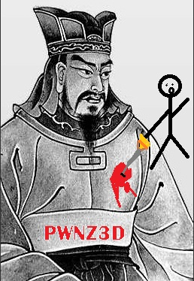
Lot of n00bz (Tzupidity)
Sun Tzu prolific in presentations, especially about “cyberwar”
Mostly ridiculous, and typically a sign the presenter has not given much thought to the topic
Genghis Khan, Mark Twain, Mike Tyson, Adolf Hitler, and old squirrel proverbs can be shoe-horned into current InfoSec just as well as Tzu
Notes:
This is not to say that Tzu cannot be applied meaningfully to Cyberwar, just that almost everyone trying does so in a half-assed shallow manner.
http://attrition.org/security/rants/fsck_sun_tzu/
InfoSec, Sun Tzu and the Art of Whore
Fri Jul 2 14:42:30 CDT 2010
swtornio & jericho
Graphic by Lyger

Slide 22



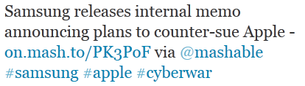



Lot of Laypersons
Notes:
Watch #cyberwar on Twitter. So broad in the use of the word, it has become worse than the bastardization of the word “hacker”.
References:
http://twitter.com/Daily_Donkey/statuses/239947962657148929
http://twitter.com/tricotron/statuses/240490508844146690
http://twitter.com/hintz2010/statuses/240675035797389312
http://twitter.com/AnthonySayegh/statuses/241485649457328128
http://twitter.com/Soridic/statuses/241520072655507456
http://twitter.com/iWebMD/statuses/243605903864107008

Slide 23

The Pentagon
2009 - Defining and Deterring Cyber War
  Defines “cyberspace”
  Makes logical points re: definition of “cyber war”
  Never officially defines “cyber war”
2011 - Cyber Combat: Act of War
  Pentagon Sets Stage for U.S. to Respond to Computer Sabotage With Military Force
Notes:
So the U.S. military will define cyberspace, hint at what cyberwar means, but not actually define it. Then two years later, say that if cyberwar is waged on us, we will respond in a kinetic fashion. *boggle*
References:
2009 - http://www.dtic.mil/cgi-bin/GetTRDoc?AD=ADA500795 -- Defining and Deterring Cyber War (06-01-2009) - Lieutenant Colonel Scott W. Beidleman, USAF
This definition in JP 1-02 provides a solid basis for defining cyber war.
From this definition and its implications, one could deduce that cyber war is simply warfare in the cyberspace domain, but this simplification is insufficient for two reasons.
Second, defining cyber war as warfare in cyberspace ignores the complexity of applying the more fundamental legal aspects of war to cyberspace.
International law does not define the term “act of war.” … international law is organized on the concepts of “use of force” and aggression.
A logical discriminator to gauge a cyber attack is to judge the action by the effect or consequence it produces, rather than its means of delivery. “Armed attack should not be defined by whether or not kinetic energy is employed or released, but rather by the nature of the direct results caused.” (Comes from 1999 paper by Michael Schmitt)
Following this logic, any cyber attack that causes the same level of damage as a traditional armed or kinetic attack, either through the destruction of physical property or loss of life, would be considered an armed attack.
International law is also unclear regarding acts of economic coercion.
2011 - http://online.wsj.com/article/SB10001424052702304563104576355623135782718.html
2012 - http://abcnews.go.com/blogs/politics/2012/05/leon-panetta-a-crippling-cyber-attack-would-be-act-of-war/ Leon Panetta, Defense Secretary
Interestingly, the US Air Force updated their mission statement to reflect ‘cyberspace’ on Dec 5, 2005:
Dec 10, 2005 http://web.archive.org/web/20051210064315/http://www.af.mil/main/welcome.asp
The mission of the U.S. Air Force is to defend the United States and protect its interests through air and space power.
Dec 13, 2005 http://web.archive.org/web/20051213102330/http://www.af.mil/main/welcome.asp
The mission of the United States Air Force is to deliver sovereign options for the defense of the United States of America and its global interests -- to fly and fight in Air, Space, and Cyberspace.
The above is interesting because an AF information warfare squadron was established in 1995 and inactivated in 1999:
http://en.wikipedia.org/wiki/609th_Information_Warfare_Squadron
The 609th Information Warfare Squadron was a squadron assigned to 9th Air Force under Air Combat Command with headquarters at Shaw Air Force Base in Sumter, South Carolina. It was the first operational information warfare combat unit in United States military history.
Established as 609th Information Warfare Squadron and activated on September 28, 1995.[2]
Inactivated on June 30, 1999
Yet, the AF also had an “Electronic warfare center” established in 1975:
http://www.fas.org/irp/agency/aia/cyberspokesman/97aug/afiwc.htm
The Air Force Information Warfare Center, collocated with Air Intelligence Agency, was created to be an information superiority cen-ter of excellence, dedicated to offensive and defensive counter information and information operations. AFIWC was originally activated as the 6901st Special Communication Center in July 1953. The following month the 6901st was redesignated as the Air Force Special Communications Center. It was then redesignated as the Air Force Electronic Warfare Center in 1975.
http://www.au.af.mil/au/ssq/2012/fall/healey.pdf
In 1995 the secretary and chief of staff jointly signed the Foundations of Information Warfare which laid out basic definitions and principals for how the Air Force would work in cyberspace.
Cyber Command struggles to define its place on a shifting battlefield
http://www.nextgov.com/cybersecurity/2012/08/hacker-wars/57438/

Slide 24
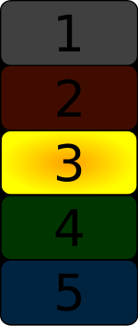
The Pentagon Disconnect
“A cyber attack is a cyber operation, whether offensive or defensive, that is reasonably expected to cause injury or death to persons or damage or destruction to objects.” Tallinn Manual for NATO
Pentagon: Cyber Attacks Considered Act of War
  1996: Hackers made about 250,000 attempts to get into military computers last year. About 65 percent were successful, the GAO report said.
  2010: DOD systems are probed by unauthorized users … over 6 million times a day
  2011: Pentagon reveals 24,000 files stolen in cyber-attack
Yet, no computer attack led to DEFCON change!
Notes:
U.S.: Laws of war apply to cyber attacks
http://www.armytimes.com/news/2012/09/dn-laws-of-war-apply-cyber-attacks-091812/
References:
1996: http://docs.newsbank.com/g/GooglePM/CO/lib00112,0EB6D38A7232661B.html
2010: http://www.forbes.com/sites/firewall/2010/06/04/just-how-big-is-the-cyber-threat-to-dod/
2011: http://www.washingtonpost.com/blogs/checkpoint-washington/post/24000-pentagon-files-stolen-in-major-cyber-breach-official-says/2011/07/14/gIQAsaaVEI_blog.html
http://en.wikipedia.org/wiki/DEFCON#History

Slide 25

Lot of Reasons (Fear & Greed)
“Cyber Briefings 'Scare The Bejeezus' Out Of CEOs”
“Cyberwar Cassandras Get $400 Million in Conflict Cash”
“Pentagon interest in cybersecurity may ease contractors’ pain from cuts”
“DHS: $40m To Research Next Big Thing in Cyber Security”
“Cybersecurity grant to fund research into critical infrastructure threats”
“Overall the Air Force spends about $4 billion a year on its cyber programs …”
Notes:
References:
http://www.npr.org/2012/05/09/152296621/cyber-briefings-scare-the-bejeezus-out-of-ceos
http://www.wired.com/dangerroom/2010/05/cyberwar-cassandras-get-400-million-in-conflict-cash/
http://www.washingtonpost.com/business/economy/pentagon-interest-in-cybersecurity-may-ease-contractors-pain-from-cuts/2012/01/12/gIQAFbPe1P_story.html
http://threatpost.com/en_us/blogs/dhs-40m-research-next-big-thing-cyber-security-012811
http://searchsecurity.techtarget.com/news/1375721/Cybersecurity-grant-to-fund-research-into-critical-infrastructure-threats
http://online.wsj.com/article/SB10001424052702303684004577508850690121634.html
Bonus References:
Hill hosting a cyberscare demonstration today
http://thehill.com/blogs/hillicon-valley/technology/232397-overnight-tech-senators-to-attend-cybersecurity-demonstration

Slide 26
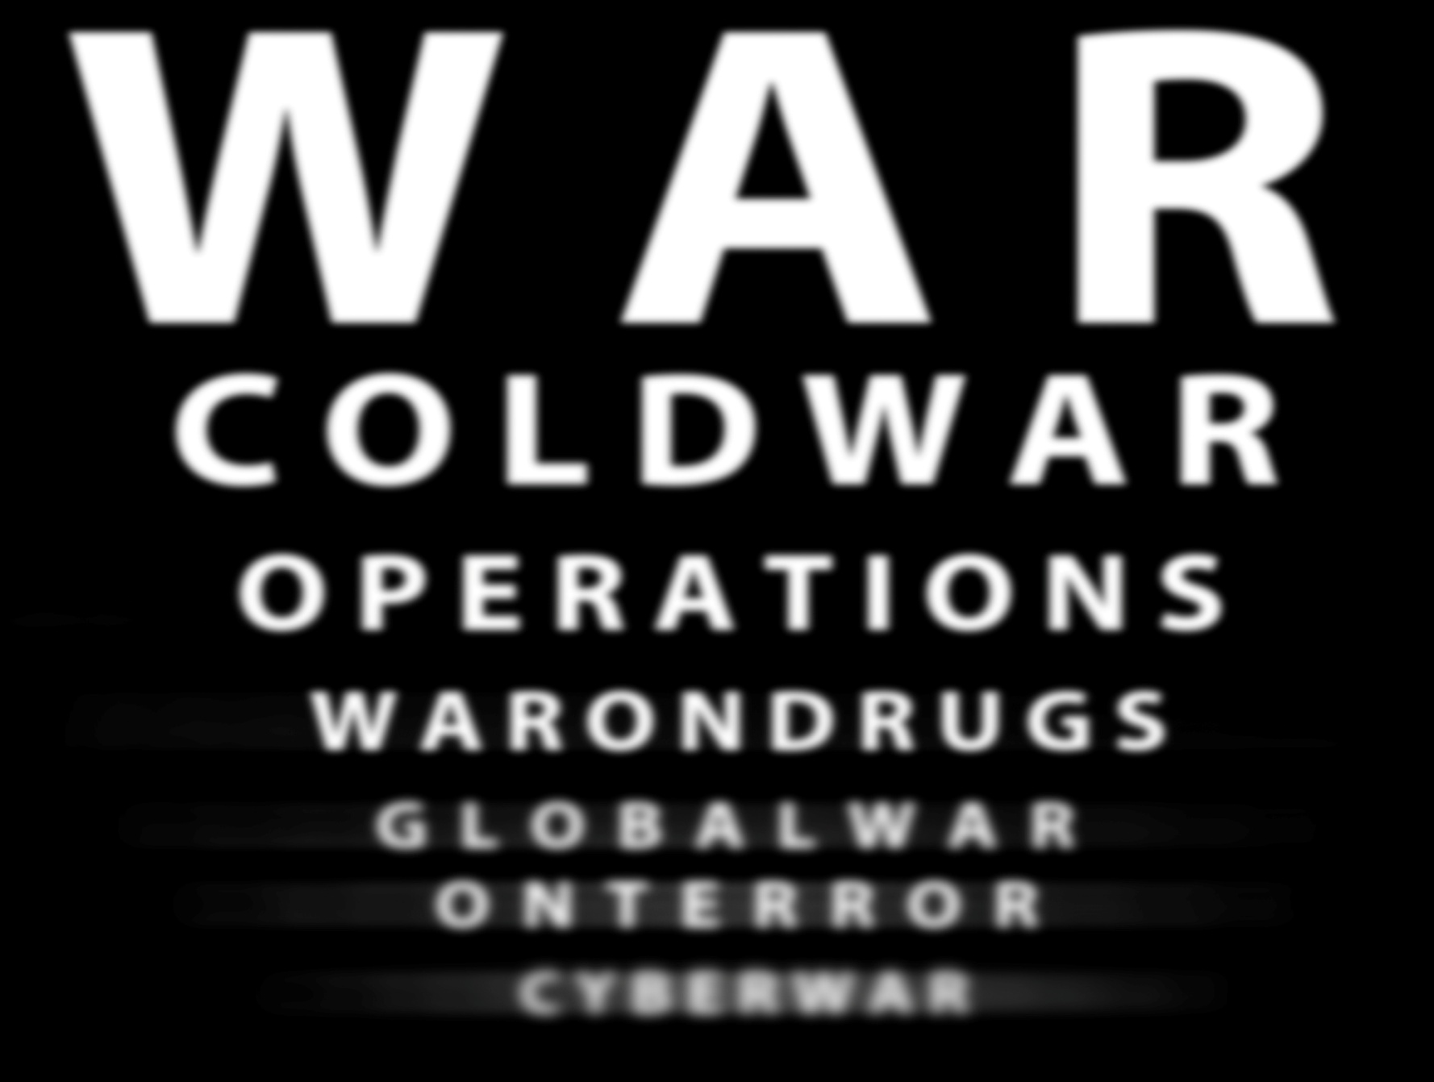
Blurring the Definition…
Notes:
War (Conventional) -> Cold War -> Operations (e.g. “Enduring Freedom”, Media called it an “occupation”) -> War on Drugs -> Global War on Terror -> Cyberwar
Cyberwar is a hoax! –vs- Cyberwar is real!
As we’ve demonstrated, the problem is so many don’t adequately define it, define it completely wrong, or show signs of a good definition but fall short.
Easy to argue hoax –vs- real when you control the definition.
How did so many lose sight of the “cold war” and other historical lessons, and not apply it to Cyberwar?
The Cyberwar Hoax
http://www.huffingtonpost.com/franzstefan-gady/the-cyberwar-hoax_b_1549927.html
I propose a system of categorizing cyber attacks based on two simple criteria: impact and intent.
^ A system with 2 points, 12 years after a similar more robust system proposed. *sigh* v
COMPUTER NETWORK ATTACK AND THE USE OF FORCE IN INTERNATIONAL LAW: THOUGHTS ON A NORMATIVE FRAMEWORK
http://www.dtic.mil/cgi-bin/GetTRDoc?AD=ADA471993
There is no cyber war the same way there is no nuclear war
http://www.forbes.com/sites/richardstiennon/2011/11/03/there-is-no-cyber-war-the-same-way-there-is-no-nuclear-war/

Slide 27

Oh Shit, China!
Notes:
This will help ensure @TaoSecurity catches this talk.

Slide 28
Cyberwar and Infrastructure Hype
A cyber attack can corrupt the operating system of a power plant and cause a nuclear meltdown, for example, or shut down civil aviation systems thus causing civilian aircraft to crash.
Well, there’s no question that if a cyber attack, you know, crippled our power grid in this country, took down our financial systems, took down our government systems, that that would constitute an act of war.
The electron is the ultimate precision-guided weapon," Deutch said. "I don't know whether we will face an electronic Pearl Harbor, but I'm certainly prepared to predict some very, very large and uncomfortable incidents in this area.“
Cyberspace is now the digital frontier of choice for executing many combat operations, by extending the medium in which greater levels of power can now be accessed by Machiavellian agents, militants and nation-states.
Notes:
References:
http://blog.oup.com/2012/08/cyber-war-and-international-law/
Cyber War and International Law
A cyber attack can corrupt the operating system of a power plant and cause a nuclear meltdown, for example, or shut down civil aviation systems thus causing civilian aircraft to crash.
http://abcnews.go.com/blogs/politics/2012/05/leon-panetta-a-crippling-cyber-attack-would-be-act-of-war/
Well, there’s no question that if a cyber attack, you know, crippled our power grid in this country, took down our financial systems, took down our government systems, that that would constitute an act of war.
http://articles.nydailynews.com/1996-06-26/news/18004926_1_deutch-pearl-harbor-hackers
The electron is the ultimate precision-guided weapon," Deutch said. "I don't know whether we will face an electronic Pearl Harbor, but I'm certainly prepared to predict some very, very large and uncomfortable incidents in this area."
http://www.infosecisland.com/documentview/22200-Digital-Apocalypse-The-Artillery-of-Cyber-War.html
Cyberspace is now the digital frontier of choice for executing many combat operations, by extending the medium in which greater levels of power can now be accessed by Machiavellian agents, militants and nation-states.
Bonus References:
http://www.mcafee.com/us/resources/white-papers/wp-hacktivism.pdf
If hacktivists remain unfocused and continue to accept anyone who signs on to act on their behalf, we may be on the verge of a digital civil war.
http://blogs.csoonline.com/malwarecybercrime/2246/digital-civil-war-methinks-you-exaggerate
Digital civil war? Methinks you exaggerate
http://www.newscientist.com/blogs/onepercent/2012/06/banking-outage-gives-tiny-glim.html
Imagine, they said, that an attacker manages to disable the communications lines, or routers, linking a nation's banks, ATMs and the point-of-sale debit/credit card terminals in supermarkets and garages.

Slide 29
Cyberwar Hype - Infrastructure
Alleged “Cyberwar” Attack | The Reality | Verdict
2003 - W32.Blaster worm “may have contributed to the cascading effect of the Aug. 14 [power] blackout” | "It didn't affect the [control] systems internally” and "It certainly compounded the problems“. | Meh
2005 / 2007 – Brazil power outages, long claimed to be the result of “hacker attacks” | 2007 “outage was caused by deposits of dust and soot” from local fire. Furnas Centrais Elétricas found no evidence of hackers for any power outage. | False
2007 – DHS video shows diesel generator “hacked”, shaking, smoking, and going into “total meltdown” | Controlled experiment, extrapolated theory that 1 generator could cause entire grid failure. Since disputed. | False
2008 – CIA says confirmed non-US remote hacking attacks caused power outages in “multiple cities” | Subsequent investigation suggests all were done with insider access, not remote. CIA claims not validated at all. | False
2009 – Foreign spies “have penetrated the U.S. electrical grid”, left backdoors, says unnamed officials. | Detected by US Intel, not utilities. No third-party validation. Article a week before Obama cyber-security review. | Meh
2010 – Three U.S. oil companies compromised “in the growing global war of Internet espionage.” | Info stolen including valuable “bid data”. No attempt to shut down or hinder operations. | False
2011 – Illinois water pump destroyed by attacker originating in Russia | Employee vacationing in Russia was asked to check system after pump failed due to natural wear and tear. | False
2012 – Hackers attacked a Northwest rail company's computers that disrupted railway signals for two days. Possible 2nd attack too. | Railway not targeted. Incident happened, but railway likely collateral damage. Slowed train traffic only. | Meh
Notes:
References:
2003 / Blaster - http://www.computerworld.com/s/article/84510/Blaster_worm_linked_to_severity_of_blackout
2007 / Brazil - http://erratasec.blogspot.com/2009/11/brazil-outage-not-caused-by-hackers.html
http://www.wired.com/threatlevel/2009/11/brazil_blackout/
http://www.aneel.gov.br/cedoc/adsp2009278_1.pdf
2007 / Diesel Generator - http://www.datacenterknowledge.com/archives/2007/09/27/can-your-generator-be-hacked/
http://www.cnn.com/2007/US/09/27/power.at.risk/index.html
http://www.schneier.com/blog/archives/2007/10/staged_attack_c.html
2008 / CIA - http://www.informationweek.com/cia-admits-cyberattacks-blacked-out-citi/205901631
http://erratasec.blogspot.com/2009/11/brazil-outage-not-caused-by-hackers.html
2009 / Electric - http://online.wsj.com/article/SB123914805204099085.html
2010 / Oil - http://www.csmonitor.com/USA/2010/0125/US-oil-industry-hit-by-cyberattacks-Was-China-involved
2011 / Illinois - http://chicagoist.com/2011/11/19/water_warfare_downstate_cyber_attac.php
http://www.wired.com/threatlevel/2011/11/scada-hack-report-wrong/
http://www.wired.com/threatlevel/2011/11/water-pump-hack-mystery-solved/
2012 / Train – http://blog.engagepr.com/blog/2007/08/as-the-media-tu.html
http://www.zdnet.com/blog/ou/undercover-nbc-dateline-reporter-bolts-from-defcon-2007/653
http://www.nextgov.com/cybersecurity/2012/01/hackers-manipulated-railway-computers-tsa-memo-says/50498/
http://www.wired.com/threatlevel/2012/01/railroad-memo/

Slide 30
Cyberwar Reality - Infrastructure
Alleged “Cyberwar” Attack | The Reality | Verdict
1997 – Massachusetts, Airport Control Tower and “other facilities” disrupted including phone service | Targeted loop carrier system, hacker wiped out telephone access to the control tower, fire department, airport security, weather service, and private airfreight firms for six hours. | True
2001 – Australian man set to prison for 2 years for hacking Queensland plant, dumping millions of liters of sewage into local area. | At the time he was employed by the company that had installed the system. Boden's laptop contained software for accessing and controlling the sewage management system. | Meh
2006 – Infected laptop brought into water treatment plant gave attacker outside access. | No evidence it was targeted attack, attackers likely did not know extent of access. | Meh
2011 – FBI says attackers hit critical infrastructure / SCADA in 3 unnamed cities. | May include Illinois (False), Texas (below), leaving a single new incident. No further details made public. Third may be NorthWest Railway (see previous slide). | True
2011 – Texas water utility hacked, information stolen and posted to web as proof | No follow-up. No public confirmation. Level of access questionable. No damage done apparently. | True?
Notes:
One was a teenager and his local airport. These types of incidents, true or false, are prone to deliberate obfuscation (cover-up, denial, etc), and will more frequently become urban legend than case history.
References:
1997 / Airport - http://news.cnet.com/2100-1023-209260.html
2001 / Sewage - http://www.theregister.co.uk/2001/10/31/hacker_jailed_for_revenge_sewage/
2006 / Laptop - http://www.computerworld.com/s/article/9004659/Hackers_break_into_water_system_network
2011 / Three - http://www.eweek.com/c/a/Security/FBI-Admits-Attackers-Compromised-SCADA-Systems-in-Three-US-Cities-548815/
2011 / Texas - http://news.cnet.com/8301-27080_3-57327968-245/hacker-says-he-broke-into-texas-water-plant-others/
http://www.theregister.co.uk/2011/11/18/second_water_utility_hack/
http://www.fiercecio.com/techwatch/story/texas-water-plant-hacker-password-was-just-3-characters/2011-11-22
http://www.chron.com/news/houston-texas/article/Hacker-targets-South-Houston-sewer-system-2277795.php
http://threatpost.com/en_us/blogs/hacker-claims-he-breached-texas-water-plant-111911

Slide 31

Satellite Hacks! Cyberwar for sure!
Alleged “Satellite” Attack | The Reality | Verdict
1999 – British military satellite hacked and “held for ransom” several news outlets report. | Britain's Defense Ministry dismissed report as “not true”. No validation of original claims. | False
2002 – Falun Gong hackers hack Chinese TV satellite (AsiaSat), inject their own material seen by millions. | Chinese government blamed pirated broadcast for "TV hijacking“, demanded authorities track culprits. | True
2006 – Hezbollah TV satellite feed hacked, Al-Manar station plays 90 second propaganda clip. | Israeli military hacked feed as part of “propaganda war against the Iranian-backed terror militia”. | True
2007 – U.S. Landsat-7 experienced 12 or more minutes of interference due to attack. | “This interference was only discovered following a similar event in July 2008.” | True
2007 – Pakistan’s Aaj TV satellite signal subverted by President Pervez Musharraf's decree. | Result of imposition of martial law, satellite uplink system hacked by authorities. | True
2007 – Israeli satellite television suffers a “month of severe interference”. | Source unknown, but it’s “threatening the commercial viability of the country's major sat-broadcaster.” | True
2007 - Tamil Tigers in Sri Lanka hack Intelsat over the Indian Ocean to transmit propaganda. | Intelsat team “pursue technical alternatives to halt the transmissions.” | True
2008 – U.S. Terra EOS AM-1 experienced 2 or more minutes of interference due to attack. | “The responsible party achieved all steps required to command the satellite but did not issue commands.” | True
2008 – U.S. Landsat-7 experienced 12 or more minutes of interference due to attack (again). | “The responsible party did not achieve all steps required to command the satellite.” | True
2008 - U.S. Terra EOS AM-1 experienced 9 or more minutes of interference due to attack. | “The responsible party achieved all steps required to command the satellite but did not issue commands.” | True
Notes:
It is odd that “interference” is used heavily from our own government, without more details. That combined with “responsible party achieved all steps required to command the satellite but did not issue commands” is alarming. Why didn’t they? Landsay-7 happening twice should be alarming, as it suggests the attacker(s) could do it again.
References:
1999 / British military satellite - http://pqasb.pqarchiver.com/orlandosentinel/access/40380067.html?dids=40380067:40380067&FMT=CITE&FMTS=CITE:FT&type=current&date=Mar+01%2C+1999&author=&pub=Orlando+Sentinel&desc=HACKERS+SEIZE+BRITAIN'S+MILITARY+SATELLITE+REPORT&pqatl=google
http://greenspun.com/bboard/q-and-a-fetch-msg.tcl?msg_id=000YIG
http://slashdot.org/story/99/02/28/1037229/crackers-reportedly-take-brit-mil-satellite
http://www.shmoo.com/mail/cypherpunks/mar99/msg00049.html
http://web.archive.org/web/20011127170846/www.zdnet.com/zdnn/stories/news/0,4586,2217730,00.html
2002 / Falun Gong - http://www.semissourian.com/story/89061.html
http://nl.newsbank.com/nl-search/we/Archives?p_product=SLTB&p_theme=sltb&p_action=search&p_maxdocs=200&p_topdoc=1&p_text_direct-0=100DF1569688AB11&p_field_direct-0=document_id&p_perpage=10&p_sort=YMD_date:D&s_trackval=GooglePM
2006 / Hezbollah TV - http://www.nysun.com/foreign/israel-war-effort-extends-even-to-hezbollah-tv/37140/
2007 / Aaj TV - http://www.iol.co.za/news/world/pakistanis-confront-news-blackout-1.377489
2007 / Israeli - http://www.theregister.co.uk/2007/10/11/israeli_satellite_telly_banjaxed_by_germans_n_cloggies/
2007 / Intelsat - http://it.toolbox.com/blogs/managing-infosec/hack-a-satellite-while-it-is-in-orbit-15690
2007, 2008 / Landsat-7, Terra EOS - http://www.uscc.gov/annual_report/2011/annual_report_full_11.pdf
2011 REPORT TO CONGRESS of the U.S.-CHINA ECONOMIC AND SECURITY REVIEW COMMISSION ONE HUNDRED TWELFTH CONGRESS - FIRST SESSION - NOVEMBER 2011

Slide 32

Threat Comparison
If the Cyberwar threat is partially (largely?) based on “outages”, why are we ignoring a more vicious, legitimate, and historical threat?
Cyberwar has done what so far? Nothing?
Outages due to faulty equipment…
Outages due to digging…
Outages due to squirrels…
Wait, squirrels?!
Notes:
From scot: Stuxnet, Flame... Both have had effects both known(openly) and secret. We have not had an all out “cyberwar” as this would be more along the lines of what happened in Georgia when Russia invaded/attacked in concert with Ddos and other attacks on their infrastructure.
10 Most Bizarre Fiber Cuts
http://blog.level3.com/2011/08/04/the-10-most-bizarre-and-annoying-causes-of-fiber-cuts/

Slide 33
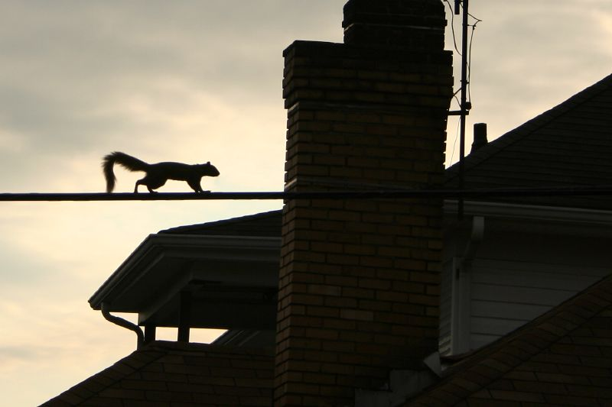

Jericho’s “Squirrel > Cyberwar Theory”
Picture by Chris LaFronte
Notes:
Excellent picture taken by Chris LaFronte (pafotofan on Flickr)
http://www.flickr.com/photos/pafotofan/1862016974/in/photostream
Guns, Squirrels, and Steel: The Many Ways To Kill a Data Center
http://www.wired.com/wiredenterprise/2012/07/guns-squirrels-and-steal/

Slide 34


Threat Comparison – A Game
Squirrel or Cyber-Weapon?
Caused an estimated US$2mil to Georgia Power in 2006, costs PECO US$1mil in preventative security measures to stop attacks yearly
Caused hundreds of gallons of raw sewage to be dumped into Mobile Bay, Alabama
Detonated a Hudson County, NJ woman’s car
Caused up to 30k Texas households to lose water. When restored, public health department issued a “boil water notice” to “ensure that harmful bacteria and other microbes are destroyed.”
Took out half of Yahoo’s Santa Clara data center around 2010
Notes:
References:
http://www.usatoday.com/news/nation/2007-03-11-suicide-squirrels_N.htm
Lincoln Electric System in Nebraska: What caused more outages? The lightning or the squirrels?
Four of the past five years, the answer has been the squirrels, says Engelman, vice president of operations for the Lincoln Electric System in Nebraska.
In Georgia, squirrel-related outages more than tripled from 5,273 in 2005 to 16,750 in 2006.
Georgia Power officials estimate the rodents cost them $2 million last year.
It appears that the problem may in part be due to acorns.
Hundreds of gallons of raw sewage poured into Mobile Bay in Alabama after a squirrel cut power to a sewage lift station there.
PECO, which powers Philadelphia and its surrounding counties, spends $1 million a year on squirrel guards to stop outages from "those rascally little varmints," Engel said.
Flaming squirrel ignites car in Bayonne
http://www.nj.com/hudson/index.ssf/2007/10/flaming_squirrel_ignites_car_i.html
A kamikaze squirrel fell from the sky and detonated a Bayonne woman's car yesterday, police said today.
"The squirrel chewed through the wire, was set on fire, fell down directly to where the car was," Tony Millar said. "The squirrel, on fire, slid into the engine compartment and blew up the car.
"They're always coming around here, chewing through the garbage," he added.
Squirrel Causes General Mayhem in Fort Worth
http://squirrely.wordpress.com/2008/03/02/squirrel-causes-general-mayhem-in-fort-worth/
A squirrel wandered into a power substation in Fort Worth last week, and “about 25,000 to 30,000 households lost water or experienced low water pressure, city officials said. And after water started flowing again, the water department issued a “boil water notice,” warning people in the affected area to boil their drinking water to ensure that harmful bacteria and other microbes are destroyed.”
Not only that, but “The city’s public health department ordered an estimated 380 affected businesses — mostly food service establishments — to close, said Amy Casas, a department spokeswoman.”
Local BBQ restaurant owner Craig Payne summed it up well:
“Darn squirrel,” Payne said. “That just goes to show you, doesn’t matter how small you are, you can make a difference.”
http://www.wired.com/wiredenterprise/2012/07/guns-squirrels-and-steal/
That's what happened to Yahoo a couple of years back, according to Mike Christian, a director of engineering at Yahoo. " A frying squirrel did take out half of our Santa Clara data center two years back," he said, speaking at the Velocity conference in Santa Clara, California last month. (http://www.youtube.com/watch?v=iO2z3ttlpi4)
Bonus refs:
http://www.charlottesvilleanimalcontrol.com/?page_id=75
Squirrels caused 177 power outages in Lincoln, Nebraska, in 1980, which was 24% of all outages. Estimated annual costs were $23,364 for repairs, public relations, and lost revenue. In Omaha, in 1985, squirrels caused 332 outages costing at least $47,144. After squirrel guards were installed over pole-mounted transformers in Lincoln in 1985, annual costs were reduced 78% to $5,148.

Slide 35
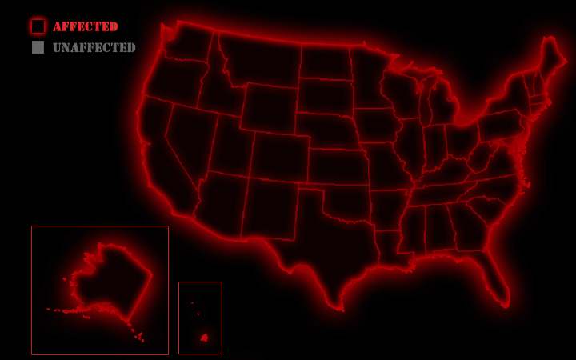
Squirrel vs US Power
Notes:
Which US states have been hit by a power outage, due to squirrels?
References: https://docs.google.com/spreadsheet/ccc?key=0Aj7qNzpSZ9ajdG5EdGU5VFZjQ2o0bnlLZ2lPU0NnZWc&pli=1#gid=0

Slide 36
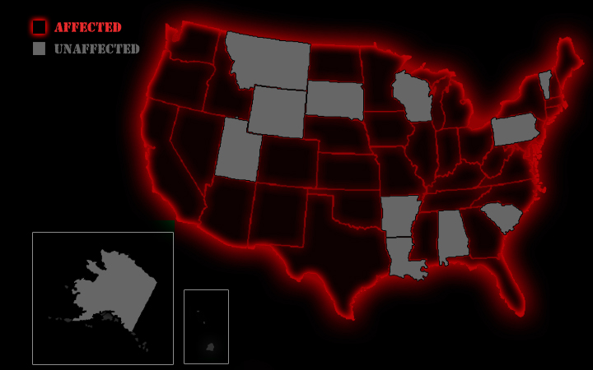
Squirrel vs US Comms
Notes:
Which US states have been hit by a communications outage (phone, fiber, satellite), due to squirrels?
References: https://docs.google.com/spreadsheet/ccc?key=0Aj7qNzpSZ9ajdG5EdGU5VFZjQ2o0bnlLZ2lPU0NnZWc&pli=1#gid=0

Slide 37
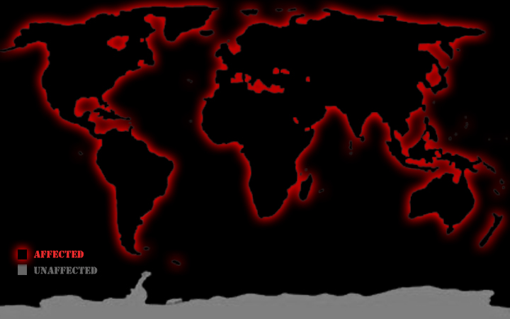
Squirrel vs World
(not just a U.S. problem!)
Notes:
Countries affected by Squirrel-based outages:
Asia: India
Africa: Libya, Nigeria, Zimbia
Australia
Europe: Germany, Switzerland, UK
North America: US, Canada, Bahamas, Costa Rica
South America: Belize, Brazil,

Slide 38
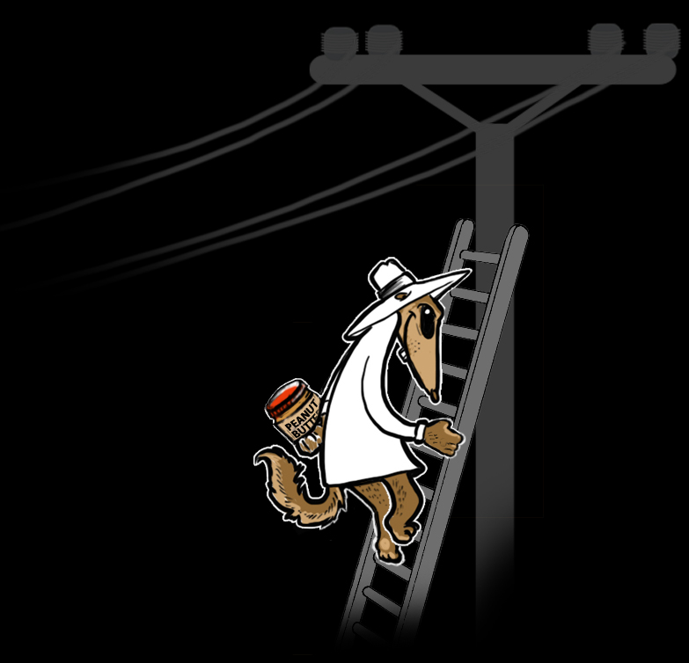
Jericho’s Squirrel Cyber-Weapon
Needed:
Sekret Squirrel Agent
Ladder
Jar of Peanut Butter
24 Hours
Notes:
http://consumerist.com/2011/08/squirrles-do-17-of-the-damage-to-fiber-optic-networks.html
Fred Lawler, SVP of Global Field Services at Level 3. "Honestly, I don't understand what the big attraction is or why they feel compelled to gnaw through cables," he writes. "Our guys in the field have given this some thought and jokingly suspect the cable manufacturers of using peanut oil in the sheathing.“
http://www.blackhatdigest.com/your-longest-outage/
Squirrels actually really enjoy Comcast cables nationwide. It’s like a delicatessen to them I think.
Melissa Mendoza
Comcast Customer Connect
National Customer Operations
@ComcastMelissa

Slide 39

This of course will lead to…

Slide 40
2) What Most Agree On

Slide 41
Defining War
Wikipedia: War is an organized, armed, and often a prolonged conflict that is carried on between states, nations, or other parties typified by extreme aggression, social disruption, and usually high mortality.
Merriam-webster: (1) a state of usually open and declared armed hostile conflict between states or nations (2) : a period of such armed conflict
Oxford: a state of armed conflict between different nations or states or different groups within a nation or state
Notes:
References:
http://en.wikipedia.org/wiki/War
http://www.merriam-webster.com/dictionary/war
http://oxforddictionaries.com/definition/american_english/war?region=us&q=war

Slide 42
War is Complex - Generations
First generation warfare is a term created by the U.S. military in 1989, referring to the earliest stages of organized, state-controlled armed forces waging war in the modern era.
Second generation warfare is a term created by the U.S. military in 1989, referring to the tactics of warfare used after the invention of the rifled musket and breech-loading weapons and continuing through the development of the machine gun and indirect fire.
Third generation warfare is a term created by the U.S. military in 1989, referring to the tactics of warfare used after the Wehrmacht's development of the blitzkrieg.
Fourth generation warfare (4GW) is conflict characterized by a blurring of the lines between war and politics, soldier and civilian. The term was first used in 1989 by a team of United States analysts, to describe warfare's return to a decentralized form.
Notes:
http://en.wikipedia.org/wiki/First_generation_warfare
http://en.wikipedia.org/wiki/Second_generation_warfare
http://en.wikipedia.org/wiki/Third_generation_warfare
http://en.wikipedia.org/wiki/Fourth_generation_warfare
http://cryptocity.net/files/presentations/the_history_of_modern_warfare.pdf
Dan Guido, presenter, says: “This is all based off of a couple of blogs, but I’m going to have a really hard time tracking them down at this point. It supposed to be like notes from a bunch of readings, not independent work. These are essentially ‘lecture notes’ from a class I took.”

Slide 43
Aspects of Cyberwar
Birth of 5th Domain
  RAND / Arquilla (1993): “Cyberwar refers to conducting, and preparing to conduct, military operations according to information-related principles.”
Kinetic Impact:
  Shmitt (1999): “Armed attack should not be defined by whether or not kinetic energy is employed or released, but rather by the nature of the direct results caused.”
Nation States:
  Richard Clarke (2010): “actions by a nation-state to penetrate another nation's computers or networks for the purposes of causing damage or disruption.”
Notes:
Rand’s early definition is pretty good, except “preparing to conduct” is not war, cyber or otherwise.
Clarke’s definition goes off the reservation completely, limiting it to nation-states and not covering espionage or information-based activity.
Wikipedia, despite all the joking, uses a simple and seemingly accurate definition.
Over time, aren’t we supposed to improve? Why does the definition get worse 17 years later with Clarke and others?
Some ‘experts’ cannot or will not define the term, yet it is part of their job, they present on the topic, etc.
Many definitions try to wrap in Clausewitz, UN, or other definitions of traditional warfare. Does Cyberwar have to fit those?
http://en.wikipedia.org/wiki/Cyberwar

Slide 44
Aspects of Cyberwar
Extends Beyond Military Targets
  RAND / Libciki (2009): “Operational cyberwar consists of wartime cyberattacks against military targets and military-related civilian targets.”
Espionage
  Wikipedia: “Cyberwarfare refers to politically motivated hacking to conduct sabotage and espionage.”
Notes:
http://www.rand.org/pubs/reprints/RP223.html

Slide 45
War is Complex - Domains
Land – “predominantly on the land surface of the planet”
Sea – “combat in and on seas, oceans, or any other major bodies of water”
Air – “use of military aircraft and other flying machines in warfare”
Space – “includes ground-to-space warfare … as well as space-to-space warfare”
Information – “involve collection of tactical information, assurance(s) that one's own information is valid, spreading of propaganda or disinformation to demoralize or manipulate”
Notes:
Note, the idea of “information” warfare is not new; it is over a decade old. If “cyberwar” is a new term for the same thing, it underscores how it is more based on media hype and the buzzword, rather than the actual premise of information warfare. Some define cyberwar in a way that shows there cannot be kinetic response (an absolute), when in reality there will always be the possibility of cross-domain response, so it is just 'war‘.
Further, note that naval and aerial war augmented ground warfare since their inception.
Cyberwarfare Called Fifth Domain of Battle by Pentagon
http://www.securitynewsdaily.com/430-cyberwarfare-called-fifth-domain-of-battle-by-pentagon.html
References:
http://en.wikipedia.org/wiki/Ground_warfare
Ground warfare or land warfare is the process of military operations eventuating in combat that take place predominantly on the land surface of the planet.
http://en.wikipedia.org/wiki/Naval_warfare
Naval warfare is combat in and on seas, oceans, or any other major bodies of water such as large lakes and wide rivers.
The first dateable recorded sea battle occurred about 1210 BC: Suppiluliuma II, king of the Hittites, defeated a fleet from Cyprus, and burned their ships at sea.
Prior to 1750, things moved by barge or sea, or not much at all. Thus armies, with their exorbitant needs for food, ammunition and fodder, were tied to the river valleys throughout the ages.
http://en.wikipedia.org/wiki/Aerial_warfare
Aerial warfare is the use of military aircraft and other flying machines in warfare, including military airlift of cargo to further the national interests
http://en.wikipedia.org/wiki/History_of_military_ballooning
Their role was strictly recognized for reconnaissance purposes.
http://en.wikipedia.org/wiki/Space_warfare
Space warfare therefore includes ground-to-space warfare, such as attacking satellites from the Earth, as well as space-to-space warfare, such as satellites attacking satellites.
It does not include the use of satellites for espionage, surveillance, or military communications, however useful those activities might be.
Space Joins Land, Sea and Air (2002)
http://www.afcea.org/signal/articles/templates/SIGNAL_Article_Template.asp?articleid=126&zoneid=87
http://en.wikipedia.org/wiki/Information_warfare
Information warfare may involve collection of tactical information, assurance(s) that one's own information is valid, spreading of propaganda or disinformation to demoralize or manipulate.
The American focus tends to favour technology, and hence tends to extend into the realms of Electronic Warfare, Cyber Warfare, Information Assurance and Computer Network Operations / Attack / Defence.

Slide 46
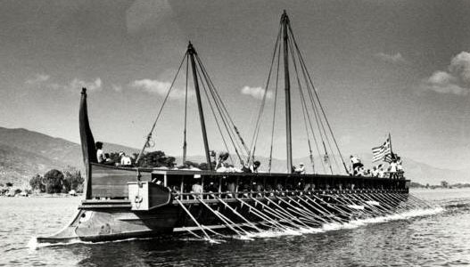
It’s Just a Domain[?|!]
Athenians, Romans, and Spartans recognized the importance of defining a war domain. Their navies augmented the ground warfare, providing supplies, troops, and communications. Why are today’s “experts” 2,000+ years behind the curve?
You can’t win a war against a land-locked country with just your Navy, can’t win a war against a country with just Information warfare. Army saying “you cannot hold a territory without boots on the ground.”
Notes:
http://kingsofwar.org.uk/2012/08/what-war-in-the-fifth-domain/
Rid argues “cyberspace is not a separate domain of war. Instead the use of computer networks permeates all other domains of military conflict, land, sea, air, and space.”
http://perplexities.posterous.com/domains-of-war
“Some support the idea that this fifth domain exists. Others don’t. Those that don't are probably right.”
Image source:
http://bolditalic.com/quotulatiousness_archive/005295.html
References:
http://joseph_berrigan.tripod.com/ancientbabylon/id28.html
[Themistocles, an Athenian general] knew that the Persian army could only succeed if it were successfully supported by supplies and communications provided by the fleet.
http://en.wikipedia.org/wiki/Roman_Navy
Unlike modern naval forces, the Roman navy even at its height never existed as an autonomous service, but operated as an adjunct to the Roman army.
http://en.wikipedia.org/wiki/Spartan_army#Spartan_Navy
Throughout their history, the Spartans were a land-based force par excellence. During the Persian Wars, they did contribute a small navy of 20 triremes, and provided the overall fleet commander, but they largely relied on their allies, primarily the Corinthians, for naval power.

Slide 47
The Disconnect
Big difference between “war” and a “domain”
These days, you don’t have “land war”, “sea war”, “air war”, and “space war” (pew pew!). You wage war, which uses elements from one or more domains (land, sea, air, space, information).
“Cyberwar” is not *war*; element of information warfare, or perhaps a new angle on an old domain. Primarily a buzzword.
Elements of cyberwar are really no different than others; attack, defend, espionage, sabotage, etc.

Slide 48







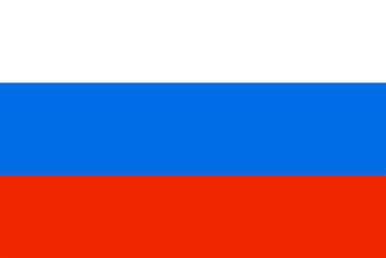

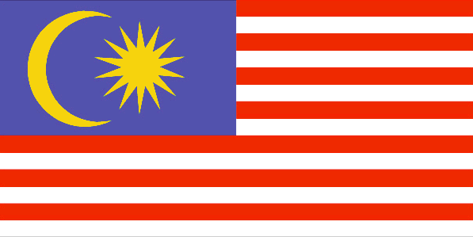
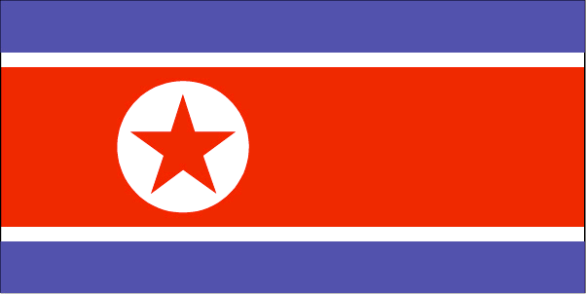
Players ’gonna Play
Notes:
Summary of cyber capabilities of certain nation-states in http://www.ists.dartmouth.edu/projects/archives/cyberwarfare.pdf ~ 2005 perspective (China, India, Iran, North Korea, Pakistan, Russia)
http://thetechlusion.com/cyber-warfare-capability-of-nations/
India to green light on state-sponsored cyber attacks
http://www.theregister.co.uk/2012/06/11/india_state_sponsored_attacks/
Germany confirms existence of operational cyberwarfare unit
http://www.stripes.com/news/germany-confirms-existence-of-operational-cyberwarfare-unit-1.179655
'N.K. third for cyber war capabilities'
http://view.koreaherald.com/kh/view.php?ud=20120607001276&cpv=0
China’s Growing Cyber War Capacities
http://www.e-ir.info/2012/07/29/chinas-growing-cyber-war-capacities/
China's cyber-warfare capabilities are 'fairly rudimentary'
http://www.wired.co.uk/news/archive/2011-11/02/china-cyberwar
Israel's unit 8200: cyber warfare
http://www.telegraph.co.uk/news/worldnews/middleeast/israel/8034882/Israels-unit-8200-cyber-warfare.html
Taiwan
http://news.yahoo.com/taiwan-step-cyberwar-capabilities-report-062353044.html
Japan
http://www.yomiuri.co.jp/dy/national/T120907004328.htm
Malaysia
http://thestar.com.my/news/story.asp?sec=nation&file=/2012/9/16/nation/12037186
US
http://www.airforcetimes.com/news/2010/05/airforce_cyber_careers_051710/

Slide 49
Targets
Most assume Cyberwar means military & SCADA. (Tip of iceberg)
DIB (Defense Industrial Base) -> DIB+ -> Fortune500
Citizens; hearts & minds (PsyOps, Collateral Damage)
Modern digital infrastructure: Gmail, RSA, router manufacturers, etc.
  Direct attack & compromise
  Supply chain tampering
Do we fully realize the potential for harm here? At least 47 published vendor backdoors going as far back as 1979.
Notes:
Old Trick Threatens the Newest Weapons
http://www.nytimes.com/2009/10/27/science/27trojan.html?_r=1&partner=rssnyt&emc=rss&pagewanted=all
Despite a six-year effort to build trusted computer chips for military systems, the Pentagon now manufactures in secure facilities run by American companies only about 2 percent of the more than $3.5 billion of integrated circuits bought annually for use in military gear.
http://www.nytimes.com/2009/04/28/us/28cyber.html?_r=2&pagew__=&hp=&pagewanted=2
Cyberwar would not be as lethal as atomic war, of course, nor as visibly dramatic. But when Mike McConnell, the former director of national intelligence, briefed Mr. Bush on the threat in May 2007, he argued that if a single large American bank were successfully attacked “it would have an order-of-magnitude greater impact on the global economy” than the Sept. 11, 2001, attacks. Mr. McConnell, who left office three months ago, warned last year that “the ability to threaten the U.S. money supply is the equivalent of today’s nuclear weapon.”
Did the Bounds of Cyber War Just Expand to Banks and Neutral States?
http://www.theatlantic.com/international/archive/2012/08/did-the-bounds-of-cyber-war-just-expand-to-banks-and-neutral-states/261230/
Cyberwars Reach a New Frontier: the Airport
http://www.businessweek.com/articles/2012-08-15/cyber-wars-reach-a-new-frontier-the-airport ← FUDtastic, but expands idea of targets
Backdoors:
http://osvdb.org/search?search%5Bvuln_title%5D=backdoor&search%5Btext_type%5D=titles

Slide 50
Cyberwar Is Upon Us
Previous Compromises & Certified Pre-owned
Eagerness to jump into “battle”
Perpetual ‘virtual cold war’ that still goes on today
No declarations of Cyberwar, despite such activity
Civilian ‘cold war’ too: AntiSec's "inevitable conflict“
Bottom line:
We are already at war, it just doesn’t look like what we expected.
Notes:
Should We Be Worried About a Cyberwar?
http://cacm.acm.org/news/100792-should-we-be-worried-about-a-cyberwar/fulltext
Vendor FAIL – Certified Pre-Owned (CPO)
http://securityerrata.org/errata/cpo/
http://www.israelnationalnews.com/News/News.aspx/159641
“Cyber has three dimensions: defense, collection or espionage and attack,” [Maj. Gen. (ret.) Amos Yadlin] said, adding that Israel “is very good at collection.
AntiSec “inevitable conflict”
http://upload.wikimedia.org/wikipedia/commons/thumb/b/b7/Anti-sec_manifesto.png/492px-Anti-sec_manifesto.png
http://www.urbandictionary.com/define.php?term=Anti-Sec&defid=4103834
http://voices.washingtonpost.com/securityfix/2009/04/digital_pearl_harbor_cyber_911.html
For the rest, I'll just list the name of the provider, its location, and the number of Internet addresses assigned to the company that showed up on Spamhaus's block list:
KAMO Electric Cooperative, Vinita, Okla. (6)
Cobb Energy, Marietta, Ga. (4)
Pulaski Electric System, Pulaski, Tenn. (2)
Arizona Public Service Co. (3)
TXU Energy, Texas (2)
Electric Fiber, NY, New York (2)
Baltimore Gas & Electric, Baltimore, Md. (1)
Florida Power and Light (1)
Hopkinsville Electric System, Ky. (1)
Southern Company, Atlanta, Ga. (1)
Newnan Utilities, Newnan, Ga. (1)
U.S. Critical Infrastructure Cyberattack Reports Jump Dramatically
http://www.darkreading.com/advanced-threats/167901091/security/attacks-breaches/240003029/u-s-critical-infrastructure-cyberattack-reports-jump-dramatically.html
http://www.khou.com/news/world/167334595.html
US general: We hacked the enemy in Afghanistan
Darpa Looks to Make Cyberwar Routine With Secret 'Plan X'
http://www.wired.com/dangerroom/2012/08/plan-x/
Air Force Openly Seeking Cyber-Weapons
http://threatpost.com/en_us/blogs/air-force-openly-seeking-cyber-weapons-082812
Army and Marines creating systems for cyber fire support
http://killerapps.foreignpolicy.com/posts/2012/09/10/pentagon_creating_system_for_cyber_fire_support

Slide 51

Litmus Test?
“A cyber attack is a cyber operation, whether offensive or defensive, that is reasonably expected to cause injury or death to persons or damage or destruction to objects.”
      Tallinn Manual on The International Law Applicable to Cyber Warfare – Michael N. Shmitt
Least ambiguous definition?
Notes:
What may be missing is…
Domain Dominance is to ensure allied access while denying your adversary. (partly addresses my Georgia & your Syria points)
While this is possibly one of the more complete and least ambiguous definitions, it still falls short:
Georgia DDOS
Syrian Area Defense Hack
http://www.theregister.co.uk/2007/10/04/radar_hack_raid/
Israel suspected of 'hacking' Syrian air defences
Tallinn Manual
http://www.ccdcoe.org/249.html
http://issuu.com/nato_ccd_coe/docs/tallinn_manual_draft?mode=window&backgroundColor=%23222222

Slide 52
3) Less Considered/Closer To Home

Slide 53
The Scales: Low Bar to Entry
To join the Nuclear Club
To join the Cyber Club
Obtain Uranium
Develop Warhead
Muster the will to use it
Enrich Uranium
Test Warhead Successfully
Obtain ICB or
Suitcase
Buy Netbook
Find a 0day
Muster the will to use it
Learn to hack
Develop Reliable Exploit
Buy Netbook
Muster the will to use it
Use MetaSploit/SHODAN or LoIC
Notes:
SCADA casualty in 2013? More tools, more SCADA knowledge, Shodan.. Just need motivation, or kid who doesn’t realize the power of his ‘weapon’. Chance of risky situation is going up. While it may not have happened, doesn’t mean it can’t, and doesn’t mean it isn’t getting more probable.
US urged to recruit master hackers to wage cyber war on America's foes
http://www.guardian.co.uk/technology/2012/jul/10/us-master-hackers-al-qaida
Instead of prosecuting elite computer hackers, the US government should recruit them to launch cyber-attacks against Islamist terrorists and other foes, according to a leading military thinker and government adviser.
The brilliance of hacking experts could be put to use on behalf of the US in the same way as German rocket scientists were enlisted after the second world war, said John Arquilla, a professor of defence analysis at the US Naval Postgraduate School in Monterey, California, in an interview with the Guardian.
^ derp. opens up a can of worms. encouraging chaos essentially?
Wysopal:
One of the things that Richard Clark was bowled over by when he visited the l0pht was that a group of 7 unfunded guys picking hardware out of university and corporate dumpsters was able to assemble a world class cyberwar lab. Cyberwar is the ultimate asymmetrical war. A small group can steal the intellectual property from dozens of billion dollar technology firms who probably have a 1000:1 ratio of manpower and funding dedicated to defense.
Perhaps a given / section 2? Some experts DO miss this point though.
VERY LOW COST – VERY LOW DIFFICULTY – VERY HIGH POWER OF ONE PERSON
Nuclear Proliferation vs a Laptop (attack tools)
Personal Power Curve
Maybe Graphic of US Military Budget by Domain?
GRAPHIC: Hyperbole much? A-Bomb vs MetaSploit

Slide 54
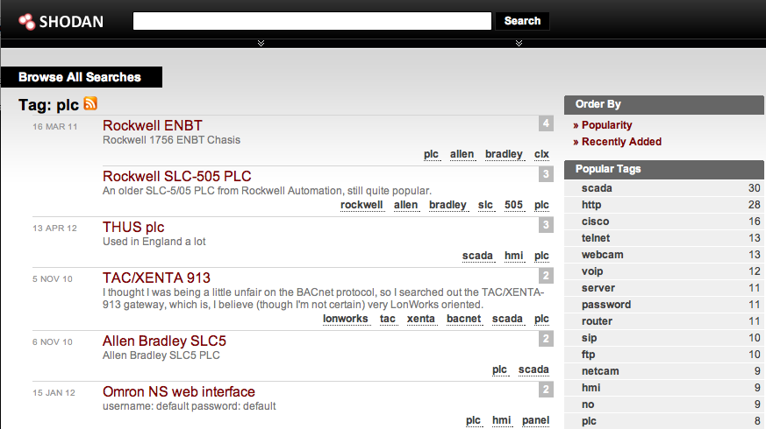
What could you do? Right now…
HDMoore’s Law + SHODAN + Too much connectivity + Willpower == ?????

Slide 55
The Scales: Automation
Stuxnet / Gauss / Duqu / Flame (6 years old!) …
Cost of development: fraction of kinetic
Easier to leverage than F-22
  Modular design, code re-use
  Virus Creation Toolkit? -> CyberWarWorm TK?
Patriotism -> Security vendors can detect, should they? This is a messy ethical question with no clear answers.
  Much bigger topic (best over B33R)
Notes:
Flaming Retort: Frankenstein Malware – the future of cyberwar, or just a catchy headline?
http://nakedsecurity.sophos.com/2012/08/27/flaming-retort-frankenstein-malware-the-future-of-cyberwar/
Stuxnets are Not in the US National Interest: An Arsonist Calling for Better Fire Codes
http://www.acus.org/new_atlanticist/stuxnets-are-not-us-national-interest-arsonist-calling-better-fire-codes
Second energy firm hit by virus
http://www.bbc.co.uk/news/technology-19434920
Is a Computer Worm Causing Iranian Nuclear Facilities to Blast AC/DC’s ‘Thunderstruck’ At Night?
http://gawker.com/5928425/is-a-computer-worm-causing-iranian-nuclear-facilities-to-blast-acdcs-thunderstruck-at-night
New Virus Hits Oil Giant, LNG Producer
http://www.isssource.com/new-virus-hits-oil-giant-lng-producer/
Natural gas giant RasGas targeted in cyber attack
http://www.scmagazine.com/natural-gas-giant-rasgas-targeted-in-cyber-attack/article/257050/
Nation-sponsored malware with Stuxnet ties has mystery warhead
http://arstechnica.com/security/2012/08/nation-sponsored-malware-has-mystery-warhead/
Mystery 'Wiper' malware linked to 'Duqu', says security firm
http://news.techworld.com/security/3379060/mystery-wiper-malware-linked-duqu-says-security-firm/
Did journalist David Sanger discover the true story behind Stuxnet, or was he caught in a deeper web of deception?
http://spectrum.ieee.org/podcast/computing/embedded-systems/stuxnet-leaks-or-lies
A Weapon We Can't Control
http://www.nytimes.com/2012/06/25/opinion/stuxnet-will-come-back-to-haunt-us.html
FBI Opens Investigation into Stuxnet Attack Leaks
http://www.infosecisland.com/blogview/21556-FBI-Opens-Investigation-into-Stuxnet-Attack-Leaks.html
Cyber-Spying Flame Attackers Operated On 'Need To Know' Basis
http://www.darkreading.com/advanced-threats/167901091/security/attacks-breaches/240007486/cyber-spying-flame-attackers-operated-on-8216-need-to-know-8217-basis.html
New research published separately today [..] shows that the sophisticated Flame cyberespionage campaign dates back to 2006 …

Slide 56
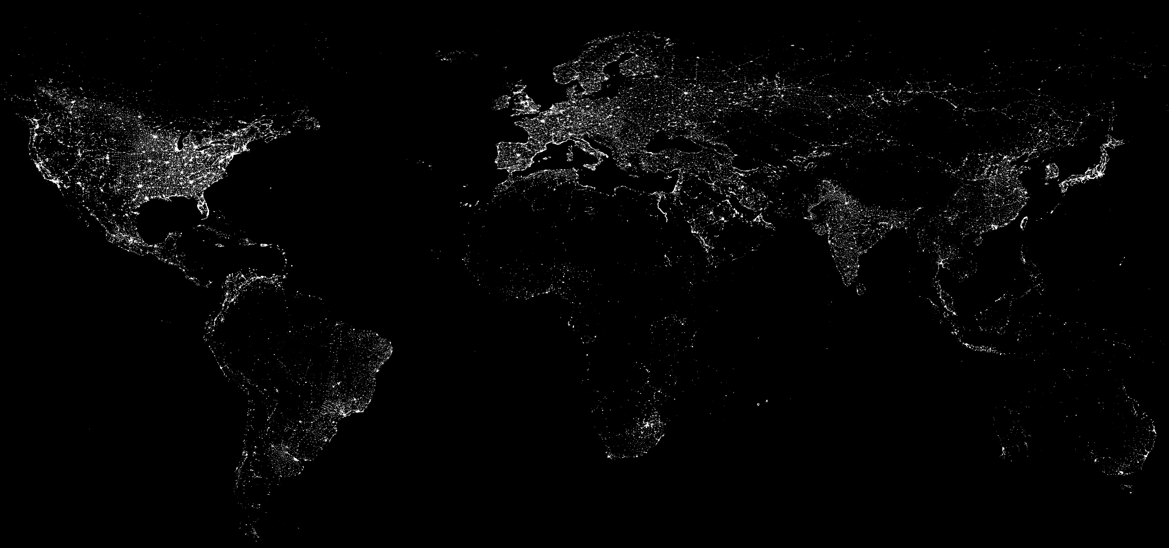
Boundaries - Geopolitical
The battleground is limited compared to conventional warfare.
Notes:
Source: http://eoimages.gsfc.nasa.gov/images/imagerecords/55000/55167/earth_lights.gif

Slide 57
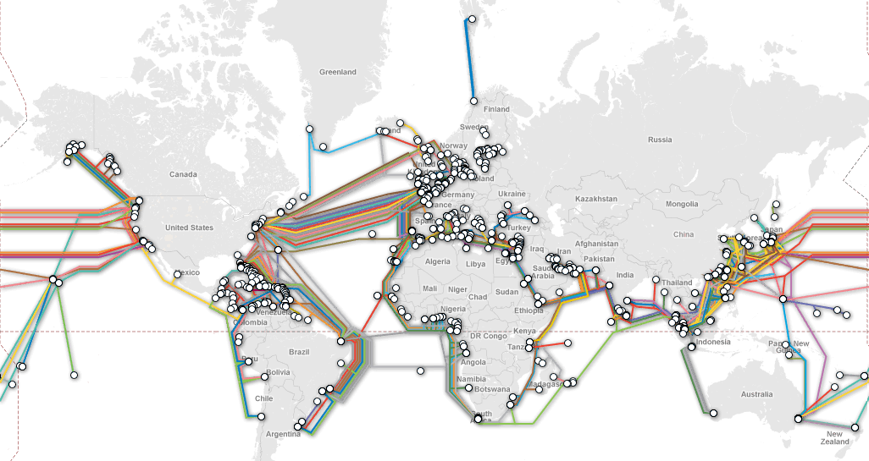
Boundaries - Logical
Routes are limited, many bottlenecks. Easier monitoring, or cutting if needed.
Notes:
Source: http://www.submarinecablemap.com/

Slide 58
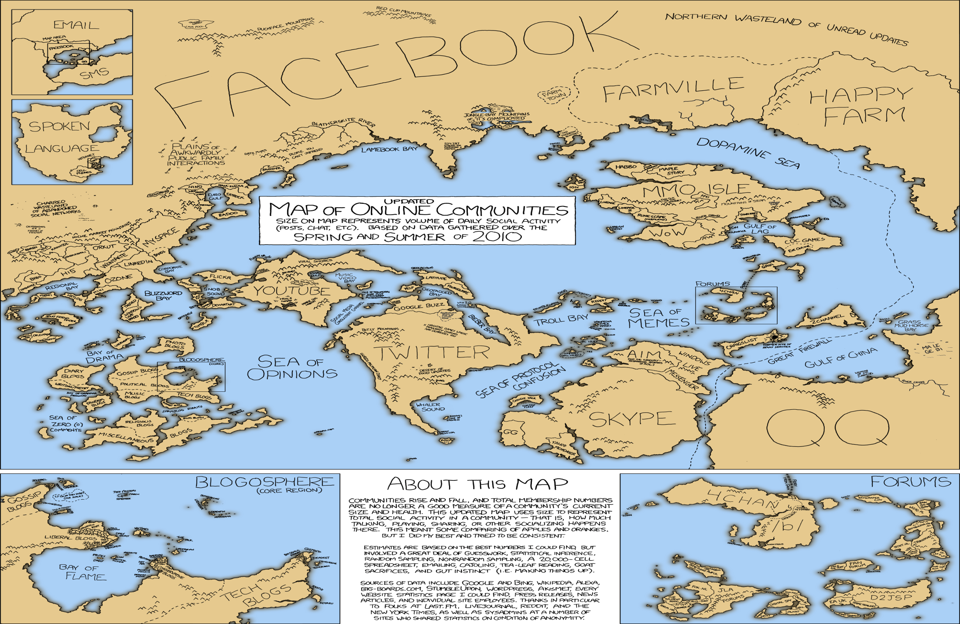




Boundaries - Ideological
Notes:
Religions, Movements, Societies, - not to mention state-specific non-state actors like the RBN in Russian or Chinese Nationalists
XKCD Map of Social Media
http://socialmediainbusiness.com/wp-content/uploads/2011/12/online_communities_2_large1.png
OCCUPY Fist:
http://1.bp.blogspot.com/-leQXC7dgEms/TpMCdkMDweI/AAAAAAAAADo/-0BpkIYxCNM/s1600/images-golocalprov-com--solidarity-fist-360x513.png
Islam Jihad Flag:
http://upload.wikimedia.org/wikipedia/commons/thumb/3/30/Flag_of_Jihad.svg/800px-Flag_of_Jihad.svg.png
Anon:
http://th01.deviantart.net/fs71/150/f/2012/229/4/1/anonymous_stencil_by_graffitius-d5bf5eq.jpg
Masonic:
http://douglawrence.files.wordpress.com/2009/10/masons.jpg

Slide 59
Cyberwar Laws
International treaty on Cyberwar?
  No law or treaty will stop a bad actor, or nation-state intent on an action.
Headlines:
  “U.S.: Laws of war apply to cyber attacks”
  “Security Think Tank Analyzes How International Law Applies to Cyber War”
    Isn’t a bit late for that?
Why we cant define ‘cyberwar’, laws do not cover what war is.
  International law does not define the term “act of war.” … international law is organized on the concepts of “use of force” and aggression. [1]
Notes:
http://www.washingtonpost.com/world/national-security/pentagon-proposes-more-robust-role-for-its-cyber-specialists/2012/08/09/1e3478ca-db15-11e1-9745-d9ae6098d493_print.html
The Pentagon has proposed that military cyber-specialists be given permission to take action outside its computer networks to defend critical U.S. computer systems -- a move that officials say would set a significant precedent.
The proposed rules would open the door for U.S. defense officials to act outside the confines of military-related computer networks to try to combat cyberattacks on private computers, including those in foreign countries.
Should There Be an International Treaty on Cyberwarfare?
http://www.usnews.com/debate-club/should-there-be-an-international-treaty-on-cyberwarfare
Security Think Tank Analyzes How International Law Applies to Cyber War
http://www.securityweek.com/security-think-tank-analyzes-how-international-law-applies-cyber-war
http://www.f-secure.com/weblog/archives/00002417.html
U.S.: Laws of war apply to cyber attacks
http://www.armytimes.com/news/2012/09/dn-laws-of-war-apply-cyber-attacks-091812/
[1] http://www.dtic.mil/cgi-bin/GetTRDoc?AD=ADA500795 -- Defining and Deterring Cyber War (06-01-2009) - Lieutenant Colonel Scott W. Beidleman, USAF

Slide 60
Actors: States, Non-states
State Actors
Diplomacy/Relations
Aid (Civil)
Allies (Military)
UN Policy
Sanctions $/Trade
Non-State Actors
Borderless
Nameless
Economy-less
Leaderless?
False
Flags
Notes:
http://www.mcafee.com/us/resources/reports/rp-virtual-criminology-report-2009.pdf
2009 mcafee report "Virtually Here: The Age of Cyber Warfare"
When determining whether a cyber attack is an act of cyber war, experts evaluate four key attack attributes:
Source: Was the attack carried out or supported by a nation-state?
Doesn’t require nation state to participate, but cyberwar can only be waged *against* nation state.

Slide 61
Attribution
Basically impossible to do, especially at scale
Geo-location of a server meaningless
Forensics near meaningless
“Who is at keyboard”, old FBI problem
“Who is at keyboard”, is even meaningless
  Jericho was at keyboard, but what are his allegiances? Who paid him to attack? What prescription meds is he on? Entirely different problem now.
(aka Impossible)
Notes:
http://www.defense.gov/home/features/2011/0411_cyberstrategy/docs/NDAA%20Section%20934%20Report_For%20webpage.pdf
Continuing to improve our ability to attribute attacks is a key to military response options.
Forensic analysis is a part of attributing attacks, but foreign intelligence collection and international law enforcement cooperation play a key role.
http://killerapps.foreignpolicy.com/posts/2012/09/06/is_the_holy_grail_of_cyber_security_within_reach

Slide 62
Attribution: Kinetic Response
Stuxnet was a logical attack with a physical effect
Even when you think possible, does it matter? US claimed credit for Stuxnet, what happened?
Thus far nation-states have been reluctant to call any logical attack an act of war
This will change
Determine Anon was responsible, how do you strike back?
“The Packet Heard ‘round the World”?
Notes:
Is there a digital attack that will have such serious consequences, that it will become a “packet heard ‘round the world”? If Stuxnet wasn’t it, what would it take to make everyone truly realize the implications of digital attacks.
E.g. A Nuke Plant meltdown via electronic attack *might* be such a moment.
Not just about loss of life – it is the devastation – but more so, what would rise to the level of concern in the general population?

Slide 63


Hearts & Minds (& Cupcakes)
Notes:
http://www.internetevolution.com/author.asp?section_id=628&doc_id=249122&
Syrian Revolution Moves to Digital Battlefield
Image source:
http://cupcakecrusade.files.wordpress.com/2010/11/johnny-cupcakes-logo.png

Slide 64
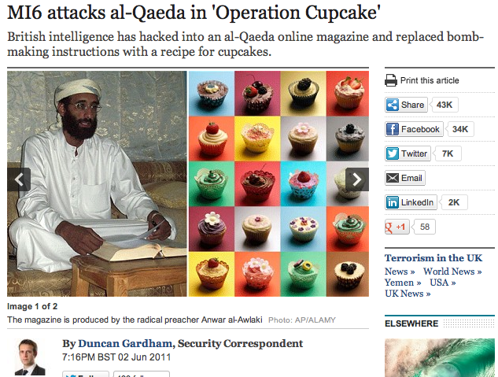
PsyOps
MI6 OpCupCake
Trolling: Younes Tsouli
  It was Aaron Weisburd through the use of PsyOps that caused Tsouli to give up his logs including his IP address, which led to his arrest.
Notes:
Operation CupCake
http://www.telegraph.co.uk/news/uknews/terrorism-in-the-uk/8553366/MI6-attacks-al-Qaeda-in-Operation-Cupcake.html
PsyOps / Non-State Actors:
It was Aaron Weisburd through the use of Psyops that caused Tsouli to give up his logs including his IP address, which led to his arrest.
http://en.wikipedia.org/wiki/Younes_Tsouli
http://forum.prisonplanet.com/index.php?topic=22570.0

Slide 65
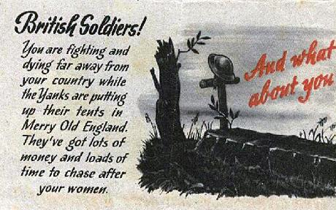

Notes:
PsyOps pivoting into Propaganda
Image source:
http://i.telegraph.co.uk/multimedia/archive/01755/nazi1_1755853c.jpg
http://i.telegraph.co.uk/multimedia/archive/01755/nazi_1755854c.jpg
http://www.telegraph.co.uk/history/world-war-two/8115580/Nazi-calling-cards-propaganda-leaflets-warning-of-wayward-wives-to-be-sold.html

Slide 66


Notes:
Propaganda as a feature of war… But also… OSINT was a huge issue in WWII… also a much bigger issue in the age of social media.
Image source:
http://digital.library.northwestern.edu/wwii-posters/img/ww1647-87.jpg
http://www.thinkhero.com/wp-content/uploads/2010/02/star_wars_trading_card_propaganda_poster_02.jpg

Slide 67


Notes:
We forget how much actionable intelligence we seep and volunteer – with 4Square, Twitter, Facebook, Pinterest, etc.
Image source:
http://pixcdn.posterrevolution.com/posters/someone-talked-wwii-war-propaganda-art-print-poster.jpg
http://s3-ec.buzzfed.com/static/imagebuzz/terminal01/2009/6/24/17/modern-wwii-propaganda-5685-1245880771-37.jpg

Slide 68
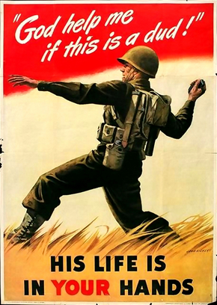

Notes:
But propaganda is also a form of PsyOps… It is a feature and tool in the toolkit of war – and its presence in anonymous (e.g.) is revealing.
Meme-Hacking is a form of shaping the zeitgeist… and Anonymous is VERY good at it. /b/ is the birthplace of so many meme’s that they grew up on it.
Image source:
http://sas.guidespot.com/bundles/guides_0d/assets/widget_cDMAvueiPoGyBzSzzWw5ZE.jpg
https://static.prtst.net/asset-proxy/55f6e73a39d405ae230fb493d33b8d06fec06842/687474703a2f2f696d673333392e696d616765736861636b2e75732f696d673333392f333134392f61747461636b6b697474656e6772362e6a7067/http://img339.imageshack.us/img339/3149/attackkittengr6.jpg
https://whyweprotest.net/community/threads/wwii-propaganda.37245/

Slide 69

Notes:
It isn’t simply doctoring WWII propaganda – they are developing their own. It shows tremendous talent and artistic capability – and taps into pop culture and draws in participation – making them youth/masses pliable to their messages and themes.
They say propaganda is social engineering of the masses… What opportunity does this represent for the world’s best social engineers? (not just Anonymous or LulzSec)
Image source:
http://www.leblogducommunicant2-0.com/wp-content/uploads/2011/01/RV2-0-Anonymous-propaganda.jpg

Slide 70
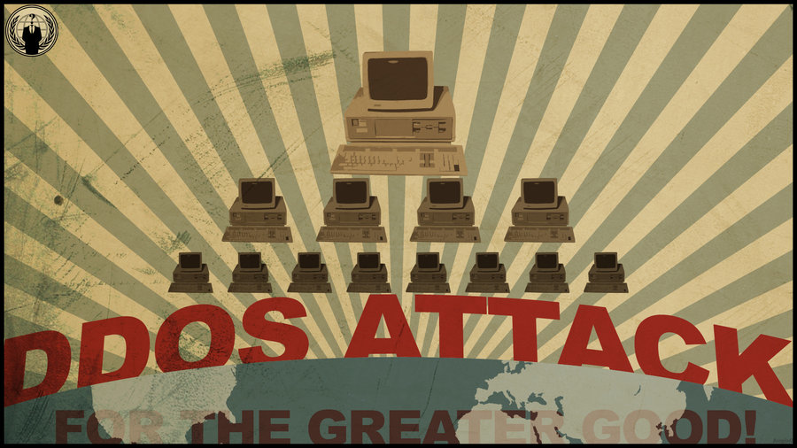
Notes:
So as the personal power curve of an individual has made any laptop a weapon, is there any surprise that this WWII retread no longer needs b-52 bombers?
Image source:
http://fc07.deviantart.net/fs70/i/2012/051/4/6/anonymous_ddos_propaganda_wallpaper_by_ampix0-d4qf6eu.jpg

Slide 71
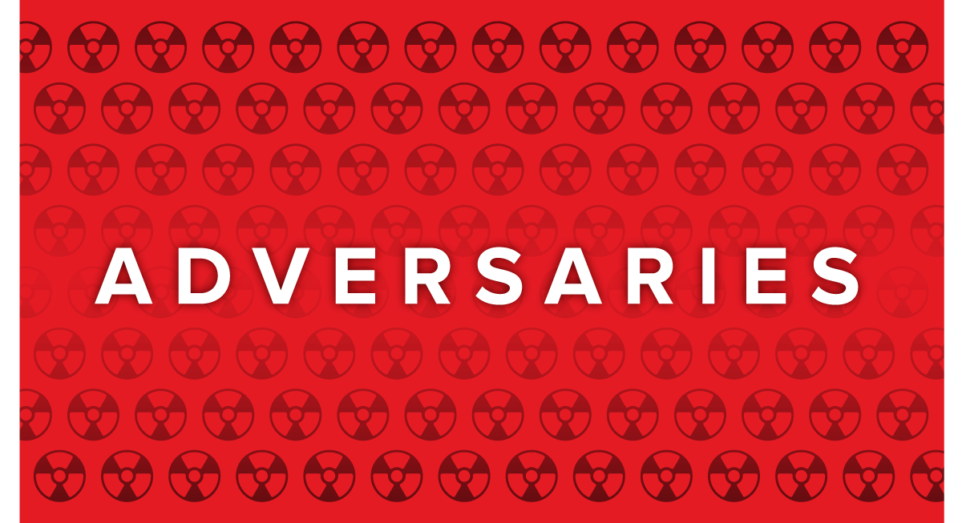






Non-Conventional: False Flags
“Anonymous is God’s gift to the Chinese” – CISO
Notes:
Another staple of non-conventional warfare is the use of False Flags and misdirection.
Josh: One reason I knew I had to study Anonymous was when I spotted my first imposter attack; one claiming to be anonymous, but was really a Russian organized crime attack.
I’ve later spotted pretenders and imposters from China, cartels, and individuals/rogues… one can assume some national intelligence and LE are in the mix.

Slide 72
Non-Conventional: False Flags
Actors
States
Motivations
Financial
Impacts
Reputational
Competitors
Hacktivists
Terrorists
Organized Crime
Insiders
Industrial
Military
Ideological
Political
Prestige
Integrity
Availability
Targets
Credit Card #s
Cyber Infrastructure
Core Business Processes
Intellectual Property
PII / Identity
Auditors
Script Kiddies
Personal
Confidentiality
Web Properties
SOURCE: Joshua Corman And David Etue “Adversary ROI”
Notes:
This model is one behind, but comes from the RSA talk by Josh Corman & David Etue from RSA 2012 “Adversary ROI: Why Spend $40B When You Can Steal it for $1M?”
If you map WHO – to WHY – to Which assets/impacts – to most frequently used attack methods (TTPs) and Skills… these patterns help reveal anomalies (especially when combined with a little OSINT and other digging)

Slide 73
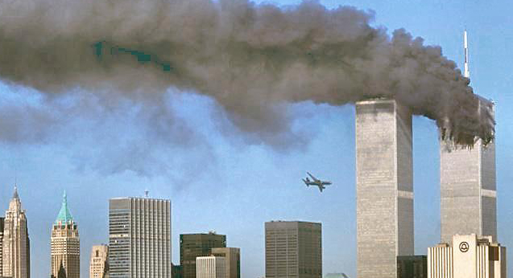
“Cyber-Terrorism”
01100011 01111001 01100010 01100101 01110010 01110111 01100001 01110010 00100000 01101000 01100001 01110011 00100000 01101110 01101111 00100000 01100100 01110010 01100001 01101101 01100001 01110100 01101001 01100011 00100000 01110110 01101001 01110011 01110101 01100001 01101100 01110011 00100000 00111101 00101001
Notes:
- Look at how effective AlQaeda was with a small team planning 9-11 and the cascading/successive aftermath, especially our reaction to the attack.
Where is the line between Cyberwar and Cyber-terrorism?
Cyber-terrorism clearly won’t look like the terrorism we know. People forget what “terrorism” truly means: “violent or destructive acts (as bombing) committed by groups in order to intimidate a population or government into granting their demands”. Is Cyber-terrorism even possible? Probably. Have we seen it? Not close. [The binary above translates to “cyberwar has no dramatic visuals =)”]
Cyber Operations and Terrorism
http://www.au.af.mil/au/awc/awcgate/army/guidterr/sup2.pdf

Slide 74

Libya: Sep 11, 2012
Suspicious Video to Inflame Islam
Protests form at a number of Embassies
U.S. Ambassador to Libya killed during riot
U.S. Special Forces landed next day
Is this repeatable and targetable?
Can do this on demand, virtually no costs.
Notes:
Josh: While I watched the September 11th, 2012 attacks on the Embassies in Egypt and Libya…
I couldn’t help but think. Couldn’t any clever person use social media to catalyze tension and protest/revolt in a specific demographic – and a specific place – when it suited them?
Could you provoke a war between 2 nations? Could you suck the US into yet-another-war? While the facts of that video are sketchy (and the role it did or didn’t play) … it could.

Slide 75

Scenario: A War @ Home
Notes:
Enumerate ways it would and would NOT be if our peers were to fight a modern US Revolutionary War
Image source:
http://upload.wikimedia.org/wikipedia/en/2/29/Assassin's_Creed_III_Game_Cover.jpg

Slide 76

Citizen Soldiers & Rogues
Citizen Solders
  Formation (Militias)
  Conscription
Rogues
  Solo Actors
  Mercenary Groups
Operational Collisions
  Blue on Blue (Mo’players, Mo’problems)
  Risk to catalyze State-to-State incidents
Letters of Marque…?
Notes:
Rogues : think J3st3r, Tom Ryan, Aaron Barr, ex-Anon gone solo (?)
Militias : think of the teams forming of private citizens – uncoordinated (note, j3st3r ~might~ be a team)
Are the carrying water for the government – is it legal? Are the pure risk to government? Does DOSing/defacing Jihadist website screw up surveillance? Put in theatre assets at risk? Make Jihadists more careful? Provoke kinetic response? To live outside of the law you need to be more moral/honest. It is a great responsibility and burden to insert oneself into this fray. Vigilantism is a HUGE choice. Are those drawn to this doing it for ego? With wisdom? With restraint?
Example: DEFCON 20, General Alexander recruiting to a degree, but not addressing “complex” issues like actually joining an agency or military, and indemnification.
http://www.latimes.com/news/nationworld/nation/la-na-terror-hacker-20120909,0,7739109,full.story
"This is a domain of warfare where an individual can make a difference," Maj. T.J. O'Connor, a signal officer with Army Special Forces, told a conference in Washington, D.C., earlier this year. "Personalities are acceptable in this domain.“
http://blogs.csoonline.com/global-security/2306/formation-cyber-militias-united-states-feasibility-structure-and-purpose-jake-mihevc
The Formation of Cyber Militias in the United States: Feasibility, Structure, and Purpose - Jake Mihevc

Slide 77

Militia
Notes:
Debunking the DOJ’s Hit Piece, Part 3: Assault on The Second Amendment
http://www.activistpost.com/2010/10/debunking-dojs-hit-piece-part-3-assault.html
Image source:
http://bdnpull.bangorpublishing.netdna-cdn.com/wp-content/uploads/2009/09/1253395922_3c13-1024x658.jpg

Slide 78

Asymmetric: Guerilla
Notes:
espionage is not war <-> war can include espionage
cybercrime is not war <-> war can include cybercrime
IMAGE SOURCE: http://shirtoid.com/r/gorilla-warfare-mrfoz-redbubble
All the cyberwar papers / theories seem to miss the “not limited to nation-state” angle. Forget about classic guerilla warfare which has dominated wars for a while. Why can’t Anon or corporate entities be players? They can! Big disconnect here.
From Rand's new whitepaper on Cyberwarfare (pg. 73):
http://www.rand.org/pubs/monographs/2009/RAND_MG877.pdf
The following hints may be indicative. Private hackers are more likely to use techniques that have been circulating throughout the hacker community. While it is not impossible that they have managed to generate a novel exploit to take advantage of a hitherto unknown vulnerability, they are unlikely to have more than one.
http://microsoft.academia.edu/DavidAucsmith/Papers/1765973/A_Theory_of_War_in_the_Cyber_Domain_An_Historical_Perspective
The low cost of entry allows non-state actors to pursue war within cyberspace with great effect. Cyberspace gives minor actors global reach and impact. Hitherto, guerrilla war could only be fought successfully on one’s home territory, as it was necessary to rely on the local population for support and anonymity. With cyberspace, it is now possible to project guerrilla war beyond one’s home territory. It is now possible to gather supporters linked not by geography, but ideology.

Slide 79
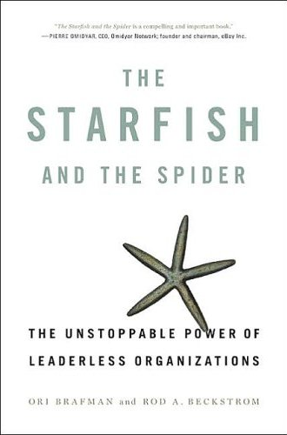

Asymmetric: Guerilla
The Starfish and the Spider
  Virtues of decentralized organization
  Characteristics for fighting
Cut a Starfish in 2 => 2 Starfish
Jericho wants to rename it:
  The Starfish and the Cow
Notes:
The domain admits well to small, leaderless, decentralized cells – ESPCIALLY when we’re applying this to the likely model for citizen militias.
Traditional “war” models do poorly with fighting starfish organizations.
http://www.amazon.com/exec/obidos/ISBN=1591841437/insekurityorgA/ - “The Starfish and the Spider” by Ori Brafman and Rod Beckstrom
Compares the differences between Centralized and Decentralized organizations. Different Advantages – Different ways to respond to each
Cow Image Source:
http://www.slate.com/content/dam/slate/archive/2001/10/97000_97789_powell_madcow.jpg
http://www.starfishandspider.com/

Slide 80


Citizen Soldiers
Notes:
http://www.latimes.com/news/nationworld/nation/la-na-terror-hacker-20120909,0,7739109,full.story
http://operationona.wordpress.com/
Citizen groups exist. We know this. I’d wager that everyone in this room either knows someone in one – or may themselves be in one.
Will they be moral?
Will they help more than hurt?

Slide 81

Who Watches the Watchers?
Notes:
Who watchers the watchers?
Accept there will always be chaos and that oversight is not possible.
There is a lot of moral complexity here – and a lot of operational risk. If you haven’t read “The Watchmen”… DO SO!
Image source:
http://images1.wikia.nocookie.net/__cb20080722223058/watchmen/images/thumb/0/0d/052708-watchmen-minutemen.jpg/300px-052708-watchmen-minutemen.jpg

Slide 82


Letters of Marque
Notes:
There may be historical precedence – Letters of Marque
Above is Sir Francis Drake - a “state-licensed” pirate. Letters of Marque granted permission for non-military to fight pirates. Piracy had gotten so bad that it threatened any sea trade. This response, while abused, was deemed critical. Many conditions with online activity echo the past.
Image source:
http://shadyislepirates.com/site_image/drake-knight.jpg
https://www.piratedocuments.com/Images/Documents/henry_morgan_gr_550w.jpg

Slide 83




Notes:
What are our constructs for teamwork and warfare?
For some, it is old school hacker groups (COTNO, GwD, TESO, ADM… even PHC)
For some it is part MMORPG, part First Person Shooter
How would a group specialize?
How would a group organize?
How would a group manage the resources?
How would a group communicate and manage trust?
http://www.textfiles.com/magazines/COTNO/
http://www.textfiles.com/magazines/GWD/
http://en.wikipedia.org/wiki/TESO
http://packetstormsecurity.org/groups/ADM/

Slide 84

Militia: Operational Parameters
“Even pirates have a code.
  More like guidelines really…”
First Principles
Codes of Conduct
Strategy & Priorities
Bright Lines & Exit Conditions
Notes:
“to live outside the law you must be honest” - Bob Dylan "Absolutely Sweet Marie” Blonde on Blonde
Some groups have formed lawfully – and some unlawfully – regardless…
Forming and operating such a group is a tremendous responsibility and should not be taken lightly.
The more principled and explicit the group is – from it’s outset – the less chance of it losing it’s footing, causing unintended consequences, turning on each other, etc.
Pt 5 of our Building a Better Anonymous lays out a blueprint and foundation for such a group.
http://blog.cognitivedissidents.com/2012/04/12/building-a-better-anonymous-series-part-5/

Slide 85

Notes:
Then there is Survivalism
Even if not a combatant, we may find ourselves among “war” – how do we protect and isolate ourselves
http://www.thesurvivalistblog.net/selecting-guns-for-bug-out-bag/
http://www.thesurvivalistblog.net/wp-content/uploads/2010/01/IMG_0135-600x800.jpg
The US CDC has the notion of an epidemic “Bug Out Bag”
What should our “Cyber-BugOutBag” look like?
What is our Duck & Cover? Our “4 minute warning”?
How do we stage our exit plan – or our hedged dependencies?
Iranian state goes offline to dodge cyber-attacks
http://www.telegraph.co.uk/news/worldnews/middleeast/iran/9453905/Iranian-state-goes-offline-to-dodge-cyber-attacks.html
Iran preparing internal version of Internet
http://www.washingtonpost.com/world/national-security/iran-preparing-internal-version-of-internet/2012/09/19/79458194-01c3-11e2-b260-32f4a8db9b7e_print.html
Image source:
http://images.uulyrics.com/cover/n/nine-inch-nails/album-survivalism-pt-2.jpg

Slide 86

…or you could “Duck & Cover”
Notes:
http://www.germanblogs.de/pub/germanblogs/satire-blog/dnc.jpg

Slide 87

Thanks
Scot Terban – Extended discussion, invaluable feedback
Space Rogue (@spacerog) – Discussion, research, feedback
Dave Kennedy (@Dave_Rel1k), David Etue (@djetue)
Rob Rosenberg / Vmyths – Research
CJI - Research
Mar (@spux / sudux.com) – Graphics
Chris LaFronte – Picture use

Slide 88

Questions?

Slide 89
Corman’s “CyberWar Soundtrack”
“Gunshots by Computer” Saul Williams (Hyperpower Remix) of NIN
  http://www.youtube.com/watch?v=CguJeODNMks
“Counting Bodies Like Sheep To The Rhythm Of The War Drums” A Perfect Circle
  http://www.youtube.com/watch?v=giaZnIr-faM
“Zombie Barricades” The Company Band
  http://www.youtube.com/watch?v=boj3A39XBxc
“Black Flags” Atari Teenage Riot
  http://www.youtube.com/watch?v=nAD82J6QMPU
“This Is War” 30 Seconds To Mars
  http://www.youtube.com/watch?v=Zcps2fJKuAI
Jericho: *sigh*
Notes:
While TurboDouchee some of these may have been playing during the construction of the slides by ONE of the presenters…

