Slide 1
Recognize
Awards
RussR, Jericho, The Dark Tangent
Notes:
The 3rd annual Defcon Recognize Awards
(First year, they were called the Defcon Awards or something confusing to the awards given out exclusively based on Defcon happenings)

Slide 2
Community Voice
  Presenters did not vote.
Recognition!
  Positive (you kick ass!)
  Negative (you suck!)
WHY?

Slide 3
All Public Nominations
Via SurveyMonkey
Board Review
  Best Nominees
  Most Frequent Nominated
Public Voting
  Right here, right now
HOW?
Notes:
Nominations for all of these awards came from the community. The moderators of this panel did NOT nominate anyone themselves.

Slide 4
Past Years
Started in 2011 by RussR
Originally called “Defcon Awards” (confusing)
Renamed to “Defcon Recognize Awards”
Last two years held on Sunday *snooze*
This year moved to Saturday *awake*

Slide 5
Worst Media Coverage
  FOX 11 coverage of Anonymous
Most Interesting Malware
  Stuxnet
Best Privacy Technology
  Whisper Systems
Best Open Source Software Response to an Attack or Method
  BackTrack
Best Author/Story That Captures the Hacker Mindset
  Kingpin, by Kevin Poulsen
Security Charlatan of the Year
  Gregory D. Evans
DC19 - 2011
Notes:
Video of the DC19 awards:
https://media.defcon.org/DEF%20CON%2019/DEF%20CON%2019%20video%20and%20slides/DEF%20CON%2019%20Hacking%20Conference%20Presentation%20By%20-%20The%20Dark%20Tangent%20and%20Russ%20Rogers%20-%20DEF%20CON%20Awards%20-%20Video%20and%20Slides.m4v

Slide 6
Worst Media Person or Outlet (Print)
  Water Pump Hack coverage (multiple outlets)
Worst Media Person or Outlet (Broadcast)
  (no nominations)
Best Privacy Enhancing Tech
  TOR
Best Sec or Hack Twitter Feed
  @YourAnonNews
“Twit-Twat” – Worst Twitter Feed (Sec/Hack)
  @AnonymouSabu
“Captain Obvious” – Most common sense talk
  General Keith B. Alexander, “Shared Values, Shared Responsibility”
Security Charlatan of the Year
  Ankit Fadia
DC20 – 2012
Winners!
Notes:
Video of the DC20 awards:
https://media.defcon.org/DEF%20CON%2020/DEF%20CON%2020%20video%20and%20slides/DEF%20CON%2020%20Hacking%20Conference%20Presentation%20By%20DT%20Jericho%20and%20Russ%20Rogers%20-%20DC%20RECOGNIZE%20Awards%20-%20Video%20and%20Slides.m4v

Slide 7
DC21 - Categories
Best Media Coverage of Hacker/Security (Any media)
Worst Media Coverage of Hacker/Security (Any media)
Best Privacy Enhancing Tech Since DC20
Worst Privacy Enhancing Tech Since DC20
Best Security or Hacker Twitter Feed
“Nit-Twit” – Worst Twitter Feed (Sec/Hack)
Best DEF CON Group Project (Approved)
Worst / Most Meaningless Security Buzzword
Biggest Law Enforcement Blunder Since DC20
Security Charlatan of the Year

Slide 8
Best Media Coverage of Hackers or Security (Any media)
Brian Krebs (krebsonsecurity.com)
Glenn Greenwald (guardian.co.uk)
The Register (theregister.co.uk)
SecurityWeek (securityweek.com)
RT.com (for Snowden coverage)
Kevin Poulsen @Wired (submitted by RussR)
Notes:
All nominations:
Guardian coverage of NSA
RT/Twitter/BBC – all topics
Glenn Greenwalk coverage of Snowden
Brian Krebs x2
Matt Honan / Wired coverage of his stuff getting deleted
Attrition.org
Moxie Marlinspike
Packetorm
The Register
SecurityWeek.com
RT (Russia Today) Op-Edge
Risky Business podcast
Social-Engineer Podcast
Mal Corpotamiento
Consumer Reports coverage of how to protect yourself from wireless threats
@YourAnonNews

Slide 9
Worst Media Coverage of Hackers or Security (Any media)
readwrite – World War III
Marie Claire: When Geeks Attack
Meet the Press: David Gregory
The Mainichi: Correction
InfoWorld: Confessions of a Cyber Warrior

Slide 10
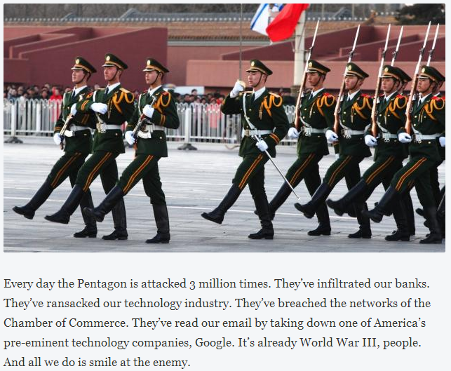
readwrite: World War III Is Already Here - And We're Losing
Notes:
http://readwrite.com/2013/02/05/world-war-iii-is-already-here-and-were-losing

Slide 11
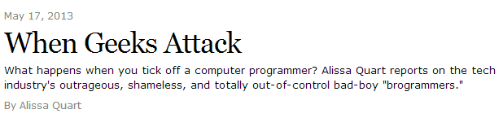
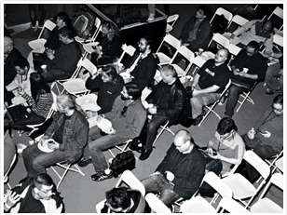
Marie Claire: When Geeks Attack
Apparently these are the “brogrammers” mentioned.

Slide 12
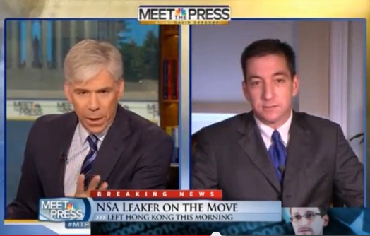
Meet the Press: David Gregory
To the extent you have aided and abetted Snowden, even in his current movements. Why shouldn’t you, Mr. Greenwald, be charged with a crime?
Notes:
To the extent you have aided and abetted Snowden, even in his current movements. Why shouldn’t you, Mr. Greenwald, be charged with a crime?

Slide 13
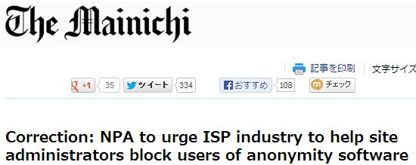
Mainichi English version reports on the National Police Agency of Japan asking ISPs to block Tor access.
Turns out actually it was a "voluntary recommendation to content providers" and not a mandatory request to ISPs.
The article got picked up by Wired.com UK and then ArsTechnica, The Register and spread like wildfire.
… after receiving numerous corrections from the Japanese readers and issued a correction…
Notes:
Mainichi English version reports on the National Police Agency of Japan asking ISPs to block Tor access.
Turns out actually it was a "voluntary recommendation to content providers" and not a mandatory request to ISPs.
The article got picked up by Wired.com UK and then ArsTechnica, The Register and spread like wildfire.
Somebody sets up a change.org petition to counter the NPAs request.
The newspaper after receiving numerous corrections from the Japanese readers and issued a correction to the article and said it was contacting all other media outlets to reflect the correction.

Slide 14
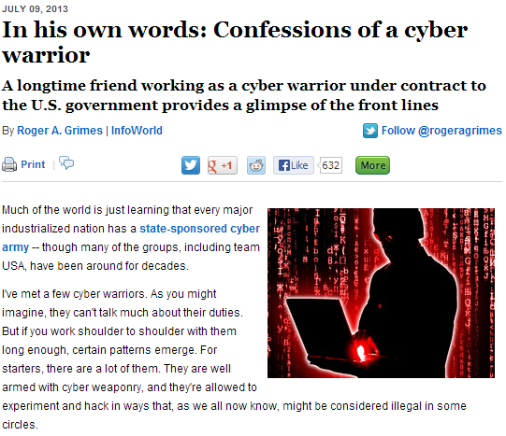
InfoWorld: Confessions of a Cyber Warrior

Slide 15
Best Privacy Enhancing Technology Since DEF CON 20
Ghostery (http://www.ghostery.com/)
Disconnect2 (https://disconnect.me/)
Twitter 2-Factor Auth (https://twitter.com/account/settings)
"Onion Pi" Rasberry (http://learn.adafruit.com/onion-pi/)
Notes:
All nominations:
Ghostery x2
Disconnect2 (https://disconnect.me/) x2
Twitter 2-Factor Auth
"Onion Pi" Rasberry
Disqualified:
Cryptocat (pre-DC20)
Anything from Whisper Systems and/or TOR (Vague)
2-Factor Auth (not specific)
Cloud Cracker - https://www.cloudcracker.com/ (not enhancing)
FaceDancer by Travis Goodspeed (pre-DC20)
Droidwall (pre-DC20)
TrueCrypt (pre-DC20)
Webroot SecureAnywhere (pre-DC20)

Slide 16

Worst Privacy Enhancing Technology Since DEF CON 20
PRISM
  (announced since DC20!)
Ciphercloud
  “Bogus security claims”
  “Abusing DMCA as defense”
Gmail
  (no reason given)
WifiSugar
  “Proof is in the website”
(Image not meant to be influencing)
Notes:
All nominations:
PRISM x5
Ghostery
CipherCloud
Gmail
The Cloud
Google Glass
NoScript
OAuth
Wifisugar
Burner (android app)
Internet Password Notebook

Slide 17
Best Twitter Feed
Tweets
Followers
@ioerror 46,882 49,090
@moxie 3,541 22,141
@YourAnonNews 68,381 1,173,985
@spacerog 15,976 5,370
@TheHackersNews 16,673 94,345
@HackerHuntress 23,250 2,933
Notes:
http://attrition.org/errata/plagiarism/thehackernews/ - Serial plagiarists.
Stats as of 7/24/2013
All nominations:
@SecurityJackass
@ioerror x2
@CyberSquirrel1
@spacerog
@TheHackerNews
@Moxie
@Packet_storm
@Mikko
@xzeroPoint
@m3g9tr0n
@SocEngineerInc
@HackerHuntress
@banashide
@dakami
@YourAnonNews

Slide 18
Nit-Twit Award
Tweets
Followers
@th3j35t3r 5,685 56,934
@Wh1t3Rabbit 36,674 8,504
@asherahresearch 49,446 3,017
@GregoryDEvans 12,047 37,101 *
@adainitiative 2,574 3,447
* Gregory D. Evans Pays For Twitter Followers
http://attrition.org/errata/charlatan/gregory_evans/evans31/
Notes:
All nominations:
@GregoryDEvans
@th3j35t3r
“That guy from Forbes”
@Wh1t3Rabbit x2
@thegrugq
@asherahresearch
@YourAnonNews
@Cyber_War_News
@attritionorg
@whitehackerz1
@adainitiative
@c0ndornipples
@aloria

Slide 19
Best Project by an Approved DEF CON Group
Honeypot that can bite: Reverse Penetration
  http://media.blackhat.com/eu-13/briefings/Sintsov/bh-eu-13-honeypot-sintsov-wp.pdf
MITM All The IPv6 Things
  http://www.defcon.org/html/defcon-21/dc-21-speakers.html
(P.S. Honeypot got 9 votes. MITM got 1. #hackthevote)
Notes:
Honeypot that can bite: Reverse penetration x9
http://media.blackhat.com/eu-13/briefings/Sintsov/bh-eu-13-honeypot-sintsov-wp.pdf
MITM All The IPv6 Things
http://www.defcon.org/html/defcon-21/dc-21-speakers.html
9 votes for the first, is more than any other nomination in any category got. #hackthevote

Slide 20
Worst Security Buzz Word Since DEF CON 20
APT
Cloud
CEH
Ada Initiative
Anonymous
Cyber
China
Snowden
Notes:
All nominations:
Cloud x3
Privacy x2
Snowden principle
APT / APT1 x5
China / China did it! x2
Anonymous (hacker group)
NSA
HyperVisor
CEH
Targeted Attacks
Ada Initiative
Watering Hole Attack
Cyber
SCADA
Chris Russo x2

Slide 21
Biggest Law Enforcement / Legal System Blunder Since DC 20
PRISM / NSA Snooping
Weev / @rabite
Aaron Schwartz Case
CISPA
(We think it is fair to declare all of these winners of this category.)
Notes:
All nominations:
Hiring Edward Snowden
Weev / @rabite x3
Aaron Schwartz Case x2
PRISM / NSA Snooping x9
Florida banning all computers
Australian Police arresting leader of LulzSec
Japanese Police arresting 5 for “threats to public safety” (that were victims of a RAT)
CISPA x2
Prenda Law

Slide 22
Unofficial Awards
(chosen by us Jericho)
Best Con Awards Show
  The Pwnies
Most Cleverist and Funniest Security Twitter Feed <3
  @SecurityHumor
Best Book on Phreaking This Year
  Exploding the Phone: The Untold Story of the Teenagers and Outlaws who Hacked Ma Bell
Internet/Hacker/Security Historian of the Year
  Jason Scott
Most prolific tweeter, most desperate for an award
  @0xabad1dea
Notes:
http://www.amazon.com/exec/obidos/ISBN=080212061X/insekurityorgA/

Slide 23
Security Charlatan Award
Nominations
Ankit Fadia *
Rahul Tyagi *
Kim ‘DotCom’ Shmitz *
Fortinet Security
Chris Russo
(Appears on attrition.org Errata page)
Notes:
All nominations:
Ankit Fadia x4
Rahul Tyagi
Fernando Gont
Th3j35t3r
Kim DotCom / Shmitz
General Keith Alexander
Jeff Carr
CipherCloud (product not person)
Verizon
NSA
Microsoft Oracle
Fortinet Security
Kim Ponder
Ada Initiative – 2 leaders
Chris Russo x3
Mike Rodgers (CISPA)
Andres Velazquez CTO of MATTICA

Slide 24
DC21 - Winners
Best Media Coverage of Hacker/Security (Any media)
  RT.com
Worst Media Coverage of Hacker/Security (Any media)
  readwrite
Best Privacy Enhancing Tech Since DC20
  Onion Pi
Worst Privacy Enhancing Tech Since DC20
  PRISM
Best Security or Hacker Twitter Feed
  @spacerog

Slide 25
DC21 - Winners
“Nit-Twit” – Worst Twitter Feed (Sec/Hack)
  The Ada Initiative / @adainitiative
Best DEF CON Group Project (Approved)
  Honeypot that can bite
Worst / Most Meaningless Security Buzzword
  “cyber”
Biggest Law Enforcement Blunder Since DC20
  (All Nominations, Joint Win)
Security Charlatan of the Year
  Kim “DotCom” Shmitz

