Slide 1
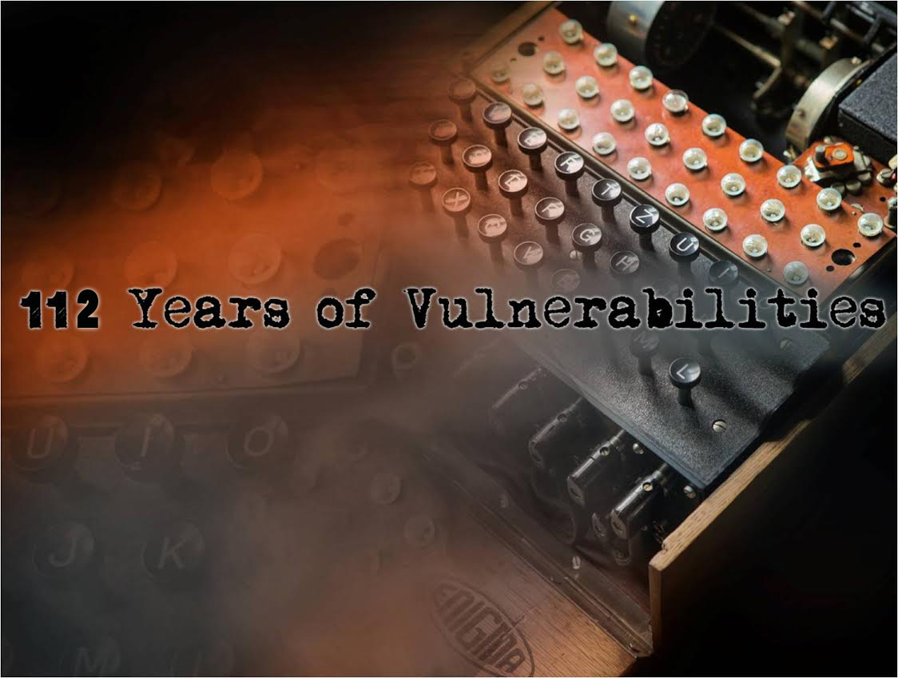
How did we get here, knowing what we know?
Notes:
Image: Photos by Ed Skoudis, graphics enhancements by Mar, off white text me!
Computer security is in bad shape. No, that is putting it nicely. Our state of security is entirely dismal. Apologists will sometimes dismiss this as our industry being 'young'. Sure, compared to building pyramids or fire, it is. But compared to the modern car industry, circa Ford and their Model T in 1908? Our industry is arguably just as old. And to go with that age, vulnerabilities from back then are still plaguing us to this day. How did we get here, knowing what we know?
This talk will give a brief but amusing overview of the history of vulnerabilities. With each crazy story we will see that the lessons buried in our history are just as important now as they were then. Yet, miraculously, we've somehow ignored that... This talk is not about painting a complete history, as that would take several books. This is about perspective.
So first, a few quick rules…

Slide 2
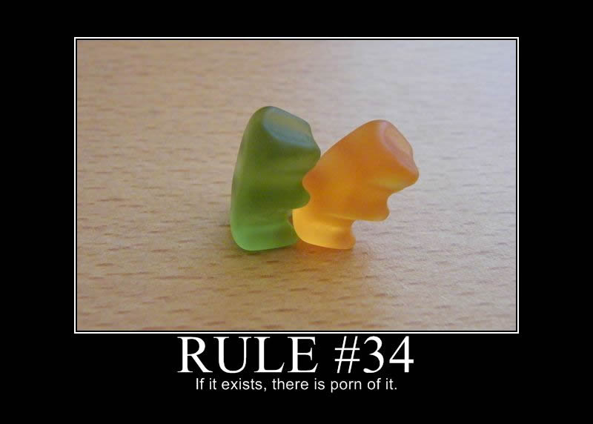
Notes:
Have questions? Wait until the end.
If I am wrong about something? Interrupt me.
(If you are right, I will make amends. If you are wrong, you will be mocked.)
Those familiar with my past talks will notice a change in style this time…
Image source:
http://i1.kym-cdn.com/photos/images/original/000/328/179/652.jpg

Slide 3
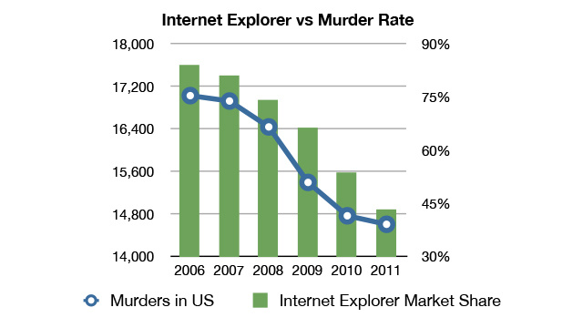
Why Vulnerability Stats Suck
Stats are presented without understanding the limits of the data
Even if explanations are provided, correlation is confused with causation:
Notes:
Rather than charts and bullets, this presentation is narrative.
And now a quick disclaimer…
http://gizmodo.com/5977989/internet-explorer-vs-murder-rate-will-be-your-favorite-chart-today
https://twitter.com/altonncf/status/293392615225823232

Slide 4
Disclaimer
By listening to presenter, you agree to be bound by all of the terms and conditions below, which are intended to be fully effective and binding upon all FTC attendees. By watching this presentation, you agree not to hold me responsible for anything. And I mean anything. Ever. All material, opinions, insults, rants, and nervous breakdowns are solely on behalf of the presenter, not his employer, past employers, attrition.org staff, squirrels, probation officer, AA sponsor, physical therapist, favorite dealer, or family that has since disowned him. Still not responsible. By watching this presentation, you hereby agree to never malign misunderstood creatures (e.g. squirrels, moles, voles, chinchillas, chipmunks, otters, possums, guinea pigs, alpacas, hedgehogs, aardvarks, sloths, aardvarks, nutria, capybara, porcupines, stoats, pygmy jerboas, prairie dogs, dormouse, turtles, ducklings, llamas, owls, goslings, platypus, tarsiers, skunks, prairie dogs, capybara, beavers, hedgehogs, bunnies, meerkats, mongoose, giant elephant shrew, penguins, olinguitos, hispaniolan solenodons, puffins, potoo birds, dik dik, red crested tree rats, pink fairy armadillos, aye-aye, naked mole rats, sunda colugo, blob fish, lowland streaked tenrees, glaucus atlanticus, koalas, ginger seals, axolotl, tarsier, and pika). By sitting in this room, you further agree to praise the glory of llamas, mini pigs, goats, and sheep. Presentation may contain peanuts. For external use only. Nutrition information not available. Terms are subject to change without notice; frequently and often. Keep presenter out of reach of children, adults, and charlatans. Do not feed presenter after midnight. Hand wash only, tumble dry on low heat. Warning: presenter may become slippery if Vaseline liberally applied. Presenter not a contraceptive device. Presenter not approved by FAA regulations. Reader assumes full responsibility. Professional driver, closed course. Disclaimer may not be up to date. Still not responsible. No money down. No purchase necessary. Call before you dig. If you are reading this disclaimer by mistake, please destroy all copies, don’t share this valuable information, and then gouge your eyes out for being in the wrong conference. Mileage may vary. Objects in presentation are bigger than they appear. Everything is true to the best of our knowledge. God kills a lawyer every time someone reads a legal disclaimer. Remember to spay or neuter your pets. This agreement shall be deemed to be an agreement entered into in the state of Colorado (or Guam). The laws of rational thinking and ethics shall govern this agreement. Complaints may be directed to the hostile, armed squirrel bodyguard. All sales are final. If rash, irritation, redness, or swelling develops, discontinue reading. Allow four to six weeks for delivery. Other restrictions or restraints may or may not apply. Any similarity to actual opinions, living or dead, is purely coincidental. Any society that needs disclaimers has too many lawyers. Besides, only lawyers and neurotics read this crap anyway, right? Any spelling or grammar errors in this presentation exist to make CF lose sleep. Anything you say can and will be used against you. 83.7% of statistics are made up. I claim no responsibility for the following disclaimer. I plead the fifth. I will drink the fifth when available. Must be 18 years of age or older to proceed further. Postage will be paid by addressee. Use only as directed. All actors and the characters they portray are 18 years of age or older, pursuant to 18 U.S.C. 2257 (A)-(C) and C.F.A Part 75. All records required are on file with the custodian of records. No user-serviceable parts inside. Do not disturb. Your seat cushion can be used as a flotation device. No trespassing. One size fits all. Many suitcases look alike. No shoes, no shirt, no problem. Do not stop on railroad tracks. Calls may be monitored for quality assurance or training purposes. Winners need not be present to win. Void where prohibited, taxed, or otherwise restricted. Caveat emptor.
Notes:
This is legally binding because you looked at it!

Slide 5

Notes:
That was of course legally binding, thanks for reading.
Hopefully we’re all adults here, if not this is for you…
On the top of persona, who am I?

Slide 6
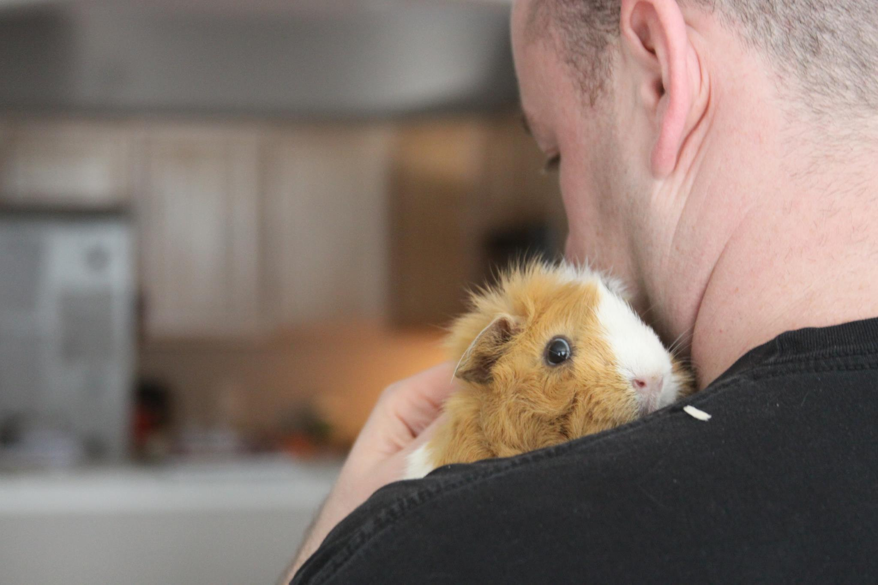
Notes:
Just some guy who likes small misunderstood creatures. That’s zesty.
Ok, the part that matters?

Slide 7
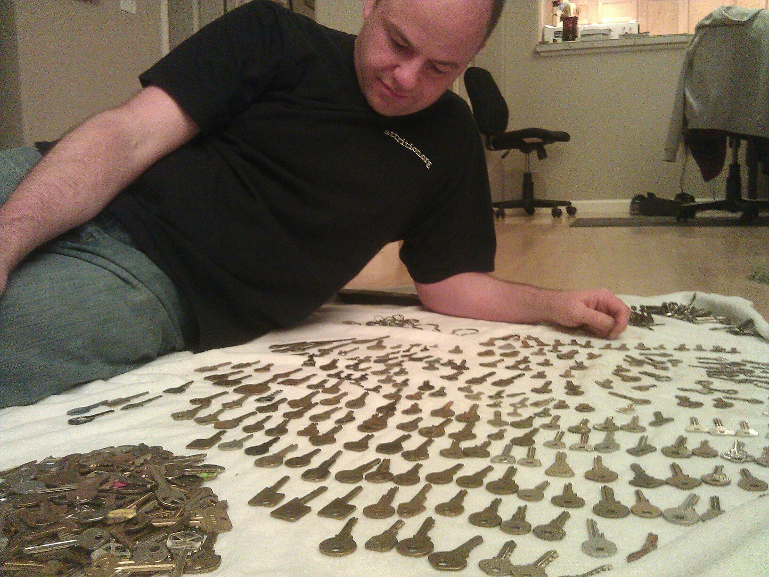
Notes:
I collect things. Always have. This matters because…

Slide 8

Collect all the Vulns
106,803 vulnerabilities
84,766 products
10,388 vendors
7,923 researchers
112 years
… spanning
… from
… disclosed by
… over
@OSVDB
Notes:
… I collect vulnerabilities just like anyone else collects stamps, coins, or STDs.
No that is not a rum-induced typo. 112 years. We’ll get there shortly.
What went into preparing for this talk?
More info: http://opensecurityfoundation.org/
More info: http://osvdb.org/
Numbers as of 2014-05-24

Slide 9
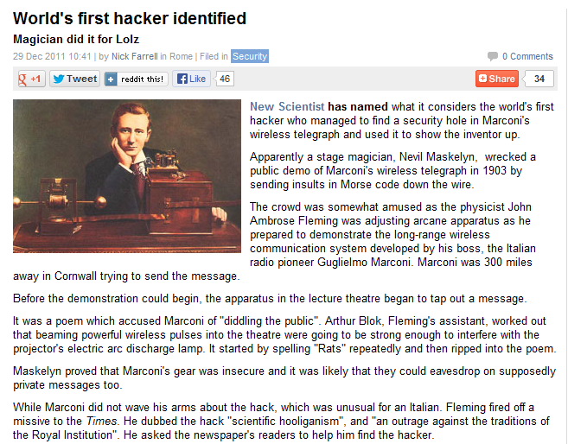
Notes:
Well, I read some articles…
e.g. http://news.techeye.net/security/worlds-first-hacker-identified

Slide 10
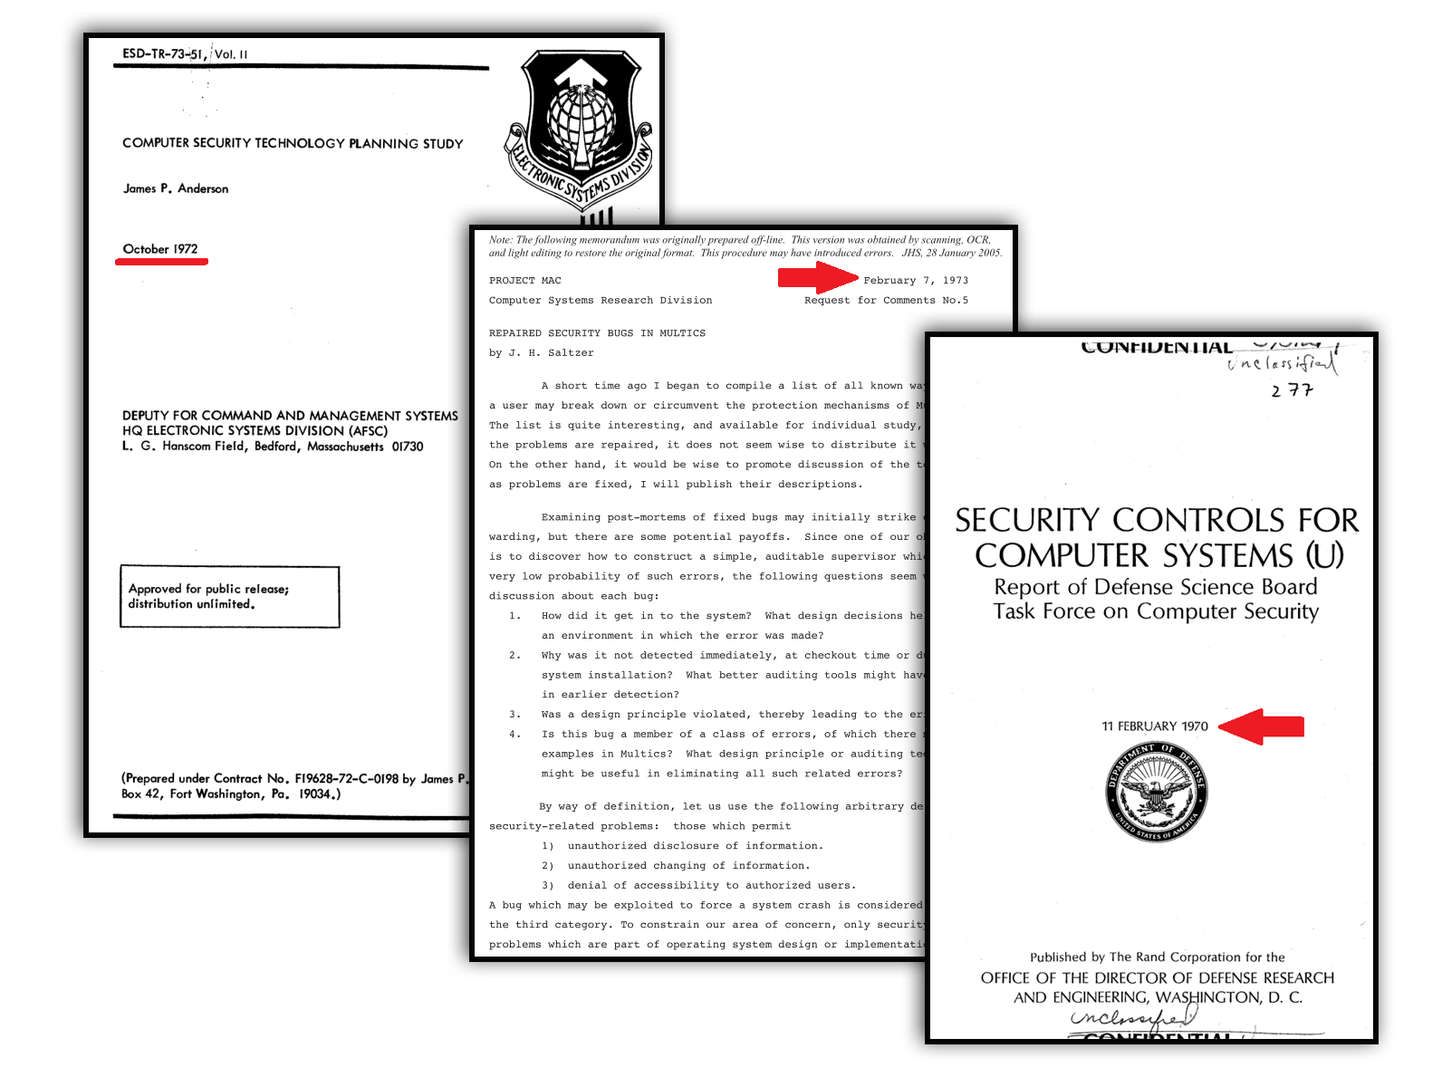
Notes:
I read some fun research papers… circa early 70’s
Pictured:
“Computer Security Technology Planning Study” by James P. Anderson, October 1972
Per author request: “should not be referenced in other publications”, February 1973
“Security Controls for Computer Systems (U)” by Report of Defense Science Board Task Force on Computer Security, February 1970

Slide 11
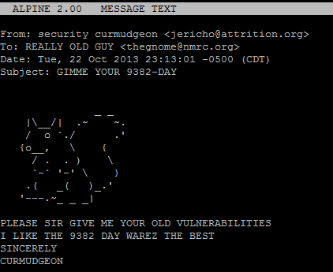
Notes:
I emailed a lot of people older, smarter, and wiser than I…
A few examples:
Simple Nomad, Jerry Saltzer, David A. Curry, Tom Van Vleck, Bill Ricker, and many many more. Sincere thanks for them indulging me on my quest for ancient vulnerabilities.

Slide 12
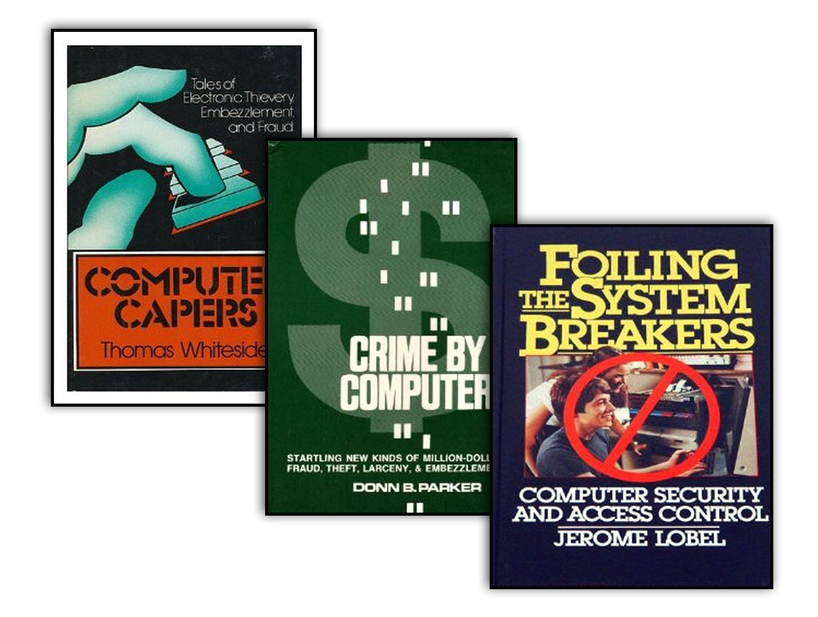
Circa 1973
Notes:
I read some books for perspective… and what did this lead me to to? This talk.
So an overview… On the surface this will seem like a sad and depressing talk…
Pictured:
http://www.amazon.com/exec/obidos/ISBN=069001743X/insekurityorgA/
http://www.amazon.com/exec/obidos/ISBN=0684155761/insekurityorgA/
http://www.amazon.com/exec/obidos/ISBN=007038357X/insekurityorgA/

Slide 13
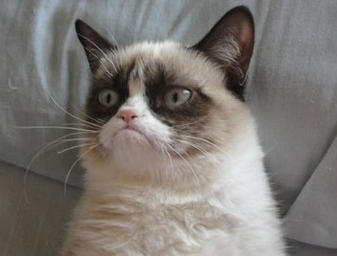
Notes:
In reality it should hopefully motivate and encourage you to do better moving forward.
Image source: http://dashburst.com/10-cats-grumpier-than-grumpy-cat/

Slide 14

Notes:
If we can fix things, everyone is happy. Let’s face it, we all know how bad things are…
Image source: http://www.catster.com/molz/happy-cat-is-happy

Slide 15
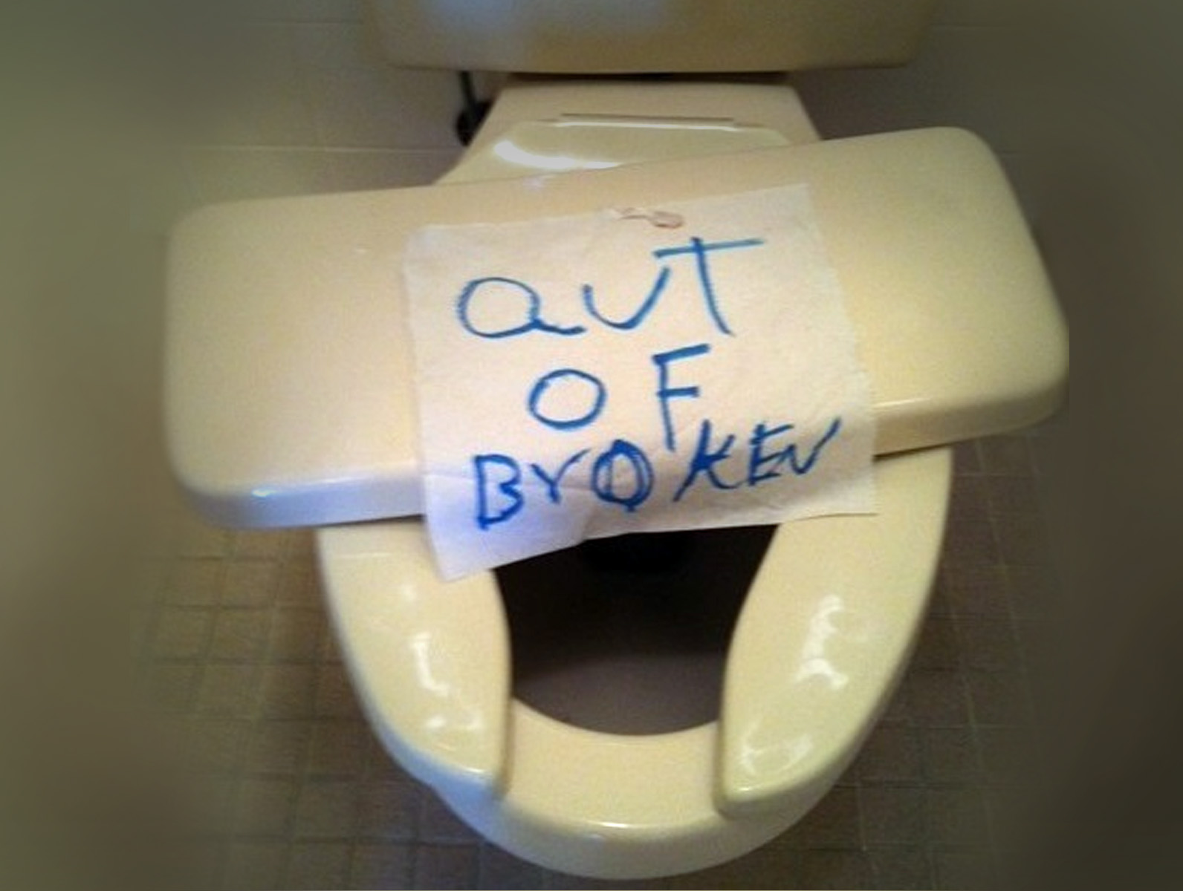
Notes:
But this talk will hopefully give you MORE historical perspective to fully understand and appreciate where we really are.
There is a common saying regarding history…
Image source: http://cheezburger.com/6132125696

Slide 16
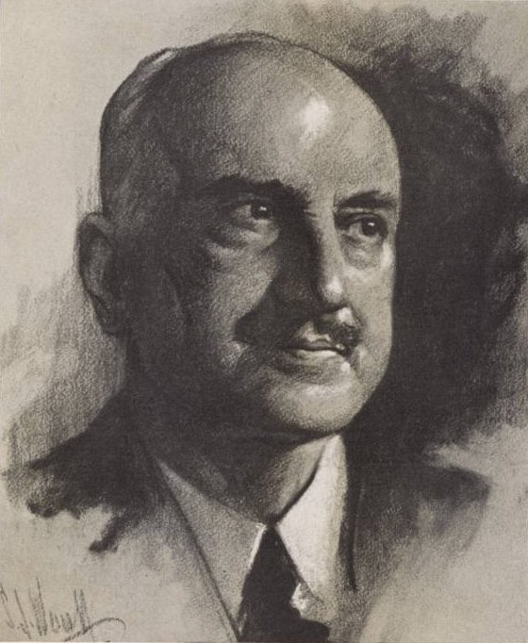
George Santayana
“Those who cannot remember the past are condemned to repeat it.”
Notes:
Those who cannot remember the past are condemned to repeat it. Of course, this spawned a hundred variations that we now also attribute to Shepard, Burke, Vonnegut, and the esteemed Jesse Ventura, but who’s counting!
Ok enough intro, let’s get to the meat of this presentation. When talking about vulnerability history, you really have to pick a start date and that may be a bit arbitrary.
http://en.wikiquote.org/wiki/George_Santayana
http://www.goodreads.com/quotes/tag/doomed-to-repeat-it

Slide 17



Notes:
Ten years ago I would have picked the 1960’s. Five years ago the 1950’s, three years or arguably the 1930’s. Now…
Images from http://www.retrowaste.com/

Slide 18
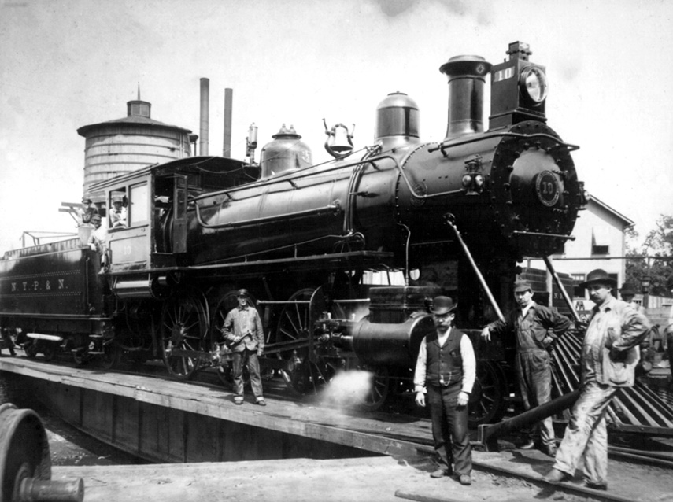
1902
Notes:
I think the early 1900’s is a good start point.
The important part of choosing such a date is to remember that a vulnerability is about the ability to cross privilege boundaries, an big distinction. With that in mind…

Slide 19
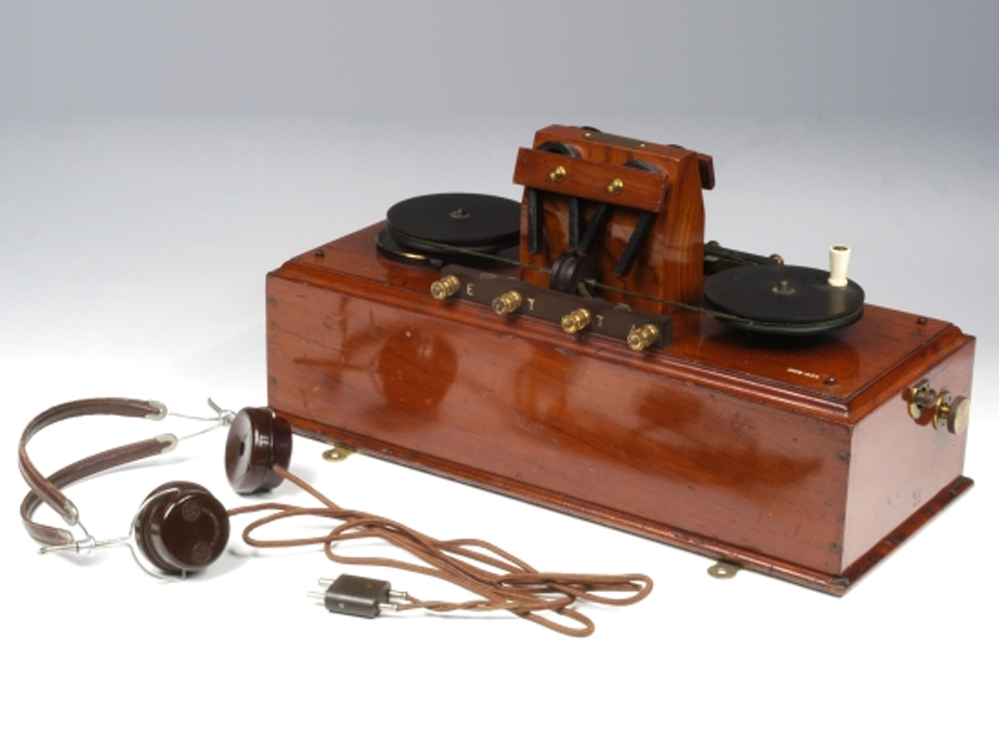
Notes:
We’ll start with the story of the Marconi Wireless Telegraph, courtesy of New Scientist and TechEye.net
Invented in the years leading up to 1903, this was a significant advance in communication technology.
Picture courtesy of http://www.mhs.ox.ac.uk/marconi/exhibition/7777.htm
Full stories:
http://news.techeye.net/security/worlds-first-hacker-identified
http://www.newscientist.com/article/mg21228440.700-dotdashdiss-the-gentleman-hackers-1903-lulz.html
http://wizzley.com/first-hacker-marconi-wireless-1903/
http://www.californiahistoricalradio.com/wp-content/uploads/2013/01/BartWirelessWar190205Lee.pdf

Slide 20
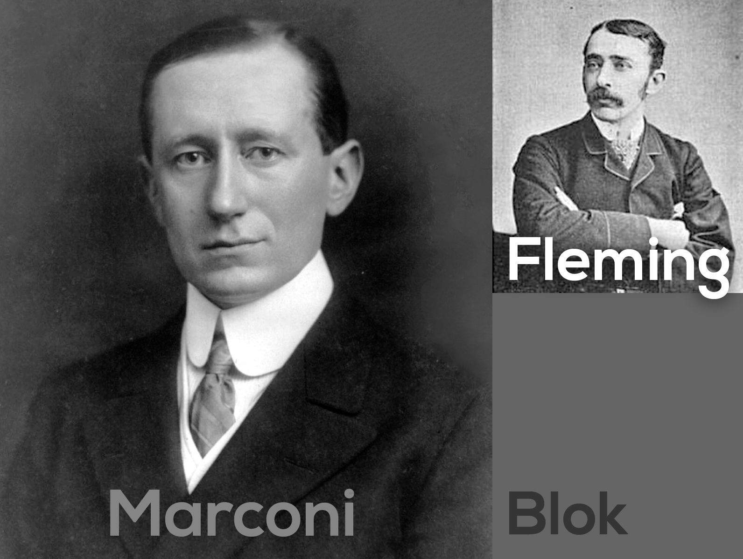
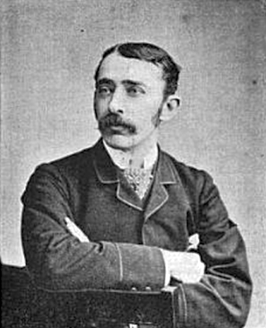
?
Notes:
The primary creator was the Italian Guglielmo Marconi who had assistants John Ambrose Fleming and Arthur Blok at his sides.
Poor Arthur was not important enough to warrant a Wikipedia page, so no picture of him.
Maroni, like most security vendors today, said his device was SECURE and that messages were PRIVATE.
"I can tune my instruments so that no other instrument that is not similarly tuned can tap my messages," Marconi boasted.
http://en.wikipedia.org/wiki/Guglielmo_Marconi
http://en.wikipedia.org/wiki/John_Ambrose_Fleming

Slide 21
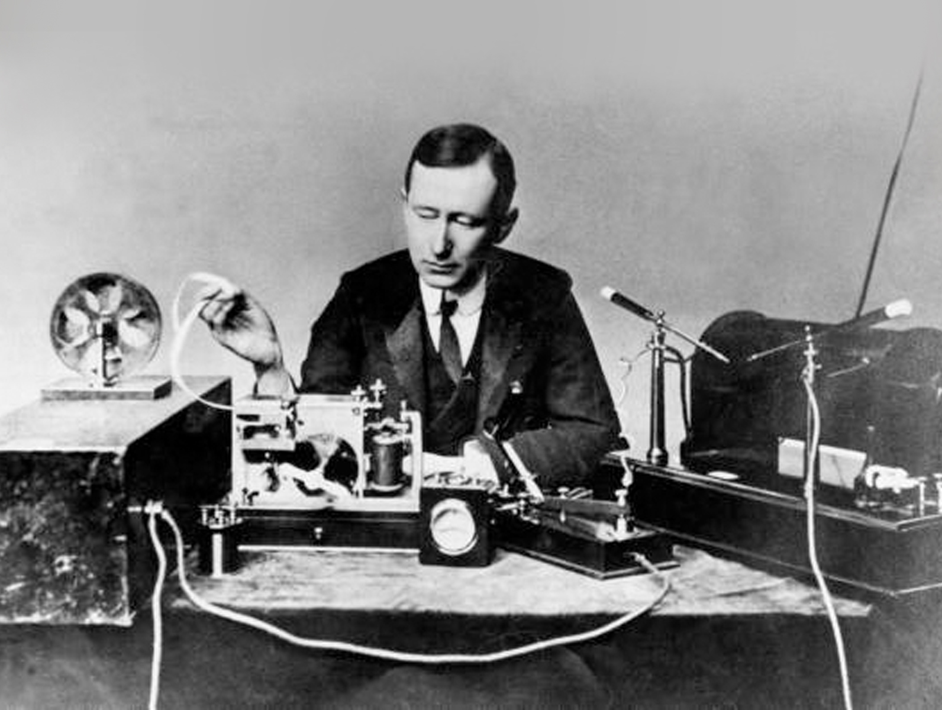
Notes:
To show off his new device, Marconi set up a public demonstration in a theatre. He was in Cornwall, 300 miles away from the demo, ready to send the message.
Fleming was set up to receive the message and impress the crowd.
Minutes before the wirelessly transmitted message was to arrive, the crowd heard a ticking noise from the theatre’s brass projection lantern.
Poor assistant Blok recognized it to be morse code, not the brilliant physicist Fleming with a Wikipedia page.
Blok figured someone was sending powerful wireless pulses that were strong enough to interfere with the projector’s discharge lamp.
Mentally decoding the missive, Blok realized it was spelling one facetious word over and over…
Image source: http://en.wikipedia.org/wiki/Guglielmo_Marconi

Slide 22
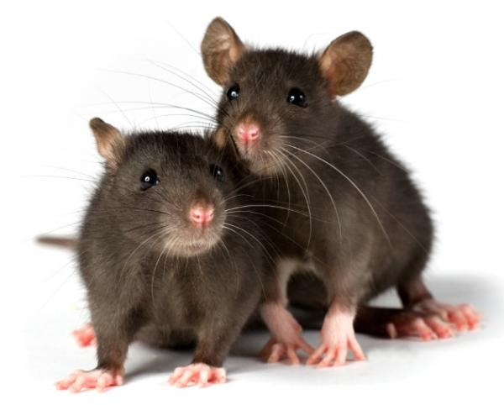
.-. .- - ... .-. .- - ... .-. .- - ... .-. .- - ... .-. .- - ...
Notes:
"Rats“. After that came a string of crude limericks and then personal insults.
Marconi wasn’t happy about this, but like some security vendors today, he wouldn't address critics.
"I will not demonstrate to any man who throws doubt upon the system," he said at the time.
Image source: http://scientopia.org/blogs/scicurious/2012/01/04/sad-lonely-lady-rats-may-really-eat-their-feelings/

Slide 23
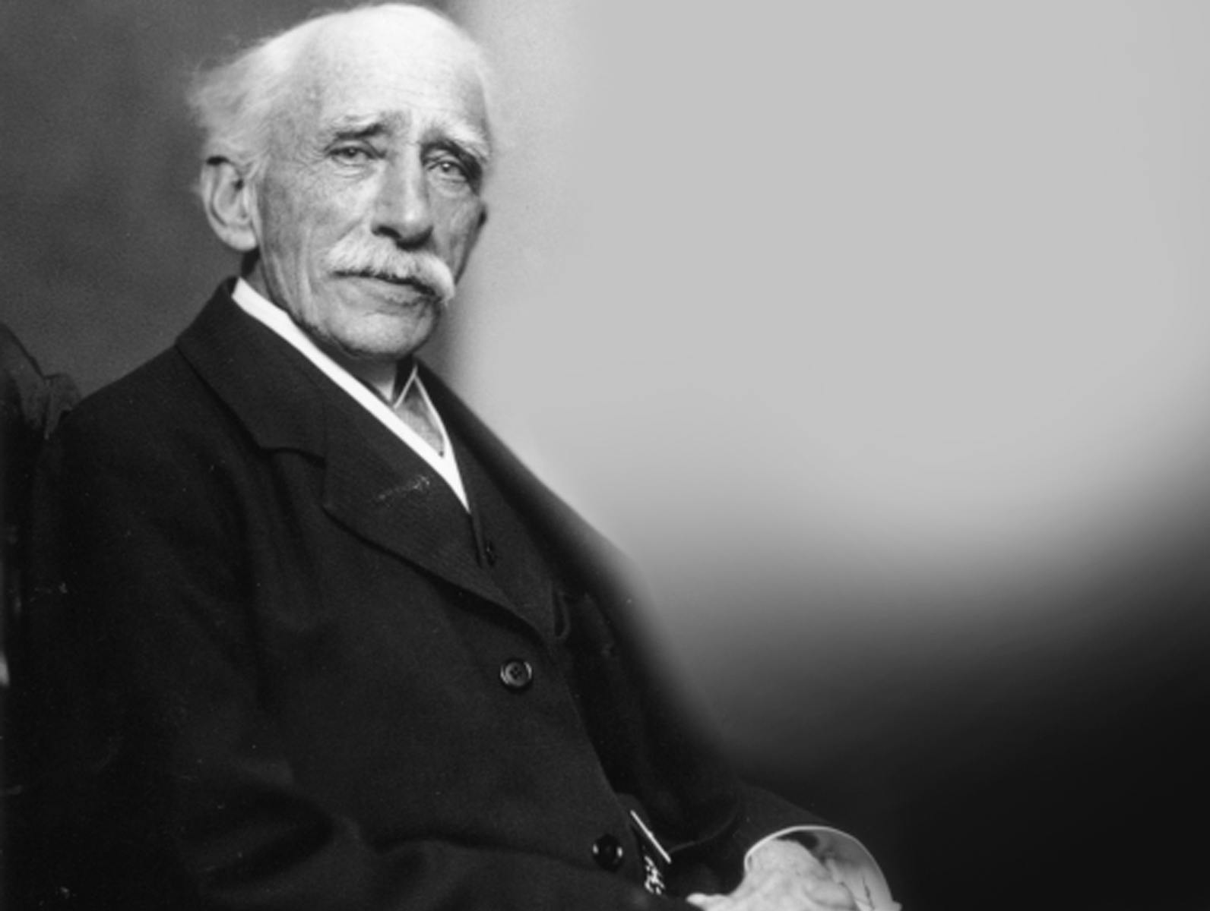
Notes:
His main man Fleming, pictured here later in life, wasn’t so rigid.
He sent a fuming letter to The Times of London dubbing the hack "scientific hooliganism” (wow what an awesome term), and "an outrage against the traditions of the Royal Institution".
Much like vendors today screaming “that isn’t a vulnerability, it’s a design feature!”
Not realizing Marconi was being trolled, he asked the newspaper for help identifying the culprit.
A mere four days later, a gleeful letter confessing to the hack was printed by The Times.
Image source: http://www.biography.com/people/john-ambrose-fleming-9296963

Slide 24
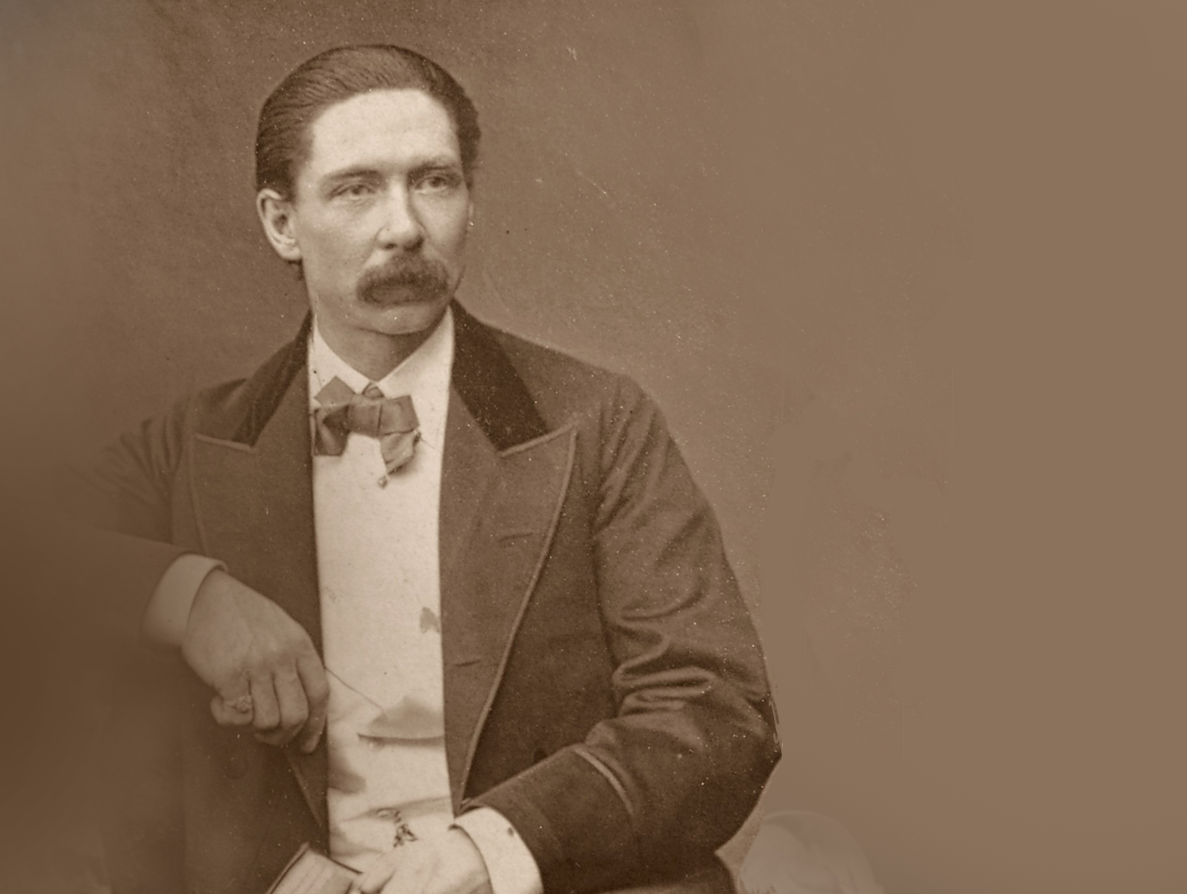
Notes:
This fine mustachioed gentleman, a stage magician and inventor, who decided to troll Marconi and show him that his notions of PRIVATE were a joke, admitted to it.
You arguably have John Nevil Maskelyne as the world’s first ‘modern’ hacker, and like today’s, he was flexing his e-peen.
So Marconi’s patented technology for broadcasting on a “precise wavelength” was shattered before it was on the market
Of course today, we know this to be simple technology. Tune the radio to a different channel…
This resulted in the first two vulnerabilities in OSVDB. Unecrypted transmission of messages for remote MitM disclosure, and message spoofing.
Image source: http://en.wikipedia.org/wiki/John_Nevil_Maskelyne
1902-11-07 Marconi Wireless Telegraph Transmitted Message Remote Disclosure http://osvdb.org/79399
1902-11-07 Marconi Wireless Telegraph Crafted Transmission Message Spoofing Weakness http://osvdb.org/79400

Slide 25
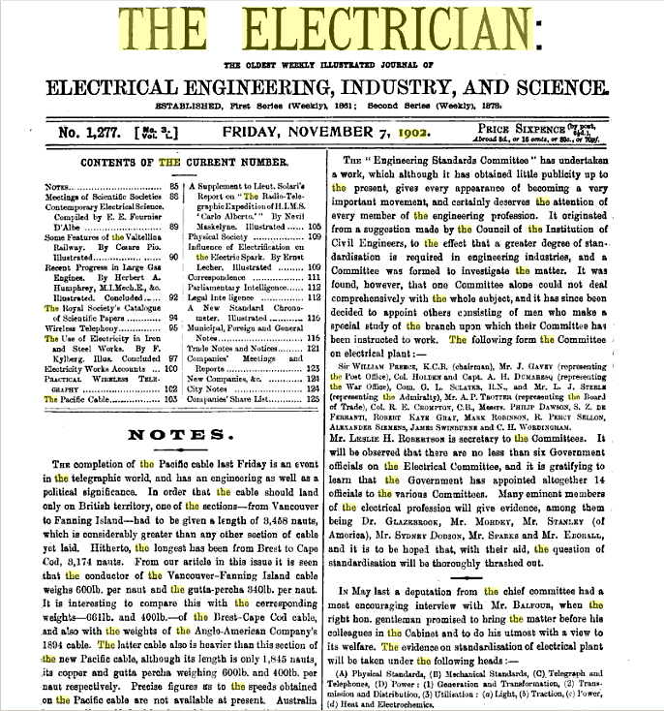
Notes:
But the story goes deeper…
Maskelyne was apparently hired by the Eastern Telegraph Company to undertake spying operations on Marconi over a year before this incident.
Maskelyne had even written an article in the Nov 7, 1902 issue of ‘The Electrician’ about the technology, at least half a year before the demo.
The comparisons to full disclosure, wiley hackers, and Internet trolls is strong in this story. Personally, I am waiting on the movie given all the intrigue and drama.
LESSON: If you say it is secure or private, verify first.
Image from Journal: http://books.google.com/books?id=jhdbAAAAYAAJ&lpg=PA501&ots=w5BK43mVA0&dq=The%20Electrician%201902%20magazine&pg=PA95#v=onepage&q=The%20Electrician%201902%20magazine&f=false
OSVDB:
http://osvdb.org/79399
http://osvdb.org/79400
(As a result of researching this talk, the disclosure date for those vulns was updated from 1903-06-01 to 1902-11-07.)

Slide 26

Notes:
Next we jump to the 1920’s through 1940’s, largely centered around World War 2.
Several countries developed or used electro-mechanical rotor cipher machines for message security.
The most famous was the Enigma, invented by a German engineer named Arthur Scherbius.
Early models were used commercially from the early 1920s and later models used into the 1940s.

Slide 27
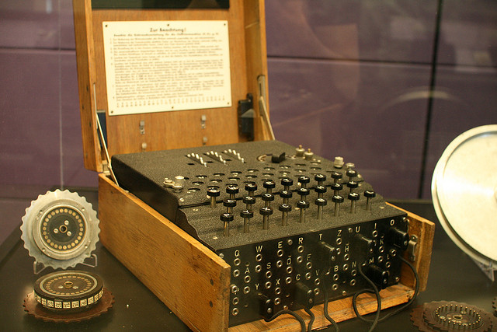
Notes:
Enigma
1932 - first break of German Army Enigma by Marian Rejewski, Jerzy Rózycki and Henryk Zygalski in Poland
Rejewski reverse engineered the device using theoretical mathmatics and material from French military intelligence
Over the coming years subsequent models would be broken by other countries.
While you may be familiar with the movie U-571 and the capture of an Enigma machine, they were actually recovered from a variety of ships and subs.
More info: http://en.wikipedia.org/wiki/Enigma_machine
http://en.wikipedia.org/wiki/Cryptanalysis_of_the_Enigma
Image source: http://www.flickr.com/photos/francois/1162284306/ by François Proulx
1939-07-25 Enigma Machine Limited Persistent Indicator Chosen Message Key Encryption Weakness http://osvdb.org/92994

Slide 28
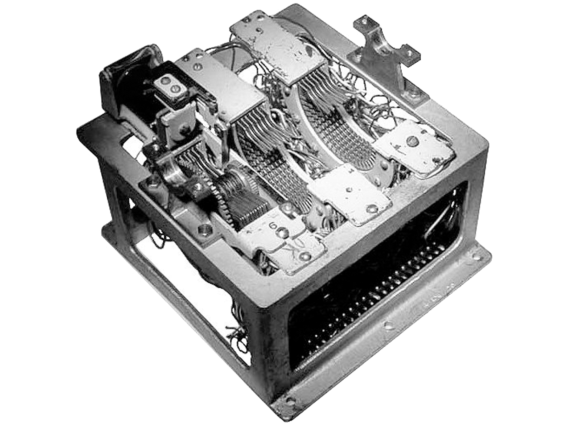
Notes:
Japan: 97-shiki O-bun In-ji-ki, which means Alphabetical Typewriter 97, or just “Purple” and intercepts diplomatic transmissions dubbed “Magic”.
Introduced in 1937, it came after the 91-shiki injiki, aka “Red” that had significant weaknesses
1940 - Break of Japan's Purple machine cipher by U.S. SIS team
http://en.wikipedia.org/wiki/Purple_(cipher_machine)
Image source: http://www.jproc.ca/crypto/purple.html

Slide 29
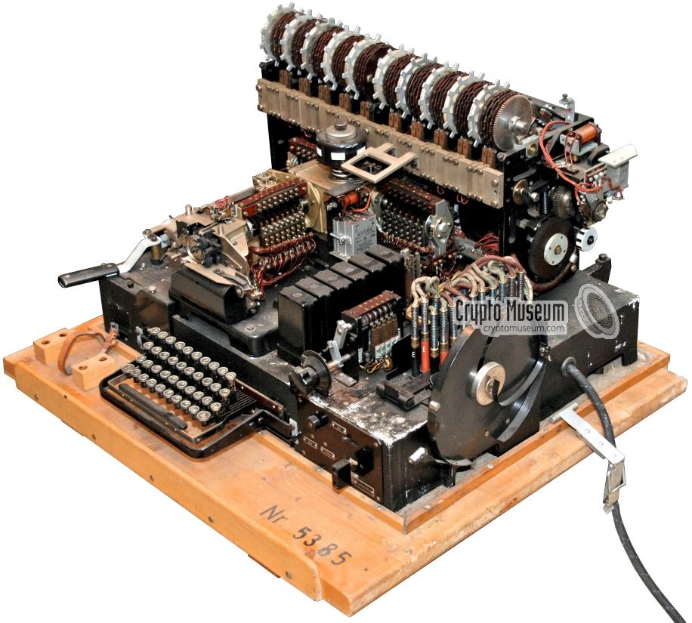
Notes:
Siemens T-52 Geheimschreiber code named “STURGEON”. May 1940, cracked by the Swedes who could tap the hard lines of comms, giving them big advantage.
http://en.wikipedia.org/wiki/STURGEON_%28cryptography%29
http://www.cryptomuseum.com/crypto/siemens/t52/img/t52d_large.jpg

Slide 30
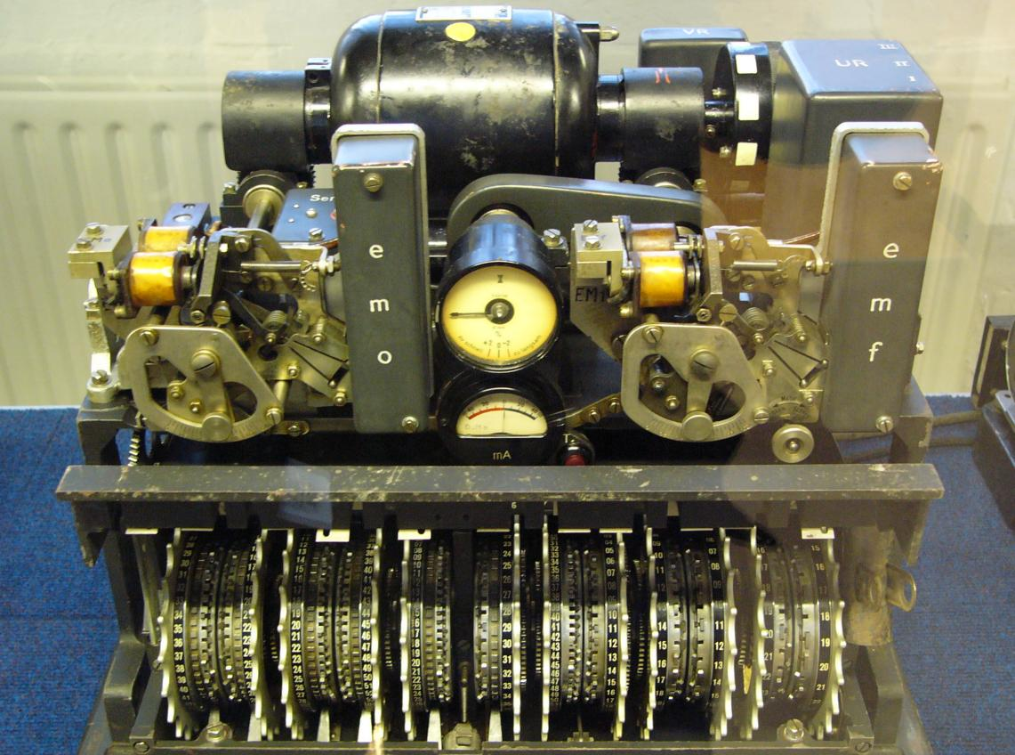
Notes:
Lorenz SZ40, SZ42A and SZ42B. Lorenz was initially cracked in 1942. Aka “TUNNY”
Know it our not, we can thank this little beauty for leading to what came after:
December 1943 - The Colossus computer was built, by Thomas Flowers at The Post Office Research Laboratories in London, to crack the German Lorenz cipher (SZ42).
The Lorenz machine was improved twice (SZ-42a and SZ-42b) and was broken during WWII by the codebreakers at Bletchley Park (UK) with the aid of Colossus…
http://en.wikipedia.org/wiki/Lorenz_cipher
http://upload.wikimedia.org/wikipedia/commons/4/4d/Lorenz-SZ42-2.jpg

Slide 31
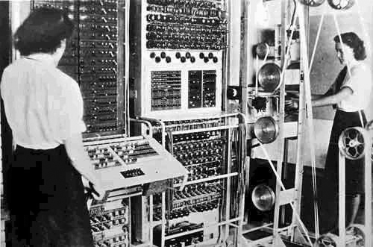
Notes:
One fun takeaway of breaking the Lorenz: it was done with the first electronic SINGLE-purpose DIGITAL computer, named Colossus in 1943.
This predates the Eniac by three years, as it was the first electronic GENERAL-purpose computer in 1946.
The other fun takeaway? Women were working on computers as long as men. #feminism what?
9ft High, 16ft Long, 10ft Wide. 5500 watts power. Equiv to modern PC.
Jumping forward a decade…
Fun Colossus image: http://img.dailymail.co.uk/i/pix/2007/11_02/033COLOSSUS_800x491.jpg
http://en.wikipedia.org/wiki/Colossus_computer
http://en.wikipedia.org/wiki/Eniac

Slide 32
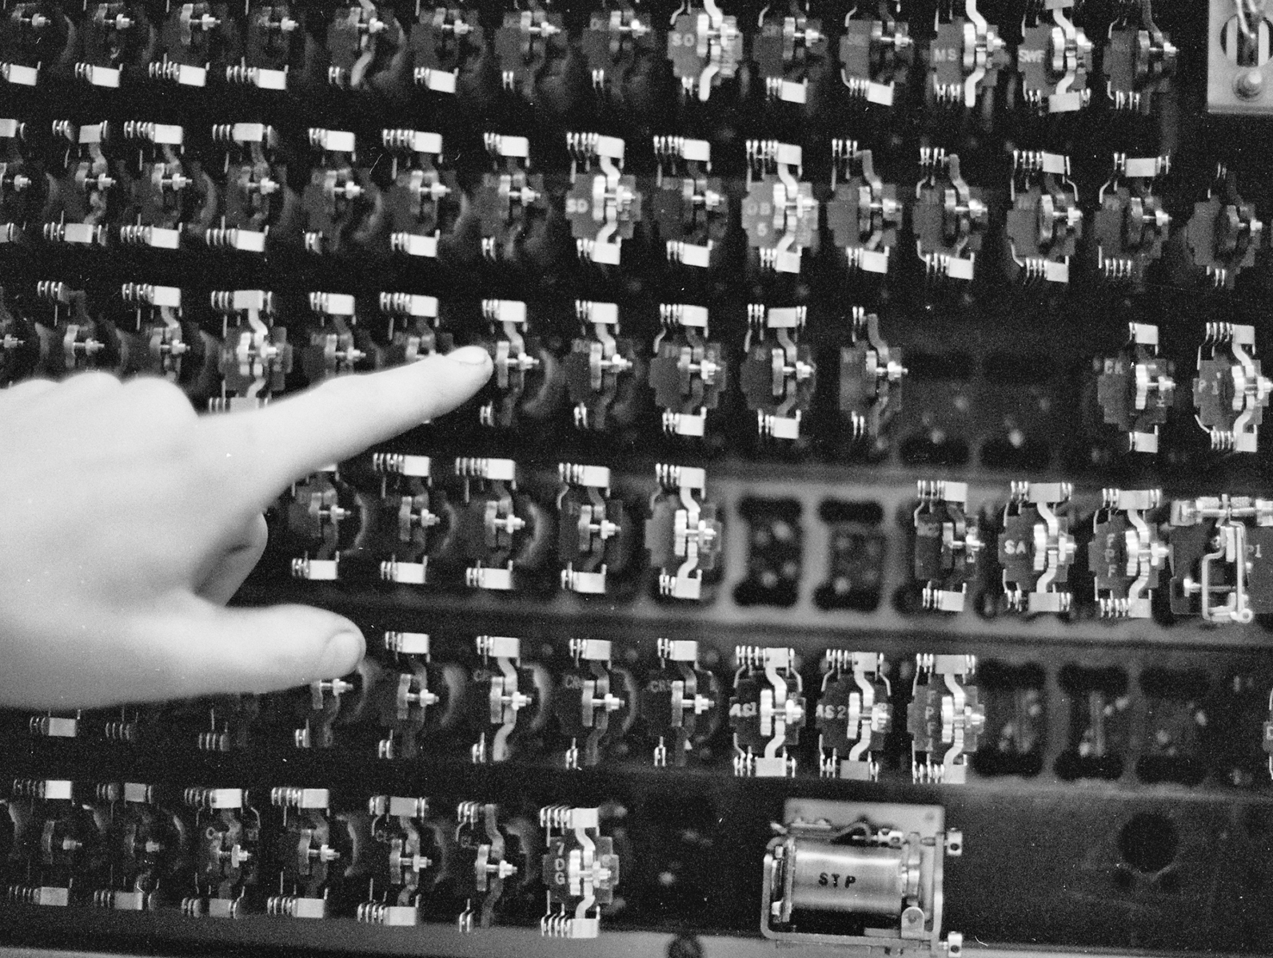
Notes:
1950s – Gave us the Rise of the Phone Phreaks
Many forget these were electro-mechanical machines that evolved into huge digital computers.
In 1955, the Western Electric Labs Panel Machine Switching System had an issue.
It predates the classic blue box by four years. User-supplied input (1000Hz modulated signal) to seize an internal trunk between cities. Then ask the remote operator to connect to a local number. Bypasses billing allowing for free long distance calls.
Image source: http://en.wikipedia.org/wiki/Panel_switch
1955-01-01 Western Electric Labs Panel Machine Switching System (MSS) Ring Forward Signal Spoofing Weakness http://osvdb.org/97295

Slide 33
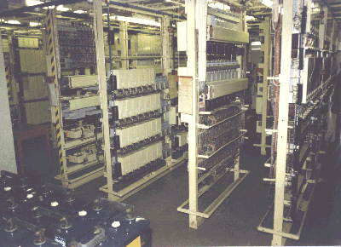
Notes:
In 1956, the Western Electric Crossbar and General Telephone Strowger Step-by-Step suffered from an issue.
The exploit at the time was known as the “black box”. Via a race condition of the phone going on/off hook fast, could make a call without the billing system kicking in.
Image source: http://en.wikipedia.org/wiki/Strowger_switch
1956-07-01 Western Electric Labs Crossbar Switch Off Hook Race Condition Billing System Bypass http://osvdb.org/97334
1956-07-01 General Telephone Strowger Step by Step Switch Off Hook Race Condition Billing System Bypass http://osvdb.org/97335

Slide 34

Notes:
Quick Perspective: The 57 years of vulnerabilities covered so far happened before Hawaii joined the Union on August 21, 1959.
Back to phones…
Image source: http://commons.wikimedia.org/wiki/File:Arothron_hispidus_is_kissing_my_camera_at_Big_Island_of_Hawaii.jpg

Slide 35
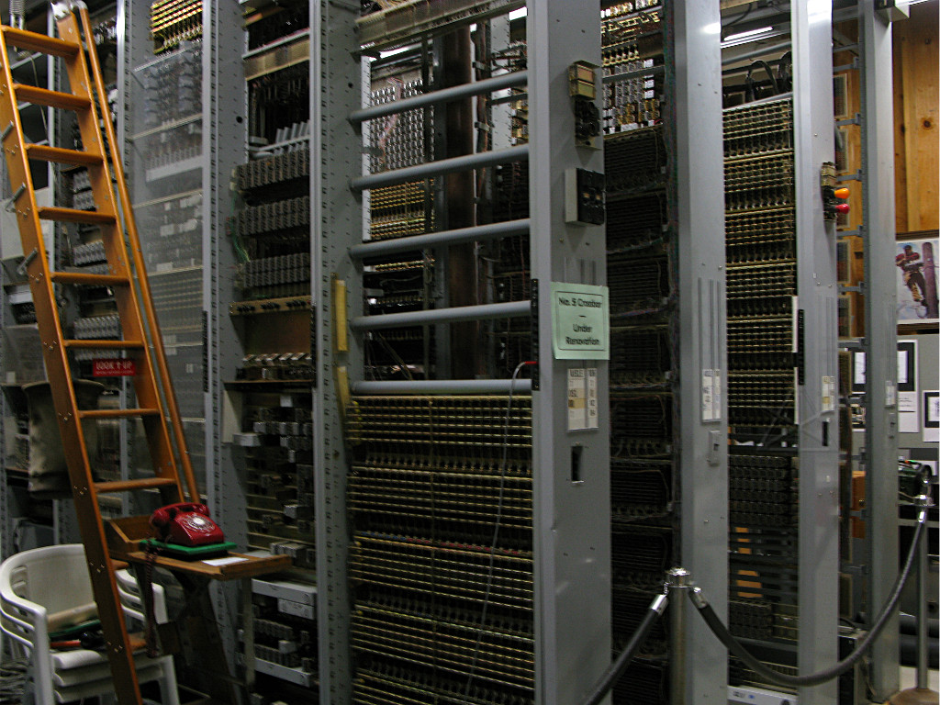
Notes:
In 1960, the Western Electric Labs #4A Crossbar switch was found to have a vulnerability.
The infamous Blue Box. carefully timed 2600Hz tone (or seventh octave E) down the line could trick the remote switch into thinking the trunk is idle. Free call!
Image source: http://techno-fandom.org/~hobbit/pix/rt11a/ from The Telephone Museum in Ellsworth, Maine a 501(c)(3)
1960-12-01 Western Electric Labs #4A Crossbar Tone Spoofing Control Channel Hijacking Weakness http://osvdb.org/97296

Slide 36
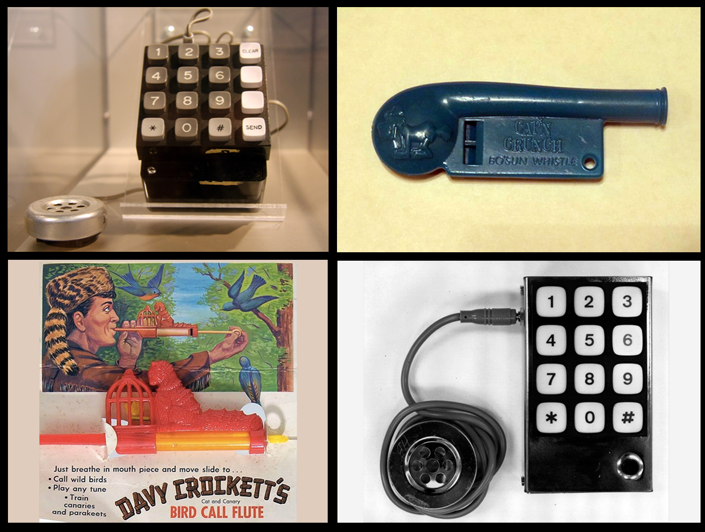
Notes:
This is where the phone company learned the hard way that user input was a bitch.
Both toys and electronics could be used to circumvent the system to make free calls.
This would allow phreaks to abuse the phone system for over a decade, even into the 70’s.
Blue Box (upper left / lower right) from http://www.offcon.org/phone-phreaking-demonstration.html and http://calitreview.com/37426/blind-boys-berkeley-blue-phone-hacks-and-wozniak/
Davy Crockett Cat and Canary Bird Call Flute ( ) from http://www.slate.com/blogs/the_vault/2013/02/01/phone_phreaks_the_toy_whistles_early_hackers_used_to_break_into_the_phone.html
Capn Crunch Bo’sun Whistle ( ) from http://www.slate.com/blogs/the_vault/2013/02/01/phone_phreaks_the_toy_whistles_early_hackers_used_to_break_into_the_phone.html

Slide 37
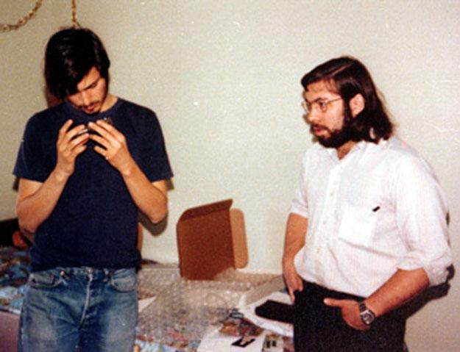
Notes:
And the 70’s… everyone recognizes these two criminals that built an empire on the back of telephone fraud, right? Steve Jobs and Steve Wozniak.
While they came much later, it gives us a recognizable visual for the abuse of the phone system and reminds us that some computer empires were built on crime.

Slide 38
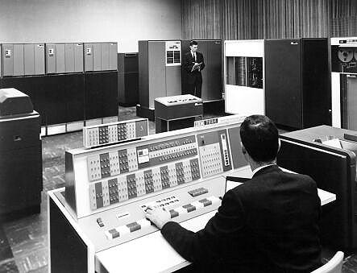
Notes:
OK now the “computer” history we’re more familiar with.
We know the Colossus and Eniac predated what was to come, but the 1960s brought us real multi-user digital machines.
Also brought a handful of computer vulnerabilities that are very familiar to us, even today.
Image source: http://securitywatch.pcmag.com/vulnerabilities/284632-the-world-s-oldest-software-vulnerability (story based on my contest to find the oldest vuln, which is no longer the oldest!)

Slide 39
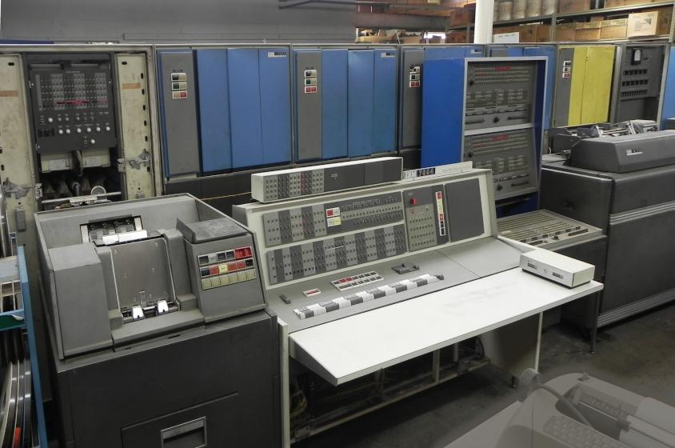
Notes:
This is the IBM 7094, the first multi-user computer system I am aware of that has software vulnerabilities resulting in gaining privileges.
1962-04-02 IBM 7094 CTSS M1416 UACCNT.SECRET Offline Printing User Passwords Local Disclosure http://osvdb.org/80183
1962-04-02 IBM 7094 CTSS Indirect Instruction Cumulative Time Usage Restriction Bypass http://osvdb.org/80182
1965-01-01 IBM 7094 CTSS Indirect Word Indirect Flag Handling XEC Opcode Local DoS http://osvdb.org/80184
1966-01-01 IBM 7094 CTSS System Text Editor Multiple Instance Password File Local Disclosure http://osvdb.org/23257
The offline printing issue happened when a user made an offline printing request for a “secret” file. It contained the unencrypted passwords for every user on the system. So printing it out and being the first one to the printing cabinet, a user could gain access to the passwords of every user on the system.
http://en.wikipedia.org/wiki/Compatible_Time-Sharing_System
http://www.multicians.org/thvv/7094.html
Image source: http://www.piercefuller.com/library/pan7094.html?id=pan7094
I wanted to use this image:
http://www.gettyimages.com/detail/photo/woman-at-computer-control-panel-1960-high-res-stock-photography/10153785#
Since it was high res and showed a woman working on computers again! But GettyImages said no, I would have to pay $685 to use it. Here is my convo with GettyImages:
http://jerichoattrition.wordpress.com/2013/10/17/any-wonder-why-people-use-images-without-attribution/

Slide 40
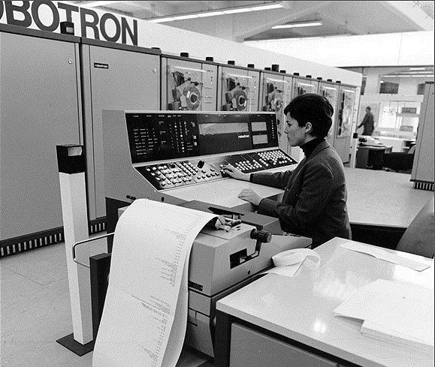
Notes:
While the 1960s were a blip on the radar, the 1970s brought us a lot of fun in the vulnerability world!
Yes that says Robotron! No not the arcade game, a computer made by a German company called GDR.
Oh look, women operating computers historically…
Image source: http://germanhistorydocs.ghi-dc.org/sub_image.cfm?image_id=148

Slide 41
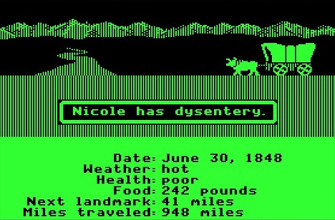
Notes:
Who remembers this wonderful game? Oregon trail!
While not a multi-user game for most of it, you could play it over TTY terminals or the phone line.
It reminds us that even for harmless apps, trusting user input is bad. Kids figured out that inserting a negative value for coins would cause an integer underflow of sorts.
1972-01-01 The Oregon Trail Negative Input Money Manipulation http://osvdb.org/97324
More info: http://web.archive.org/web/*/http://mentalfloss.com/article/51930/legend-oregon-trail
Image source: http://latimesblogs.latimes.com/technology/2009/02/oregon-trail-ip.html
“Soon Dillenberger and Heinemann were sharing The Oregon Trail with their own students, who lined up outside the janitor’s closet after class to take turns. It wasn’t long before the kids found ways to exploit the program’s bugs. Spending a negative amount of money on supplies, for example, increased your cash flow. “Kids are clever,” Dillenberger says, adding that he and Heinemann continually revised the source code to refine the program.”

Slide 42
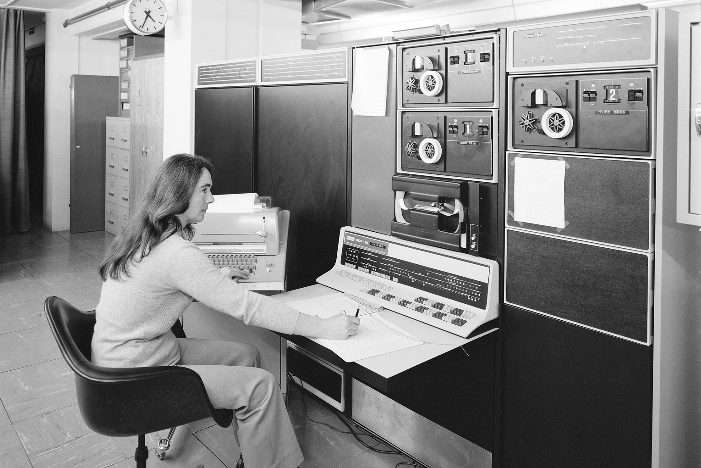
Notes:
This is a PDP-10, manufactured in 1966 and carried into the 80’s. It ran one of two operating systems, either TOPS-10 or TENEX.
In 1972, TENEX was found to have a timing attack vulnerability that allowed a user to figure out another’s password.
It is important to note that this was a timing attack against virtual memory paging that resulted in a password disclosure, while many timing attacks disclosed the last 20 years have been dismissed as impractical.
PDP-10 Info: http://en.wikipedia.org/wiki/PDP-10
Tcsh Info: http://www.herongyang.com/Computer-History/Tcsh-What-Is-Tcsh.html
Image source: http://cds.cern.ch/record/916840
1972-01-01 TENEX Page Fault Race Condition Password Prediction Weakness http://osvdb.org/23199
“By carefully examining the virtual memory paging timing for differential timing for page faults, it is possible to determine if a specific character matched a portion of the password. By performing this timing attack for each character of a password, an attacker could effectively brute force a relatively strong password in a matter of minutes, instead of having to exhaust a majority of the possible password space.”

Slide 43
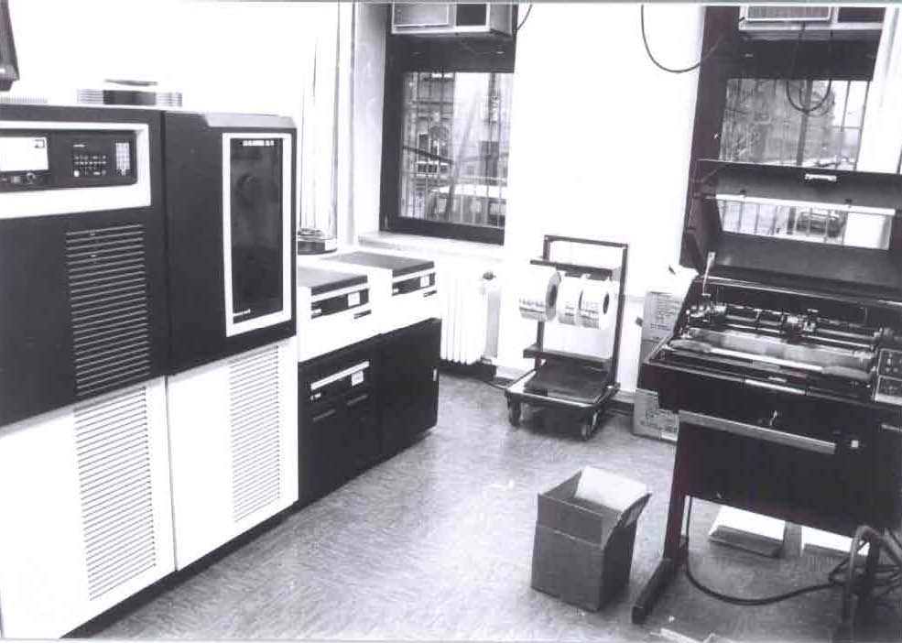
Notes:
This is a Honeywell DPS6 running GCOS-III, or “General Comprehensive Operating System” from GE.
In October, 1972 two vulnerabilities were discovered in it, and another in 1979.
First was a method to abuse the TS FOTRAN compiler to execute commands outside the security envelope.
Second was the File System (FILSYS) module not handling buffers allowing for disclosure of arbitrary user credentials.
Third was unprotected user-accessible memory containing other user passwords.
GCOS Info: http://en.wikipedia.org/wiki/General_Comprehensive_Operating_System
Image source: http://www.teigland.de/19.html
1972-10-01 GCOS-III on HIS 635 TS FORTRAN Assigned GO TO Envelope Bypass http://osvdb.org/22137
1972-10-01 GCOS-III FILSYS Buffer Allocation Information Disclosure http://osvdb.org/22138
1979-01-01 GCOS-III Memory Print Arbitrary Passwords Local Disclosure http://osvdb.org/82445

Slide 44
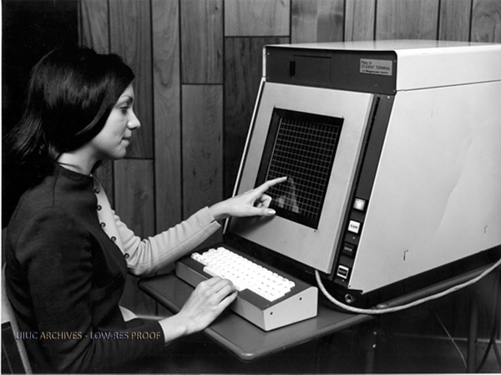
Notes:
The TUTOR programming language was developed for the PLATO IV computer system seen here.
With a crafted ‘ext’ command sent to a remote terminal, could lock it up requiring a power reset to fix. And remote Denial of Service is born!
Info on TUTOR: http://en.wikipedia.org/wiki/TUTOR_(programming_language)
Info on PLATO IV: http://en.wikipedia.org/wiki/PLATO_(computer_system)
Image source: http://web.archive.org/web/20110618184853/http://edudemic.com/2011/04/classroom-technology
Note: Image watermark (UIUC Archive) indicates original point of origin http://www.library.illinois.edu/hpnl/genealogy/uiuc.html
1974-01-01 TUTOR on PLATO IV ext Command Remote DoS http://osvdb.org/66172

Slide 45
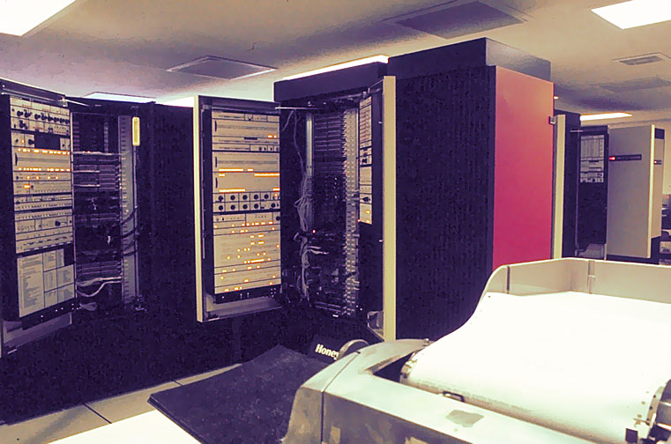
Notes:
MIT’s Honeywell 6180, one of many computers that ran Multics, "Multiplexed Information and Computing Service".
In the 70’s, there were at least 16 vulnerabilities in Multics. I’d like to point out that since I first gave this talk in November, 2013, I have dug up 6 additional vulns on Multics in the 70s. There are more out there…
Statistically, Multics was kind of the Oracle of the 1970’s.
More info: http://www.multicians.org/security.html
Image source: http://www.multicians.org/features.html
1974-06-01 Multics on HIS 645 mxerror Crafted signaller|0 Local DoS http://osvdb.org/22133
1974-06-01 Multics on HIS 645 Unlocked Stack Base Master Mode Privilege Escalation http://osvdb.org/22134
1974-06-01 Multics on HIS 645 Execute Instruction SDW Access Check Bypass http://osvdb.org/22135
1974-06-01 Multics on HIS 645 Crafted IDC Modifier Privileged Ring Access http://osvdb.org/22136
1974-06-01 Multics on 6180 Call Limiter Gate Segment Failure Privilege Escalation http://osvdb.org/22128
1974-06-01 Multics on 6180 Tally Word Permission Error Login DoS http://osvdb.org/22129
1974-06-01 Multics on 6180 SLT-KS Dual SDW hphcs_ Privilege Escalation http://osvdb.org/22130
1974-06-01 Multics on 6180 Multiple Unspecified Issues http://osvdb.org/22131
1977-01-01 Multics on GE-645 XRAY Facility Arbitrary File Access http://osvdb.org/23345
1979-01-01 Multics Password File Encryption Compromise http://osvdb.org/82446

Slide 46
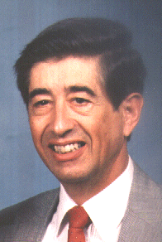

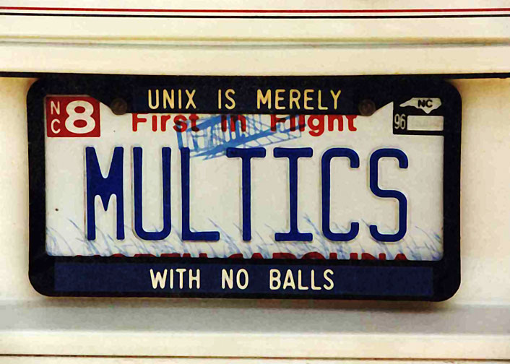
Notes:
Early 1979, Roger R. Schell led a tiger team while at the Naval Postgraduate School (NPS) for the military against the Multics operating system.
During the test, they penetrated Multics and modified the manufacturer's master copy of the Multics operating system itself by adding a backdoor.
The backdoor was tiny and required a password for use.
Even after the team told Honeywell that it existed and how it worked, they could not find it.
Instead of looking further and fixing, the vendor just kept distributing Multics, even with the backdoor in place. This is probably the first government backdoored operating system to be shipped, accidentally.
Interestingly enough, more reading reveals that the Karger / Schell paper from 1974 shows they did the same thing 5 years earlier, but that backdoor was not distributed.
"Honeywell recompiled check$device_name, so that the trap door would not be distributed to other sites."
More info: http://blog.osvdb.org/2012/06/01/fascinating-vulnerability-and-glimpse-into-33-year-old-pen-testing/
More info: http://www.airpower.maxwell.af.mil/airchronicles/aureview/1979/jan-feb/schell.html
Roger R. Schell bio: http://amcis2005.aisnet.org/schell.htm
82447 1979-01-01 Multics Unspecified Third-party Backdoor
Note that the 1979 Schell article says the backdoor was distributed:
Trap door installed. The tiger team penetrated Multics and modified the manufacturer's master copy of the Multics operating system itself by installing a trap door: computer instructions to deliberately bypass the normal security checks and thus ensure penetration even after the initial flaw was fixed. This trap door was small (fewer than 10 instructions out of 100,000) and required a password for use. The manufacturer could. not find it, even when he knew it existed and how it worked. Furthermore, since the trap door was inserted in the master copy of the operating system programs, the manufacturer automatically distributed this trap door to all Multics installations.

Slide 47
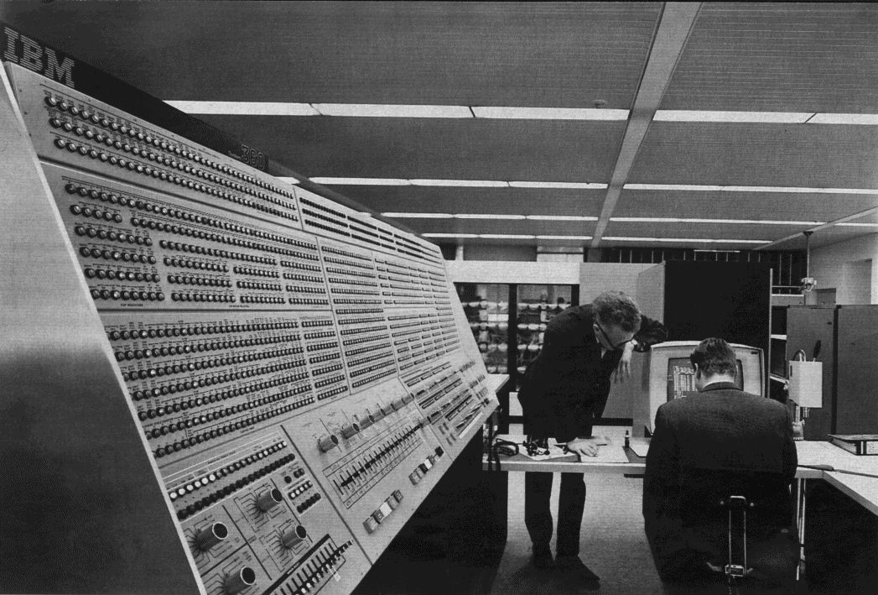
Notes:
This is a Model 91 IBM 360 computer used at NASA. The 360 series ran OS/360 (one of three variants).
In 1974 it was found to have an access restriction bypass vuln in the IMASPZAP utility.
This software is still used today, and the System/360 software is still supported by IBM via the zSeries computers.
More fascinating? 1964 -> 2005 – 50 Years of use, just this one vulnerability found in the original operating system.
33 vulnerabilities in software FOR z/OS from 2005 on.
More info: http://en.wikipedia.org/wiki/IBM_System/360#Operating_system_software
Image source: http://upload.wikimedia.org/wikipedia/commons/thumb/9/9e/360-91-panel.jpg/220px-360-91-panel.jpg (Model 91, taken at NASA)
1974-06-01 IBM OS/360 Supplied IMASPZAP Service Aid Access Restriction Bypass http://osvdb.org/22132
Note that previous versions of this talk were not very clear on the 49 (now 50) years of no vulns, vs software made for z/OS which had issues. Sorry =(

Slide 48
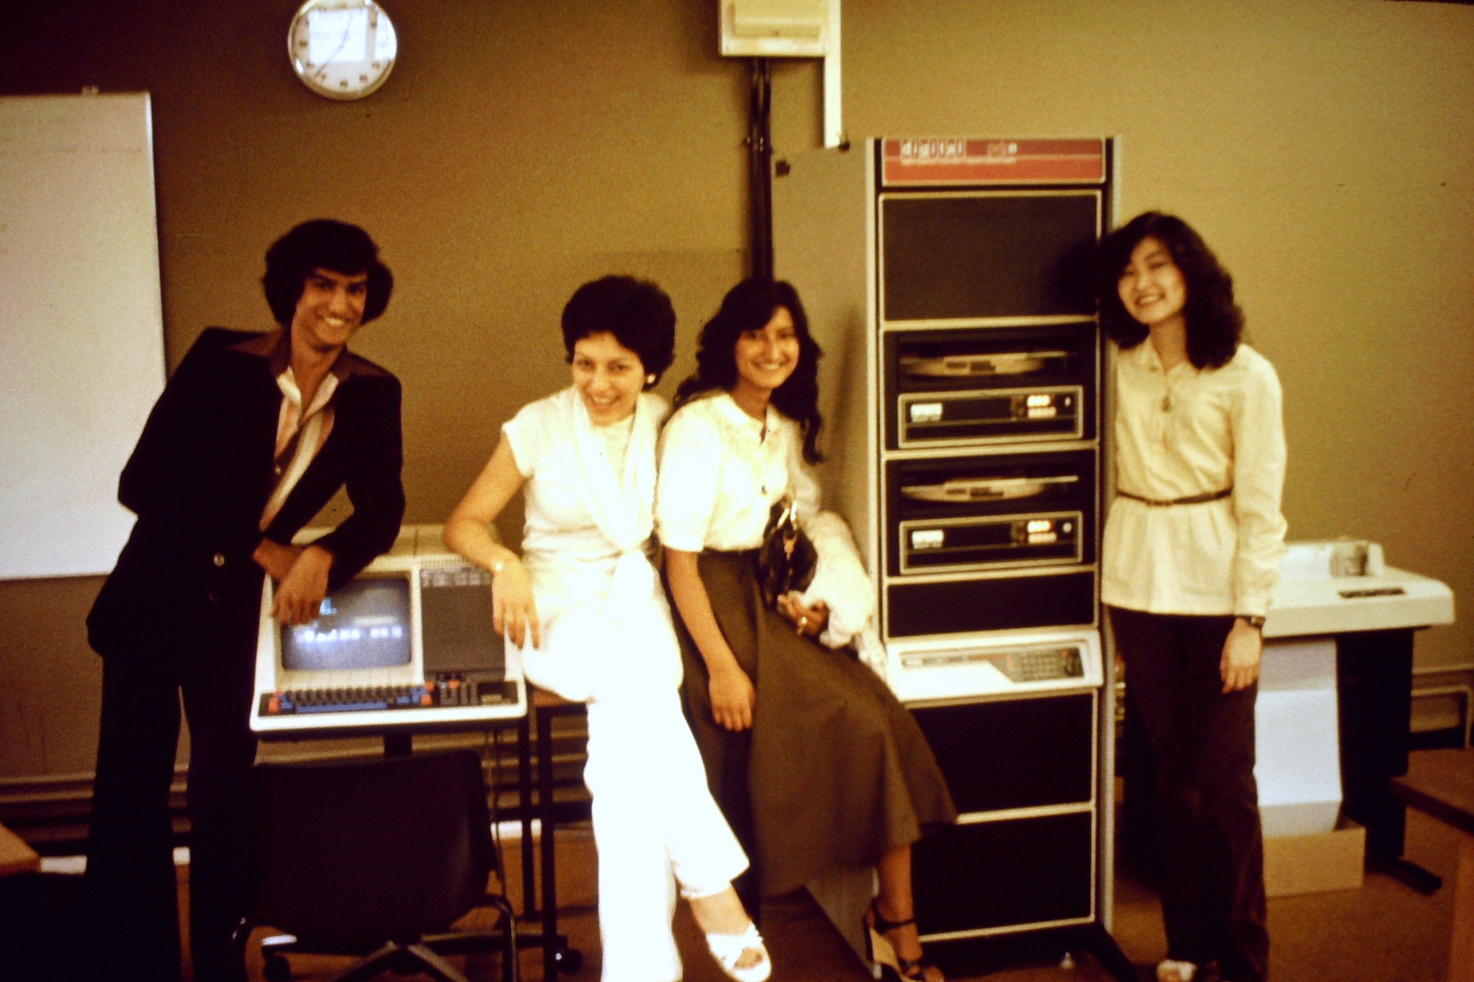
Notes:
This is a PDP-11 at Tottenham College in 1978. RSTS was a multi-user time-sharing OS from DEC for the PDP-11 series.
In 1975, four vulnerabilities were identified in RSTS/E including a DoS, arbitrary user credential disclosure, file disclosure, and an unspecified remote issue with the Login process.
That last bit is very interesting to a vulnerability historian. Rather than full disclosure, we have limited disclosure from admins of a system who saw the vulnerability used to compromise a system.
From 1902 until 1975, this is the first “unspecified” issue we have.
BTW, that is Rafiq on the left. Who said geeks weren’t sexy?
From the paper that disclosed this:
And at one point, our system was infested by a cabal of teenagers from a nearby prep school, who had broken in by exploiting a bug in the login process. They had their way with the system for several weeks before they
were detected, and it took several days of round-the-clock work to eradicate the numerous trap doors and time bombs they had left behind.
More info: http://en.wikipedia.org/wiki/RSTS/E
Image source: http://emistheblog.wordpress.com/2011/05/21/the-origins-of-femis/
1975-01-01 RSTS/E User TTY Assignment Exhaustion Local DoS http://osvdb.org/67359
1975-01-01 RSTS/E TTY Permission Weakness Arbitrary User Login Credential Disclosure http://osvdb.org/67360
1975-01-01 RSTS/E Record-oriented Access Race Condition File Content Disclosure http://osvdb.org/67361
1975-01-01 RSTS/E Login Process Unspecified Remote Issue http://osvdb.org/67362
Note that in a previous version, I attributed this to the VENDOR which is incorrect. Sucks being pressed for time =( This is due to an admin mentioning the vuln, not the vendor.

Slide 49
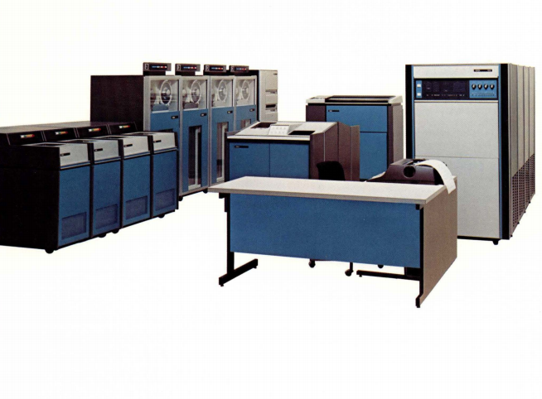
Notes:
This is a Xerox 560, capable of running the CP-V operating system, released in 1973.
In 1975, a vulnerability was found that allowed to a user to bypass the built-in memory protection to elevate privileges.
If you don’t think that “memory protection bypass” is serious and relevant, consider that 33 years later, Azimuth Security gave a talk titled “How to Impress Girls with Browser
Memory Protection Bypasses”.
More info: http://archive.computerhistory.org/resources/access/text/2010/06/102687533-05-03-acc.pdf
More info: http://en.wikipedia.org/wiki/Universal_Time-Sharing_System
Paper mentioned: http://www.azimuthsecurity.com/resources/bh2008_slides_dowd_sotirov.pdf
Image source: http://bitsavers.trailing-edge.com/pdf/sds/sigma/5xx/560_Flyer_Jan74.pdf
1975-01-01 XEROX CP-V Memory Protection Bypass Local Privilege Escalation http://osvdb.org/88775

Slide 50
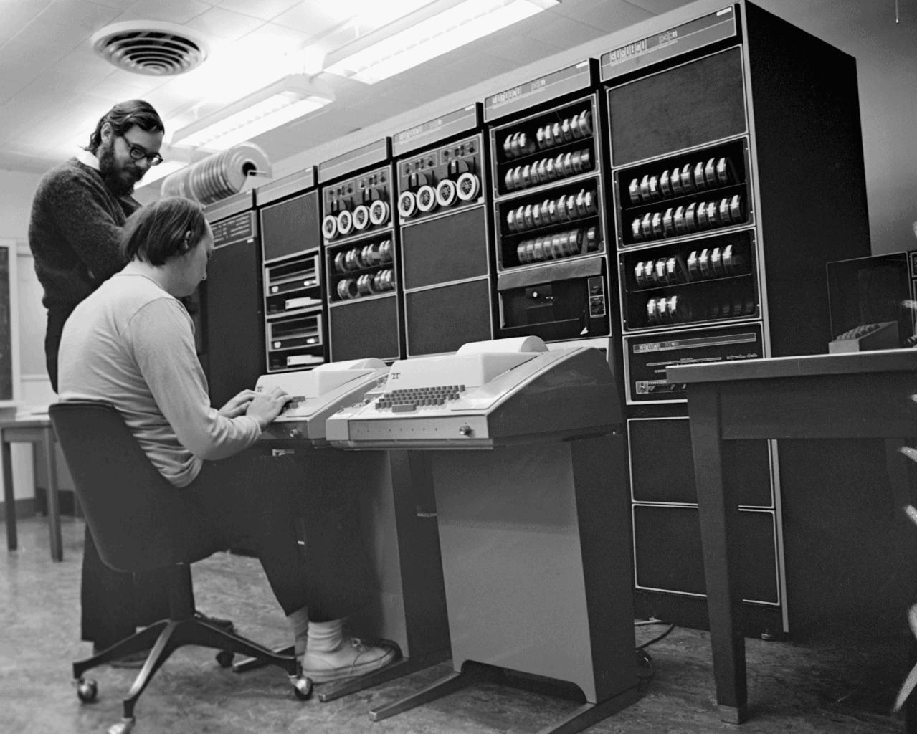
Notes:
This is a PDP-11 as well, and pictured are Dennis Richie and Ken Thompson. These two names should be familiar, as they are modern day computing heroes.
Creators of UNIX, which is not just an operating system but a philosophy, this is the basis for hundreds of subsequent variants including Solaris, AIX, HP-UX, IRIX, BSD, AppleMac OS X, Unicos, and Linux.
In 1975, an unspecified vulnerability was found in the login process related to array checking. Another vague disclosure, this from Tom Truscott at HP Labs. First vendor disclosure?
Six years later another V6 issue was found in the ‘su’ program, which is arguably when the floodgate opened for Unix vulnerabilities, as well over a dozen more were reported the next ten years.
Image source: http://www.psych.usyd.edu.au/pdp-11/Images/Images.html / http://www.psych.usyd.edu.au/pdp-11/Images/ken-den_s.jpeg
More info: http://en.wikipedia.org/wiki/Unix / http://en.wikipedia.org/wiki/Version_6_Unix / http://en.wikipedia.org/wiki/Unix_philosophy
1975-05-01 UNIX-V6 login(I) Array Checking Uspecified Issue http://osvdb.org/58015
From the digest:
One way to subvert a SUID program is to take advantage of a common programming error, such as failure to check an array bound. The famous UNIX-V6 login(I) bug is an example of this.

Slide 51
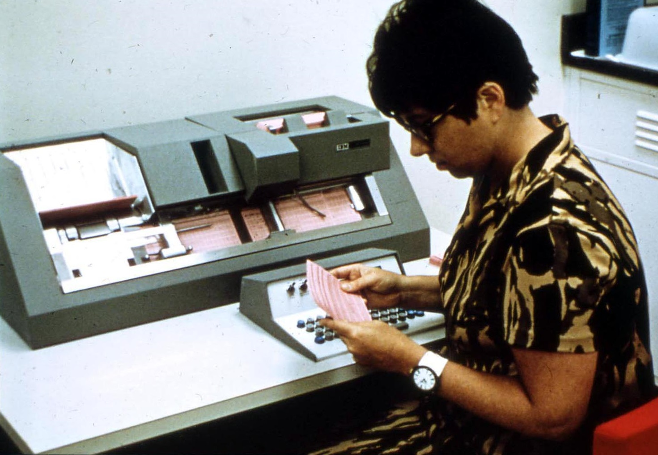
Notes:
This is an IBM 370 punch card system, part of a larger computer system that ran one of four different operating systems.
Two vulnerabilities were found, one in 1977 for privilege escalation and one in 1979 for password file disclosure.
At this point we should consider that this same type of vulnerability has kept coming up, and that form of authentication has been failing us since.
More info: http://en.wikipedia.org/wiki/IBM_System/370
Image source: http://www.chezfred.org.uk/University/ComputerXHistory/TheIbm370/1974-IBM370-209.htm
1977-01-01 IBM 370 DIAGNOSE Instruction Gain System Privileges http://osvdb.org/3038
1979-01-01 IBM 370 w/ TSO Password File Direct Request Local Disclosure http://osvdb.org/82444

Slide 52
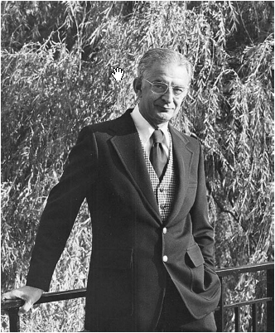

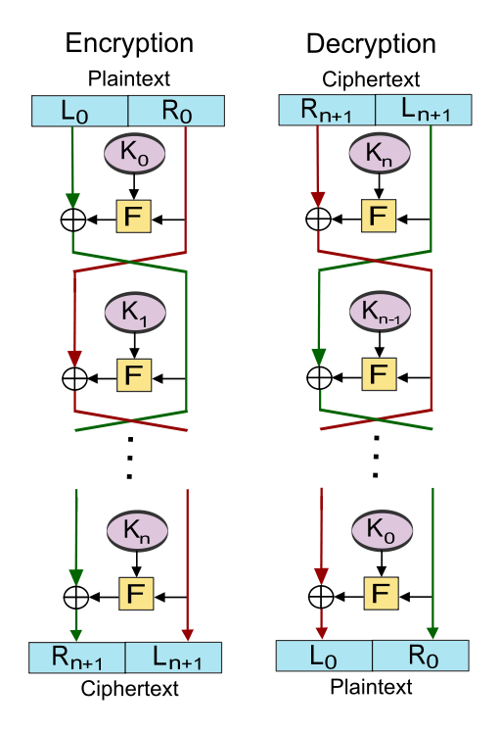
Notes:
New Data Seal (NDS) algorithm, based on Lucifer created by Horst Feistel colleagues at IBM. Commercial cipher. Were military ciphers in use at this point but details fuzzy, lot of digging needs to be done.
Precursor to the Data Encryption Standard, or DES which is still widely used today.
In 1977, NDS was found vulnerable to a “slide attack” that resulted in a full compromise.
This was one of the early computer-based algorithms that fell, and would be one of hundreds to fall including DES.
IBM Logo circa 1972
More info: http://en.wikipedia.org/wiki/Lucifer_(cipher) / http://en.wikipedia.org/wiki/New_Data_Seal / http://en.wikipedia.org/wiki/Data_Encryption_Standard
Image source: http://fistpark.tistory.com/47 / http://en.wikipedia.org/wiki/Feistel_cipher
1977-01-02 New Data Seal (NDS) Algorithm Slide Attack Chosen Plaintext Cryptanalysis Compromise http://osvdb.org/49711

Slide 53
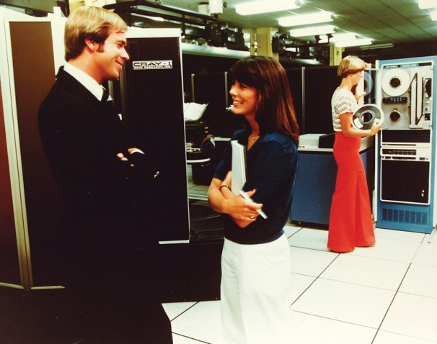
Notes:
Vulnerabilities were surfacing enough in the 70’s so it was a concern to some (e.g. military).
So from here we get into a more modern security world.
Remember, most back then were not security people, as there were few dedicated to that task, but admins were expected to secure their systems in some cases.
By the 80’s, vulnerabilities were becoming more prevalent, to the point some decided a list of them should be maintained.
Those first lists were the early vulnerability databases. Different than today’s, but the same intent and goal. Catalog all the vulns.
Before the 80’s, the original VDB was likely the “Repaired Security Bugs in Multics” from 1973. For a vulnerability historian, this is kind of a holy grail …
Image source: 1970’s NSA via http://www.washingtonpost.com/national/on-innovations/a-history-of-the-nsa/2013/06/19/ded58b8a-d823-11e2-a9f2-42ee3912ae0e_gallery.html#photo=23

Slide 54
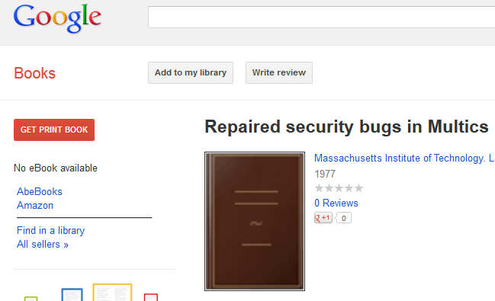
Notes:
This vulnerability list was eventually put into book format, or so it seemed, printed in 1977. 0 reviews, come on!
That image is the generic “we don’t have a cover” image for Google Books I have since learned.
So obviously I wanted to ‘get print book’ in order to review it. As well as integrate any missing vulns into OSVDB.

Slide 55

Notes:
Great, Google fails to find a copy. Not even in the Amazon market or AbeBooks has it.
But look, I can find it in a library!

Slide 56

Notes:
It exists in one library according to Google books, and it is 941 miles away. In California. No one wants to go to California.
Hawaii? Yes. California? No.
So of course this prompts my logical, reserved response…

Slide 57

Notes:
Yeah, I wasn’t happy.

Slide 58

Notes:
Fortunately, I had a digital copy waiting for me at a small conference at UPENN, courtesy of Andrea Matwyshyn who had requested an inter-library copy be sent to her.
Who knew professors had such power. After two years of searching, I finally had it.
Ultimately, six more MULTICS bugs were added to the database as a result.

Slide 59

Notes:
While on this topic…
I gave this talk to a small group of people last week as a dry run. After the talk, a co-worker and I got to talking about military crypto and he lent me copies of two books…
This is “Military Cryptanalytics” Part 1, by Friedman and Callimahos. Part 2’s Appendix 6 has a variety of information on military crypto devices that were compromised.
This book is from 1956 and was de-classified 49 years later. So overnight, I may have doubled the vulnerability entries related to these machines, once I have a chance to read and digest the material.
OK, back to the vulnerability history!

Slide 60

Notes:
The 1980’s are a more familiar time for us. Computers are smaller, and more importantly, prevalent.
After the “Repaired Security Bugs in Multics” you have more efforts to catalog bugs in the 1980s.
This came in two forms: mail lists that catered to security discussion including vulns, and concise lists of vulns.
I’m switching tracks briefly here from specific vuln types and specific technology to the fact that there were starting to be so many, they had to be cataloged.
Image source: http://www.alumniblog.ncsu.edu/2010/08/17/library-exhibit-celebrates-50-years-of-pams/

Slide 61

Notes:
If so bugs exist that you feel the need to collect and catalog them, that should be a warning sign.
Well, in our case, vulnerabilities.

Slide 62

Notes:
After the Multics list, in the mid to late 80’s we saw several other people attempt to catalog vulnerabilities, or centralize discussion on them.
This came in the form of the Unix 'Security Mailing List‘ in 1984 by Lyle McElhaney (not pictured), Matt Bishop's UNIX Hole List in 1985, the Rutgers mail list in 1985 by Al Walker, the Phage mail list in 1988 by Gene Spafford, and the Zardoz mail list in 1989 by Neil Gorsuch.
There were also other vulnerability lists but details are fuzzy, I am still working on tracking these down. These include The Unix Known Problem List, UC Santa Cruz hack method list, an internal Sun Microsystems Bug-List, and more. I’ve gotten my hands on others like version 4.2 of the Mt Xinu bug list.
Image source: http://www.linkedin.com/pub/neil-gorsuch/8/9bb/63a (Neil Gorsuch), http://www.csmonitor.com/Innovation/Responsible-Tech/2008/0611/squeezing-the-most-out-of-a-gallon (Al Walker), http://nob.cs.ucdavis.edu/bishop/ (Matt Bishop), and http://about.me/spaf (Gene Spafford)
Mail list archives: http://securitydigest.org/unix/ http://securitydigest.org/rutgers/ http://securitydigest.org/phage/ http://securitydigest.org/zardoz/

Slide 63


Notes:
Following in their footsteps, despite only being familiar with a couple of the lists at the time, in the early 90s I would start maintaining a vulnerability database.
I was affiliated with a hacker group back in the early 90’s, and like any good hacker group, we maintained a list of vulnerabilities we used to break into systems. Since BBSs were prevalent, and the Internets were still random tubes laying on the ground, we kept the database in the classic FILES.BBS format. At some point that name stuck, but we re-formatted. Even back then, we had a primitive classification system (OSAT), and preliminary references (advisory IDs and/or publisher). I took over maintaining it at some point, and kept it up until 1998.
Interesting to me is that even when professional VDBs hit the scene, they didn’t adopt a classification scheme until OSVDB did, under my direction, well after 2004.

Slide 64

Notes:
By this point there were dozens of books on security, Unix and VMS boxes all over, the early years of the Internet, and a changing mindset where things were increasingly networked.
This gave access to additional computers you couldn’t otherwise interact with.
This also gave curious types (e.g. hackers) the ability to poke around your system.
Yes, in 1987 that was the entire Internet in one relatively simple graphic!
1987 BBN Internet Map
Image source: http://www.computerhistory.org/internet_history/internet_history_80s.html

Slide 65

Notes:
Even the home PCs were starting to run Bulletin Board Systems (BBS) more frequently, which had their own vulnerabilities.
Dialup access was just as good as a network for accessing, and compromising, remote systems.
By this point, security starts to take hold in people’s minds.
Image source: http://bloggingtom.ch/archives/2006/01/30/good-old-bbs/
More info: http://tinyurl.com/bbs-vulns or
http://osvdb.org/search/search?search%5Bvuln_title%5D=bbs&search%5Btext_type%5D=titles&search%5Bs_date%5D=1970-01-01&search%5Be_date%5D=1995-01-01&search%5Brefid%5D=&search%5Breferencetypes%5D=&search%5Bvendors%5D=&search%5Bcvss_score_from%5D=&search%5Bcvss_score_to%5D=&search%5Bcvss_av%5D=*&search%5Bcvss_ac%5D=*&search%5Bcvss_a%5D=*&search%5Bcvss_ci%5D=*&search%5Bcvss_ii%5D=*&search%5Bcvss_ai%5D=*&kthx=search

Slide 66

Notes:
The late 70’s and early 80’s gave us a new look at Denial of Service (DoS) attacks.
Unlike the DoS attacks we’re familiar with now, based on saturating a connection or sending magic packets a system can’t handle..
These attacks were based on physical sabotage. Either via bombs or arson, people would destroy computer systems for a variety of reasons.
Sometimes simple revenge from a jilted employee. Other times, activist groups.
The logo above is for Le Comité pour la Liquidation Ou la Destruction des Ordinateurs (CLODO), who attacked Univac, Honeywell, and other companies.
More info: https://www.facebook.com/pages/CLODO/299982560929?v=info and http://www.processedworld.com/Issues/issue10/i10clodo.htm
Image source: http://www.processedworld.com/Issues/issue10/i10clodo.htm
For a fun read on 1800’s DoS attacks against cables: http://www.history.com/this-day-in-history/griersons-raid-cuts-telegraph-wires-near-macon and http://research.archives.gov/description/519420

Slide 67

Notes:
The 70’s and 80’s also gave us our first taste of SCADA vulnerabilities, despite the next SCADA vuln being published a full 17 years later in 2001.
Note that while the first publication was in 1983, the problem had been around a while.
Image source: http://www.morguefile.com/archive/display/96358
1983-12-20 Nuclear Power Plant Portable Radio Transmitter Interference Arbitrary System Shutdown DoS http://osvdb.org/86573

Slide 68


Notes:
In 1983, the Nuclear Regulatory Commission (NRC) issued an “information notice” numbered 83-83 about portable radio transmitters and nuclear power plants.
Seems harmless enough.
Not labeled an advisory or designated important.
What does this really mean?
1983-12-20 GE Differential Relay Type 12 STD 15B5A Radio Frequency Interference False Operation System Shutdown DoS http://osvdb.org/86573

Slide 69

Notes:
The first incident occurred at the Farley nuclear plant in Alabama, in 1975. Technicians figured out the Differential Relay Type 12 STD 15B5A is “radio frequency sensitive”.
Translated; a standard walkie talkie could shut down critical systems at a nuclear power plant. Let that sink in.
Image source: http://www.southerncompany.com/about-us/our-business/southern-nuclear/pdfs/farleyBrochure_2010.pdf
1983-12-20 GE Differential Relay Type 12 STD 15B5A Radio Frequency Interference False Operation System Shutdown DoS http://osvdb.org/86573

Slide 70

Notes:
Yes, first incident, meaning there were more.
The second incident happened at Sequoyah nuclear plant in Tennessee, in May of 1979. A tech’s walkie talkie sent a spurior signal to all four channels of a pressurizer initiating a safety injection.
A Pressurizer is a component of a pressurized water reactor. The basic design of the pressurized water reactor includes a requirement that the coolant (water) in the reactor coolant system must not boil.
More info: http://en.wikipedia.org/wiki/Pressurizer
Image source: http://en.wikipedia.org/wiki/File:Sequoyah_Nuclear_Generating_Station.jpg

Slide 71

Notes:
The third incident happened at Three Mile Island in Pennsylvania, in Feb of 1982. Workers carrying combustible gas monitors indicated air that wasn’t friendly for breathing. The cause? Their face mask built-in radios.
The equipment you wear to ensure your own safety, can’t be trusted.

Slide 72

Notes:
The fourth incident occurred at Grand Gulf in Mississippi in July of 1983, where a shutdown cooling loop was lost for 30 minutes.
Does it scare you more that a simple walkie-talkie caused this many problems at four nuclear power plants, or that the Nuclear Regulatory Commission figured it out and issued an advisory 8 years after the first incident?
But wait… more good news!

Slide 73

Notes:
The vulnerability was re-discovered at the Davis-Besse nuclear power plant in Ohio, March, 2011, losing its emergency water cooling system for two minutes. I hear that safety system is kind of important too.
Since giving this presentation, I have filed FOIA requests to NRC in hopes of finding out which vendors and hardware were specifically affected. $174 to fill that request, small price to pay.
http://www.cleveland.com/business/index.ssf/2011/03/davis-besse_nuclear_power_plan_1.html

Slide 74

Notes:
Now we’re up to the 1990s, and this really is the rise of the vulnerabilities.
The 90’s saw more mail lists like Bugtraq, comprehensive vulnerability databases like ISS X-Force, and the creation of a standard for vulnerability identifiers like CVE.
The 90’s had 2,369 documented vulnerabilities, and in reality, thousands more that never made it into vulnerability databases. But I’m working on that…
This is also why I don’t think graphs work for this presentation.

Slide 75

Notes:
Because I see that graph and want to fill in pretty colors to make it more interesting…

Slide 76

Notes:
Or play tic-tac-toe, even if I lose to a chicken. Anyway….

Slide 77

Notes:
Up to 1994 you saw primarily Unix-based vulnerabilities, both local and remote.
Encryption algorithms like GDES, Snefru, Khafre, REDOC-II, LOKI, Lucifer, BassOmatic, and Khufu were falling like flies. Yes, encryption algorithms continued to have cool names.
Image source: https://www.its.uq.edu.au/about-its/history-computing-uq

Slide 78

Notes:
1994 hits, and Pandora’s box opens.
Image source: http://www.buzzfeed.com/catsparella/the-best-maru-moments-of-2010-1ruv
Maru info: http://en.wikipedia.org/wiki/Maru_(cat)
Maru videos: http://www.youtube.com/user/mugumogu

Slide 79

Notes:
With the commercialization of the Internet, birth of the World Wide Web, and more rapid deployment, we saw an eternal fountain of web-based vulnerabilities.
Over the next 15 years we’d see yearly vulnerability counts jump considerably as a result.
BTW, this is the first web server ever.
Note that 1994 is my somewhat arbitrary date based on perception of web server/page availability during my early Internet days, and Mosaic/Netscape becoming a commercial endeavor between Aug 1993 and April 1994.
More info: http://en.wikipedia.org/wiki/Web_server
Image source: http://en.wikipedia.org/wiki/File:First_Web_Server.jpg

Slide 80

Notes:
The turn of the century saw a frequently changing landscape. As new technology came and went, new vulnerability classes identified, shifting to large databases, more of our life web accessible, vuln research and disclosure matured greatly, but we also saw a steady stream of crap.
Image source: This thing is on a dozen+ stock photography sites, uploaded by various ‘members’. No way that many people have copyright. I spent 15 minutes trying to track down the original image and had no luck. Call me a copyright abuser.

Slide 81

Notes:
2006 saw the great spike of XSS and SQLi as a result.
The quality of disclosures varied greatly, but there were so many inaccurate reports (meaning they are flat out wrong), we have to track them on OSVDB as “myth / fake”. We currently have 455 disclosures flagged like this, and honestly, there are probably closer to a couple thousand. More recently, we also started flagging entries as “not a vulnerability” where people don’t understand the concept of ‘crossing privilege boundaries’. We already have 259 flagged as such, and the classification was introduced on 2013-01-31.
Image source: Jurassic Park. Modified by Mar

Slide 82

Notes:
We learned anyone can be a “security researcher” by plugging in some script code or a back tick.
Disclosures had (and often still have) no vendor URL, no version, sometimes no script name, but damnit, they were a security researcher!
On the more serious side…
Image source: Local collection (this thing is ancient)

Slide 83

Notes:
We also saw vulnerabilities disclosed in systems that may seem more ‘obscure’, but in reality may have more impact on us long term.
Between 2004 and 2009, this included electronic voting machines from Premier Election Systems (aka Diebold), Hart, Election Systems & Software (ES&S), Sequoia, and Digivote. Basically every company that makes such machines.
Image source: Whitney Curtis, http://usatoday30.usatoday.com/news/opinion/editorials/story/2012-09-19/electronic-voting-fraud-security/57809062/1
Electronic voting machine vulns: http://tinyurl.com/evoting-vulns or
http://osvdb.org/search/search?search%5Bvuln_title%5D=electronic+voting&search%5Btext_type%5D=alltext&search%5Bs_date%5D=&search%5Be_date%5D=&search%5Brefid%5D=&search%5Breferencetypes%5D=&search%5Bvendors%5D=&search%5Bcvss_score_from%5D=&search%5Bcvss_score_to%5D=&search%5Bcvss_av%5D=*&search%5Bcvss_ac%5D=*&search%5Bcvss_a%5D=*&search%5Bcvss_ci%5D=*&search%5Bcvss_ii%5D=*&search%5Bcvss_ai%5D=*&kthx=search

Slide 84

Notes:
Vulnerabilities were identified in various automobiles including ways to bypass the keyless entry systems, including BMWs.
Automobile vulns: http://tinyurl.com/auto-vulns

Slide 85

Notes:
And because key systems or a stolen car are nothing…
Toyota recently settled an ‘Unintended Acceleration’ lawsuit in which software bugs or vulnerabilities may be the cause.
Several other vehicles have been identified the last five years as containing vulnerabilities in their numerous Electronic Control Units (ECU).
It is important to note that there are practical, real-world attack scenarios for these too, not just plugging in behind the dashboard.
http://www.safetyresearch.net/2013/11/07/toyota-unintended-acceleration-and-the-big-bowl-of-spaghetti-code/
Image source: http://forums.themustangsource.com/f647/toyota-moving-forward-480509/

Slide 86

Notes:
It was also disclosed that some newer Ducati motorcycles that had a small onboard computer had a keyless system.
You could start the bike if you knew the 4-digit code. The default 4-digit code…
Image source: https://web.archive.org/web/20101205050342/http://www.cyclenews.com/files/news_articles/industry/1110/30_Diavel_Carbon.jpg and http://arizonafoothillsmagazine.com/autos/wp-content/uploads/2011/03/2011-Ducati-Diavel-Diamond-Black-phoenix-arizona-valley-scottsdale.jpg
2011-04-05 Ducati Diavel Motorcycle Default Ignition Password http://osvdb.org/75811

Slide 87

Notes:
Also in the ‘scary’ realm, we started seeing more disclosures in medical devices.
This is actually a Therac-25 which had an issue back in 1985 where a small race condition may have caused a potentially lethal radiation overdose. Oops.
Medical vulns: http://tinyurl.com/medical-vulns

Slide 88

Notes:
There has also been interesting research into Implantable Cardioverter Defibrillators (ICD) aka pacemakers since many of them come with some sort of wireless protocol for diagnostics.
They also come without any form of authentication. Or encryption. This is bad… how do we know?
More info: http://boingboing.net/2012/10/18/researcher-claims-feasibility.html

Slide 89

Notes:
Former Vice President Dick Cheney had the wireless feature of his pacemaker disabled in 2007.
One year before Daniel Halperin et al published a seminal paper on ICD vulnerabilities.
Five years before a pacemaker hacking plot in the TV show ‘Homeland’ (2012) appeared.
http://nakedsecurity.sophos.com/2013/10/22/doctors-disabled-wireless-in-dick-cheneys-pacemaker-to-thwart-hacking/
http://www.theverge.com/2013/10/21/4863872/dick-cheney-pacemaker-wireless-disabled-2007
http://www.cbsnews.com/video/watch/?id=50157524n

Slide 90

Notes:
We’ve also seen great research from Jay Radcliffe on insulin pump vulnerabilities.
As a diabetic with a pump, at the end of his scary research and the vendor refusing to fix the issues, he swore off using such pumps.
Image source: http://www.emftesting.net/2010/10/are-insulin-pumps-a-concern-for-emf-exposure/

Slide 91

Notes:
Security products, designed to protect us.
Yet almost 2% of OSVDB consists of vulnerabilities in them. WTF
And that brings us to this decade. What are we seeing?
Image source: http://nanobitwallpaper.com/computer-security-software/

Slide 92

Notes:
Everything.
All of the old classics we have come to love or loathe.
While there are some exciting new devices as more of our lives are filled with gadgets that must be connected, the vulns are the same.
Vulns have even become an industry unto themselves.

Slide 93

Notes:
2011 and later gave us the sharp rise of bug bounty programs.
While several bounties had been operating for many years (the first by Netscape in 1995), many companies and online services started their own, seeing the incredible value.
What used to fetch thousands of dollars at best now commands six figures in some cases.
Image source: http://www.geeky-gadgets.com/facebook-bug-bounty-numbers-04-08-2013/

Slide 94

Notes:
Bug bounties are also seeing more frequent payouts.
For example, Google has payed out at least $1,011,946.30 to date, primarily for vulns in their own software.
But they have also paid out for vulns in OSX, OpenGL Driver, Windows Kernel, Libxslt, libxml, nVidia Driver, FFmpeg, and more.
Speaking of money, if I had a nickel for every vulnerability ever disclosed, I’d have a shit load of nickels.
OSVDB hit the 100,000 mark on cataloged vulnerabilities on December 25, 2013. Over 107,000 as of today.
What have we learned?
Image source: http://www.chinasmack.com/2013/pictures/bank-employees-spend-all-day-counting-10000-rmb-in-coins.html

Slide 95

Lessons Learned
Notes:
The obvious lesson is that vulnerabilities are not new by any stretch of the imagination.
The last 112 years have shown us, repeatedly, that hardware and software is vulnerable.
Cleartext transmissions from 1902, Crypto failure since 1939, trusting user input since 1955,
Overflows since 1983, SQL injection since 1998, cross-site scripting since 1999…
But I am certainly not the only one saying it.
Image source: http://www.tineye.com/search/950c7103b8b304e93dbcd63ecd219f42bdb15c10/?pluginver=chrome-1.1.3 Used all over, no clear source.

Slide 96

Notes:
Remember these guys? Roger Schell and Gene Spafford
In 2002, Schell wrote a paper titled “Thirty Years Later: Lessons from the Multics Security Evaluation” where he revisits the Multics work he did. He concludes:
The unpleasant conclusion is that although few, if any, fundamentally new vulnerabilities are evident today…
Given the … vulnerabilities that existed thirty years ago, today’s “security enhanced” or “trusted” systems would not be considered suitable for processing even in the benign closed environment.
Spaf: I've been looking back though the archive of talks I've given over the last few decades. It's a reminder of how many things we, as a field, knew about a long time ago but have been ignored by the vendors and authorities. It's also depressing to realize how little impact I, personally, have had on the practice of information security during my career.
In early November of 1988 the world awoke to news of the first major, large-scale Internet incident. Some self-propagating software had spread around the nascent Internet, causing system crashes, slow-downs, and massive uncertainty.
Flash forward to today. The problem has gotten larger and worse, although in a manner that hides some of its magnitude from the casual observer.
Despite that incredible history, here we are, still suffering from the same vulnerabilities over and over. So we have to ask…
https://www.cerias.purdue.edu/site/blog/post/happy_anniversary_--_bang_my_head_against_a_wall/

Slide 97

Notes:
Quite simply, because we aren’t addressing the underlying problem. Instead…

Slide 98

Notes:
We keep putting bandaid solutions on top of older bandaids, desperately trying to plug a hole of the sinking ship.
Rather than fix the issues at the root, we continue to come up with new, exciting, and profitable ways to fix the symptoms.
Image source: http://listsoplenty.com/blog/?p=9338

Slide 99

Notes:
If it has more blinky lights and colorful buzzwords, it will better protect us!
Instead of asking how to fix the systemic problem, we ask “Will your cloud-based holistic DLP solution protect you from the BYOD threat, or be a stomping ground for the latest APT?” Oh my.

Slide 100

Notes:
As a security industry, we sell degenerate solutions that treat symptoms, not cure the disease.
We go to security conferences and preach to the choir, talking about the next best thing and magical solutions.
But any real solutions, if they are out there, are lost in the echo chamber.
Ultimately, the security industry is a lot like these fine folks above, and we know how productive they are.

Slide 101

Notes:
We spend countless hours debating “full disclosure” and how much time to give vendors to fix a reported vulnerability.
All the while, many vendors including some of the biggest, drag their feet and take as many as 3 years to fix simple issues.
Even after an issue is disclosed.
Image source: http://www.despair.com/apathy.html

Slide 102

Notes:
The age-old question is “How do we fix this?”
I’m more of a breaker than a builder, so this isn’t exactly my brand of cola.
All these “smart” vendors with “industry leading” whatever; Shouldn’t they actually be fixing the problem?
Image source: http://hivizme.wordpress.com/2012/06/29/accl-enter-the-premier-league-of-network-cabling/

Slide 103

Notes:
All I can offer you is perspective, food for thought, and a small dose of reality…
Image source: http://www.fantom-xp.com/wp_33__Perspective.html

Slide 104

Notes:
The only way things will get fixed, is if we make it personal to those in power to change things.
Be it software vendors or legislators, they have to care first.
Once the issue is personal, then we can cut into the vendor’s bottom line.
We recently saw this with the FTC settlement against TRENDnet for their ‘SecurView’ cameras, that could be used as a baby monitor. As soon as creeps on the Internet could access these cameras without authentication, it became personal. Then the government stepped in, and mandated they could not call their product ‘secure’ among other things.
The FTC has levied 34,463,748.63 in fines and “consumer redress calculations” since 8/13/1998. Companies are starting to pay attention.
More info: http://www.ftc.gov/opa/2013/09/trendnet.shtm
Image source: http://www.break.com/pictures/wha-happened-2178789 (and hundreds of other blogs)

Slide 105

Notes:
112 years have shown us that design and code is not getting better. I think by this definition, our industry qualifies for insanity.
This is despite fancy tools, SDLC, dev-OPS, standards, certifications, auditing, and more.
Something has to change, and fast.

Slide 106

Thanks:
Mar for awesome graphics
OSF and RBS for providing resources to do the research
Towne/Nickerson/Hutton for inspiration to tell a story
Andrea Matwyshyn for historical docs
Jeff Mann for historical crypto book & info
Countless people that were around “back then” to give me info, pointers, and perspective
Shakacon, so pro, much wow!
You! For listening.

Slide 107

Questions?

